Slide 1
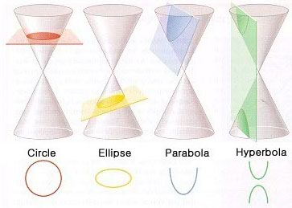
Section 9.2 – The Ellipse – (CONICS)
Ellipse – a set of points in a plane whose distances from two fixed points is a constant.

Slide 2
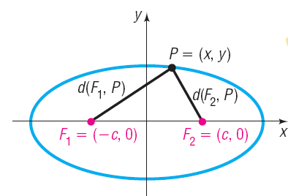
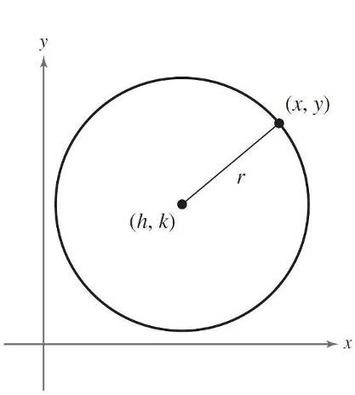
Section 9.2 – The Ellipse
A circle is a set of all points in a plane that are equidistant from a single point called the center, and the distance from the center to any point on the circle is a constant, called the radius.
An ellipse – a set of points in a plane whose sum of the distances from two fixed points (the FOCI) is a constant.
$$d\left(F_{1},P\right)+d\left(F_{2},P\right)=constant$$
•
Q
$$d\left(F_{1},Q\right)+d\left(F_{2},Q\right)=$$
$$constant$$
$$=d\left(F_{1},P\right)+d\left(F_{2},P\right)$$

Slide 3
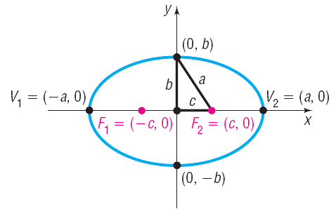
Section 9.2 – The Ellipse
Foci – the two fixed points, $F_{1} and F_{2}$, whose distances from a single point on the ellipse is a constant.
Major axis –line that contains the foci and goes through the center of the ellipse (given by 2a)(Will have the bigger denominator - Always the a).
Vertices – the two points of intersection of the ellipse and the major axis, $V_{1} and V_{2}$ .
Foci
Co-Vertices – the two points of intersection of the ellipse and the minor axis.
Minor axis – the line that is perpendicular to the major axis and goes through the center of the ellipse. (given by 2b)
Major axis
Minor axis
Vertices

Slide 4
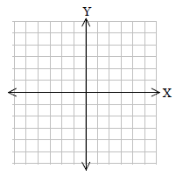
Section 9.2 – The Ellipse
Find the vertices for the major and minor axes, and the foci using the following equation of an ellipse. Then Graph it.
$$\frac{x^{2}}{25}+\frac{y^{2}}{16}=1$$
Major axis is along the x-axis
Vertices of major axis:
$$a^{2}=25$$
$$a=±5$$
$$\left(−5,0\right) and (5,0)$$
•
Co-Vertices of the minor axis
$$b^{2}=16$$
$$b=±4$$
$$\left(0,4\right) and (0,−4)$$
•
•
•
•
Foci
•
$$c^{2}=a^{2}−b^{2}$$
$$c^{2}=25−16$$
$$c^{2}=9$$
$$c=±3$$
$$\left(−3,0\right) and (3,0)$$

Slide 5
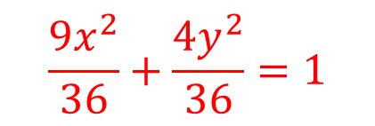
Section 9.2 – The Ellipse
Find the vertices for the major and minor axes, and the foci using the following equation of an ellipse. Then graph.
$${9x}^{2}+4y^{2}=36$$
$$\frac{{9x}^{2}}{36}+\frac{{4y}^{2}}{36}=1$$
$$\frac{x^{2}}{4}+\frac{y^{2}}{9}=1$$
Major axis is along the y-axis
Vertices of major axis:
$$a^{2}=9$$
$$a=±3$$
$$\left(0,−3\right) and (0,3)$$
•
•
Vertices of the minor axis
•
•
$$b^{2}=4$$
$$b=±2$$
$$\left(2,0\right) and (−2,0)$$
•
•
Foci
$$c^{2}=a^{2}−b^{2}$$
$$c^{2}=9−4$$
$$c^{2}=5$$
$$c=±\sqrt{5}$$
$$\left(0,−\sqrt{5}\right) and (0,\sqrt{5})$$

Slide 6
Section 9.2 – The Ellipse
Find the center, vertices, and foci given the following equation of an ellipse.
$$\frac{{(x−3)}^{2}}{25}+\frac{{(y−9)}^{2}}{9}=1$$
Center:
$$(3,9)$$
Major axis is along the x-axis
Foci
Vertices:
$$a^{2}=25$$
$$a=±5$$
$$c^{2}=a^{2}−b^{2}$$
$$\left(3−5,9\right) and (3+5,9)$$
$$c^{2}=25−9$$
$$\left(−2,9\right) and (8,9)$$
$$c^{2}=16$$
Vertices of the minor axis
$$c=±4$$
$$b^{2}=9$$
$$b=±3$$
$$\left(3−4,9\right) and (3+4,9)$$
$$\left(3,9−3\right) and (3,9+3)$$
$$\left(−1,9\right) and (7,9)$$
$$\left(3,6\right) and (3,12)$$

Slide 7
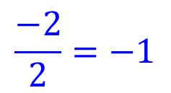
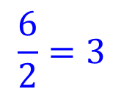
Section 9.2 – The Ellipse (Warmup Day 2)
Find the center, the vertices of the major and minor axes, and the foci using the following equation of an ellipse.
$${16x}^{2}+4y^{2}+96x−8y+84=0$$
$${16x}^{2}+96x+4y^{2}−8y=−84$$
$${16(x}^{2}+6x)+4(y^{2}−2y)=−84$$
$$\frac{6}{2}=3$$
$$\frac{−2}{2}=−1$$
$$3^{2}=9$$
$${(−1)}^{2}=1$$
$${16(x}^{2}+6x+9)+4\left(y^{2}−2y+1\right)=−84+144+4$$
$$16{(x+3)}^{2}+4{(y−1)}^{2}=64$$
$$\frac{{16(x+3)}^{2}}{64}+\frac{{4(y−1)}^{2}}{64}=1$$
$$\frac{{(x+3)}^{2}}{4}+\frac{{(y−1)}^{2}}{16}=1$$

Slide 8
Section 9.2 – The Ellipse
$$\frac{{(x+3)}^{2}}{4}+\frac{{(y−1)}^{2}}{16}=1$$
Center:
$$(−3,1)$$
Major axis: $x=−3 (vertical)$
Foci
Vertices:
$$a^{2}=16$$
$$a=±4$$
$$c^{2}=a^{2}−b^{2}$$
$$\left(−3,1−4\right) and (−3,1+4)$$
$$c^{2}=16−4$$
$$\left(−3,−3\right) and (−3,5)$$
$$c^{2}=12$$
Minor axis: $y=1 (horizontal)$
$$c=±2\sqrt{3}$$
Vertices of the minor axis
$$\left(−3,1−2\sqrt{3}\right) and (−3,1+2\sqrt{3})$$
$$b^{2}=4$$
$$b=±2$$
$$\left(−3,−2.464\right) and (−3, 4.464)$$
$$\left(−3−2,1\right) and (−3+2,1)$$
$$\left(−5,1\right) and (−1,1)$$

Slide 9
Section 9.2 – The Ellipse
$$\frac{{(x+3)}^{2}}{4}+\frac{{(y−1)}^{2}}{16}=1$$
Center:
$$(−3,1)$$
Major axis vertices:
$$\left(−3,−3\right) and (−3,5)$$
•
•
Minor axis vertices:
$$\left(−5,1\right) and (−1,1)$$
•
•
•
Foci
•
$$\left(−3,−2.464\right) and (−3,4.464)$$
•

Slide 10
Section 9.2 – The Eccentricity
The eccentricity e of an ellipse is given by the ratio:
The eccentricity will be 0 < e < 1.
The smaller the eccentricity, the more circular the ellipse.

Slide 11
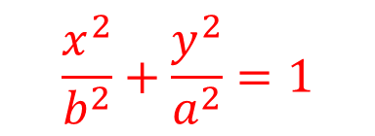
Section 9.2 – The Ellipse
Find the equation of an ellipse given a vertex of $\left(0,12\right)$ and a focus of $(0,−2\sqrt{11}$). Graph the ellipse. Assume a center of (0, 0).
Vertices of major axis:
$$\left(0,12\right) and (0,−12)$$
Vertices of the minor axis
$$a=±12$$
$$a^{2}=144$$
•
$$c=±2\sqrt{11}$$
$$c^{2}=44$$
•
$$b^{2}=a^{2}−c^{2}$$
$$b^{2}=144−44$$
•
•
$$b^{2}=100$$
$$b=±10$$
•
$$\left(−10,0\right) and (10,0)$$
•
$$\frac{x^{2}}{b^{2}}+\frac{y^{2}}{a^{2}}=1$$
$$\frac{x^{2}}{100}+\frac{y^{2}}{144}=1$$

Slide 12
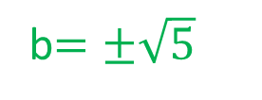
Section 9.2 – Ellipse Last one
Find the standard form of the equation of the ellipse having foci at (0,1) and (4,1) and a major axis length 6.
What do we need in order to write an equation?
Indirectly you are given what?
a, c, and center
$$b^{2}=a^{2}−c^{2}$$
$$b^{2}=9−4$$
b$=±\sqrt{5}$

Slide 13
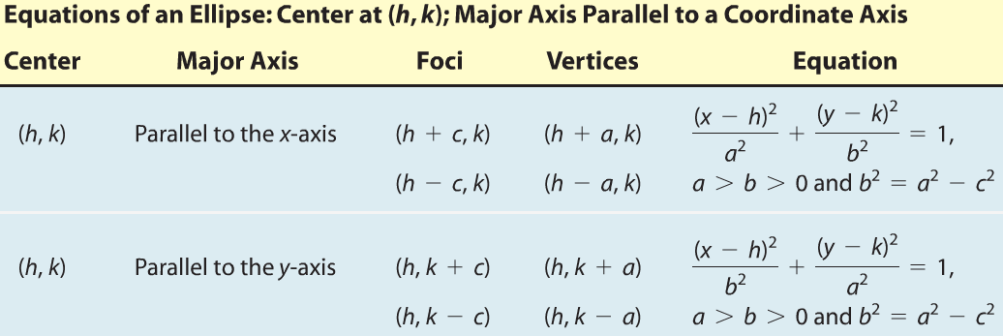
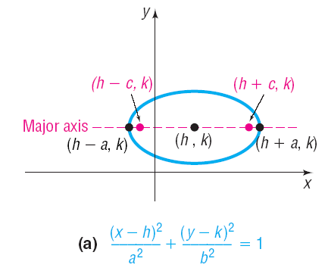
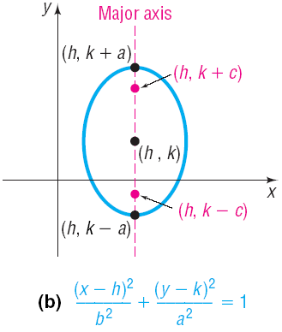
Section 9.2 – The Ellipse

Slide 14
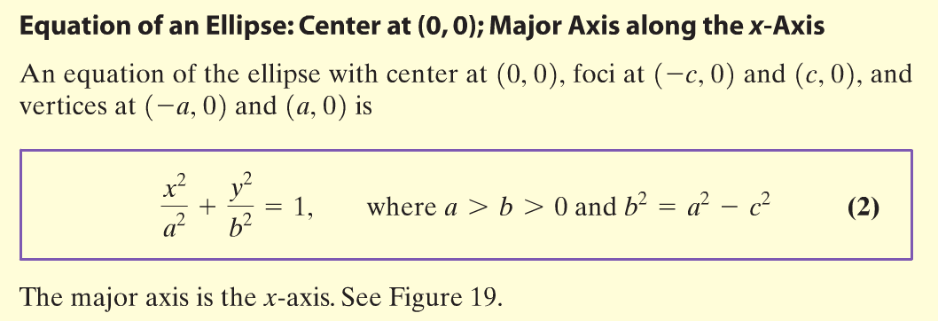
Section 10.2 – The Ellipse

Slide 15
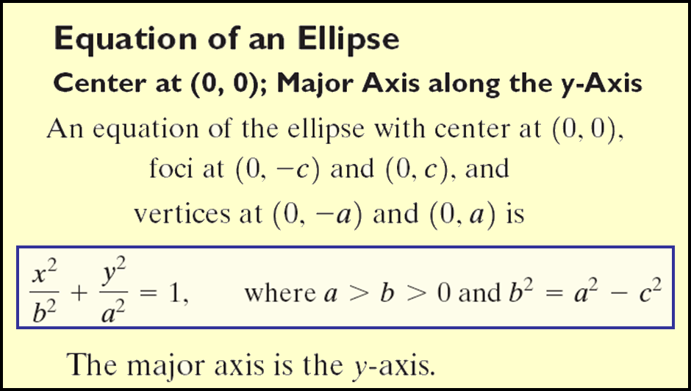
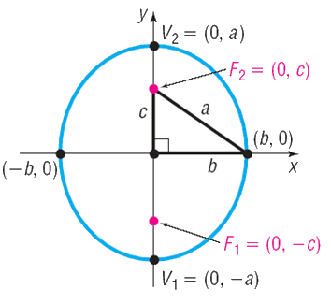
Section 10.2 – The Ellipse

Slide 16
Section 10.2 – The Ellipse
Find the center, vertices, and foci given the following equation of an ellipse.
$$\frac{{(x−3)}^{2}}{25}+\frac{{(y−9)}^{2}}{9}=1$$
Center:
$$(3,9)$$
Vertices:
•
$$\left(−2,9\right) and (8,9)$$
•
•
•
•
•
Vertices of the minor axis
•
$$\left(3,6\right) and (3,12)$$
Foci
$$\left(−1,9\right) and (7,9)$$

