Slide 1
Warm-up
The solution set of a linear system of equations contains all ordered pairs that satisfy all the equations at the same time.
Decide if each ordered pair is a solution of the given system?
2x + y = -6 Substitute the ordered pair into each equation.
x + 3y = 2 Both equations must be satisfied.
A) (-4, 2) B) (3, -12)
2(-4) + 2 = -6 2(3) + (-12) = -6
(-4) + 3(2) = 2 (3) + 3(-12) = 2
-6 = -6 -6 = -6 2 = 2 -33 ≠ -6
∴ Yes ∴ No

Slide 2
Solving Linear Systems
Solving Systems of Equations by Graphing

Slide 3
Systems of Linear Equations:
There are three ways to solve systems of linear equations:
1. By graphing
2. By substitution
3. By elimination

Slide 4
Solving a system of equations by graphing.
There are 3 steps to solving a system using a graph.
Graph using slope and y – intercept or x- and y-intercepts. Be sure to use a ruler and graph paper!
Step 1: Graph both equations.
This is the solution! LABEL the solution!
Step 2: Do the graphs intersect?
Substitute the x and y values into both equations to verify the point is a solution to both equations.
Step 3: Check your solution.

Slide 5
1) Find the solution to the following system:
2x + y = 4
x - y = 2
Graph both equations. I will graph using x- and y-intercepts (plug in zeros).
Graph the ordered pairs.
2x + y = 4
(0, 4) and (2, 0)
x – y = 2
(0, -2) and (2, 0)

Slide 6
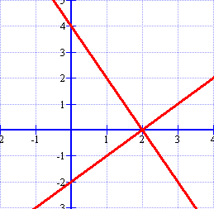
Graph the equations.
2x + y = 4
(0, 4) and (2, 0)
x - y = 2
(0, -2) and (2, 0)
Where do the lines intersect?
(2, 0)
2x + y = 4
x – y = 2

Slide 7
Check your answer!
To check your answer, plug the point back into both equations.
2x + y = 4
2(2) + (0) = 4
x - y = 2
(2) – (0) = 2
Nice job…let’s try another!

Slide 8
2) Find the solution to the following system:
y = 2x – 3
-2x + y = 1
You can put both equations in slope-intercept or if it makes the problem easier. I’ll do slope-intercept form for the 2nd one!
y = 2x – 3
y = 2x + 1
Graph using slope and y-intercept

Slide 9
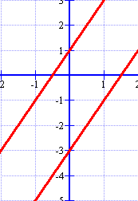
Graph the equations.
y = 2x – 3
m = 2 and b = -3
y = 2x + 1
m = 2 and b = 1
Where do the lines intersect?
No solution!
Notice that the slopes are the same with different y-intercepts.

Slide 10
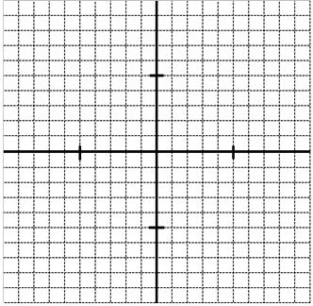
Your Turn
Solve the system by graphing.

