Slide 1
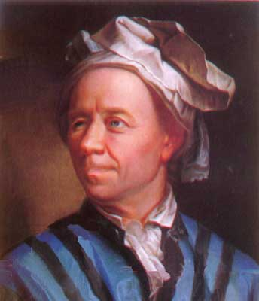
6.1 day 2
Euler’s Method
Leonhard Euler made a huge number of contributions to mathematics, almost half after he was totally blind.
(When this portrait was made he had already lost most of the sight in his right eye.)
Leonhard Euler 1707 - 1783

Slide 2
It was Euler who originated the following notations:
(function notation)
(base of natural log)
(pi)
(summation)
(finite change)
Leonhard Euler 1707 - 1783

Slide 3
There are many differential equations that can not be solved.
We can still find an approximate solution.
We will practice with an easy one that can be solved.
Initial value:

Slide 6
Exact Solution:

Slide 7
This is called Euler’s Method.
It is more accurate if a smaller value is used for dx.

Slide 8
Example

Slide 9
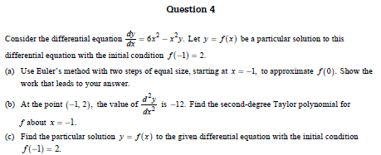
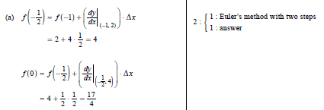
Example

