Slide 1

Section 8.8
Power Series

Slide 2
Write the following series in Sigma Notation starting at n = 0

Slide 3
Power Series
In all the prior sections we’ve only looked at series with numbers (n) in them. Now our series will also have variables (x) in them.
This will not change how things work however. Everything that we know about series still holds.
In power series convergence is still a major question that we’ll be dealing with.
The difference is that the convergence of the series will now depend upon the values of x that we put into the series.
A power series may converge for some values of x and not for other values of x.

Slide 4
Power Series

Slide 5
Write the power series for the following with starting index at n = 0

Slide 6
Power Series for Elementary Functions

Slide 7

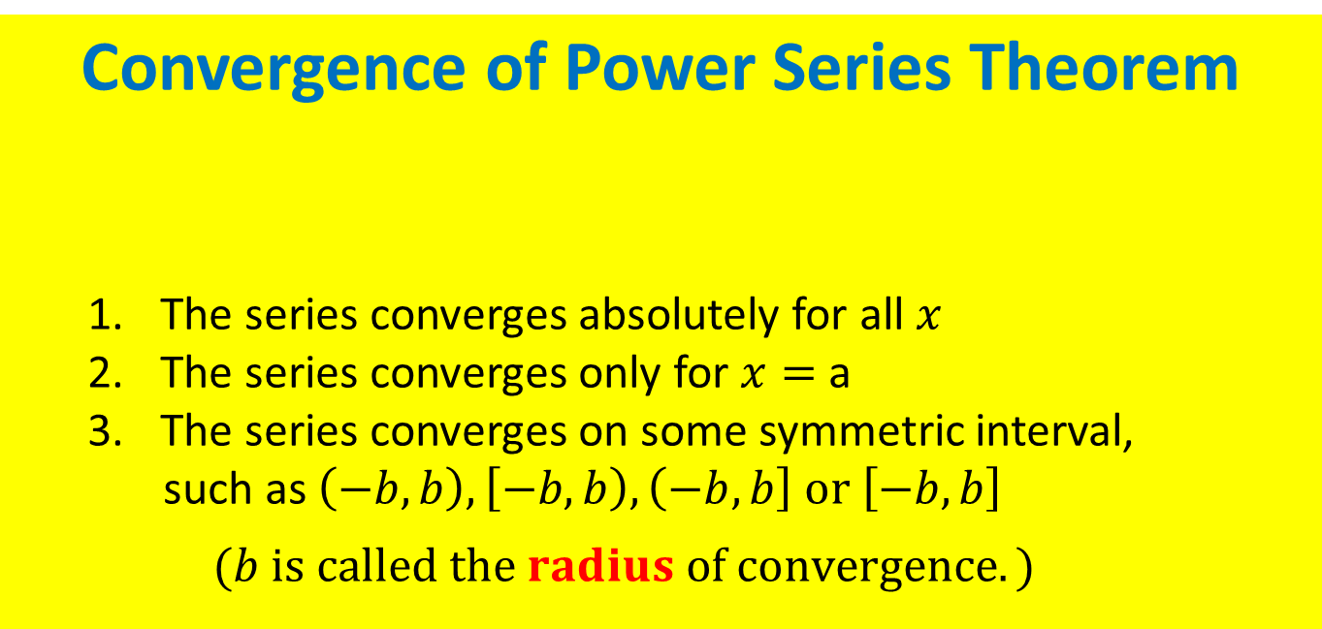
Convergence of Power Series Theorem
  The series converges absolutely for all $x$
  The series converges only for $x=$ a
  The series converges on some symmetric interval,
  such as $\left(−b, b\right), \left[−b, b\right), \left(−b, b\right] or \left[−b,b\right]$
  $$(b is called the radius of convergence.)$$
$$Given a Power Series \sum{a_{n}x^{n}} (centered at 0) , then either$$
The two tests that we will use to find the interval of convergence are the Ratio and Root Tests.
Every power series will converge at x = a, and may not converge for anything else.

Slide 8
Something we already know

Slide 9

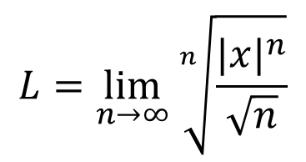

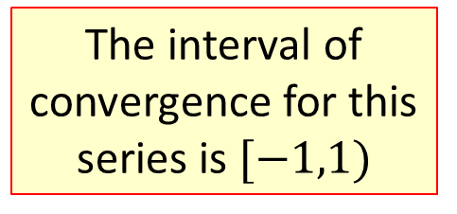

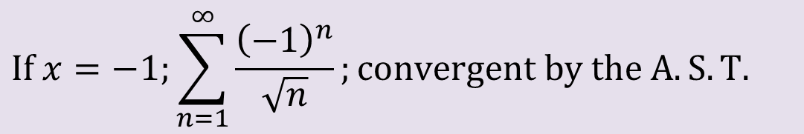
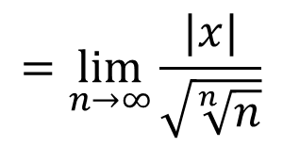
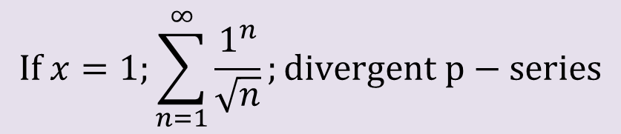
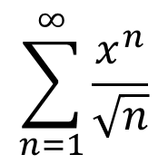
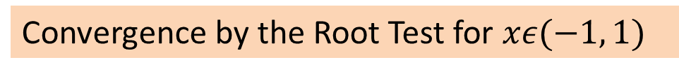
Example: Find the radius of Convergence.
$$\sum_{n=1}^{∞}{\frac{x^{n}}{\sqrt{n}}}$$
Since we are using a test that is only valid for positive series, we must put absolute value around any quantity that might be negative.
Convergence by the Root Test for $xε(−1, 1)$
$$L=\lim_{n→∞}{\sqrt[n]{\frac{{|x|}^{n}}{\sqrt{n}}}}$$
$$=\lim_{n→∞}{\frac{|x|}{\sqrt{\sqrt[n]{n}}}}$$
Root Test to Converge
$$L=|x|<1$$
$$=\lim_{n→∞}|x|$$
Since the Root Test fails if the limit equals 1, we test the endpoints separately.
$$\lim_{n→∞}\sqrt[n]{n}=1$$
$$If x=1;\sum_{n=1}^{∞}{\frac{1^{n}}{\sqrt{n}}};divergent p−series$$
The interval of convergence for this series is $[−1,1)$
$$If x=−1;\sum_{n=1}^{∞}{\frac{{\left(−1\right)}^{n}}{\sqrt{n}}};convergent by the A.S.T.$$

Slide 10
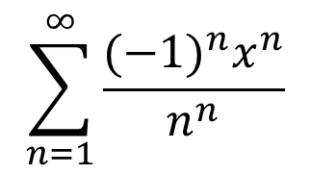

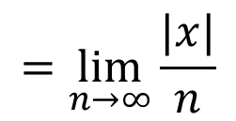
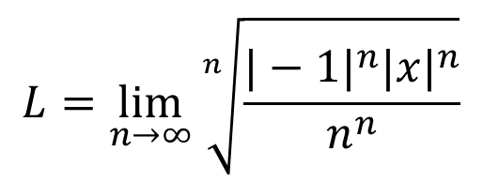
Example: Find the radius of Convergence.
$$\sum_{n=1}^{∞}{\frac{{(−1)}^{n}x^{n}}{n^{n}}}$$
$$L=\lim_{n→∞}{\sqrt[n]{\frac{{|−1|}^{n}{|x|}^{n}}{n^{n}}}}$$
$$=\lim_{n→∞}\frac{|x|}{n}$$
$$=0$$
This series is convergent on $(−∞,∞)$ by the Root Test.

Slide 11

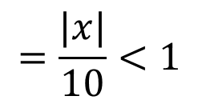
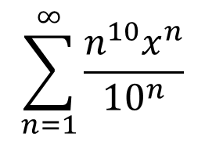
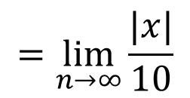
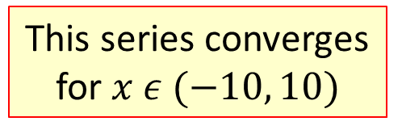

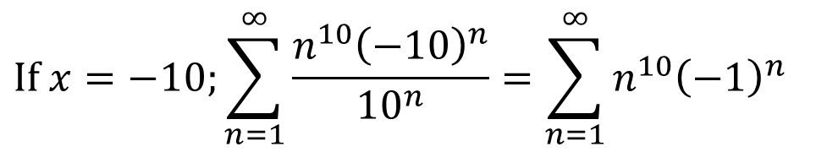
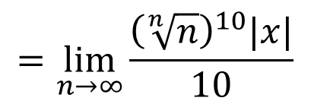
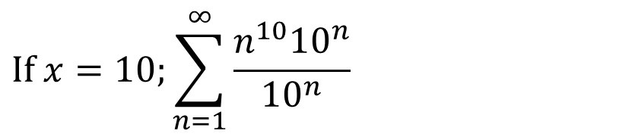
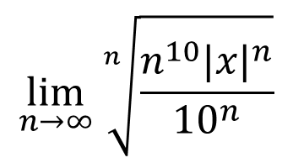

Example: Find the radius of Convergence.
$$\sum_{n=1}^{∞}{\frac{n^{10}x^{n}}{10^{n}}}$$
$$1$$
$$\lim_{n→∞}{\sqrt[n]{\frac{n^{10}{|x|}^{n}}{10^{n}}}}$$
$$=\lim_{n→∞}\frac{{\left(\sqrt[n]{n}\right)}^{10}|x|}{10}$$
$$=\lim_{n→∞}\frac{|x|}{10}$$
$$=\frac{|x|}{10}<1$$
Convergence for $\left|x\right|<10 or −10<x<10$
Now check the 2 endpoints.
This series converges for$x ε (−10, 10)$
$$If x=10;\sum_{n=1}^{∞}{\frac{n^{10}{10}^{n}}{10^{n}}}$$
; very divergent!
$$If x=−10;\sum_{n=1}^{∞}{\frac{n^{10}{\left(−10\right)}^{n}}{10^{n}}}=\sum_{n=1}^{∞}{n^{10}{\left(−1\right)}^{n}}$$
; also divergent by nth Term Test

Slide 12

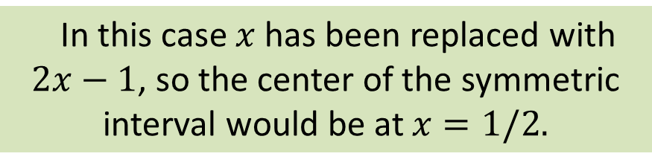
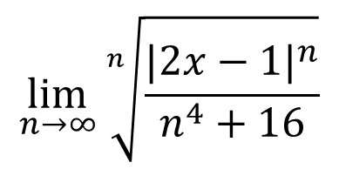

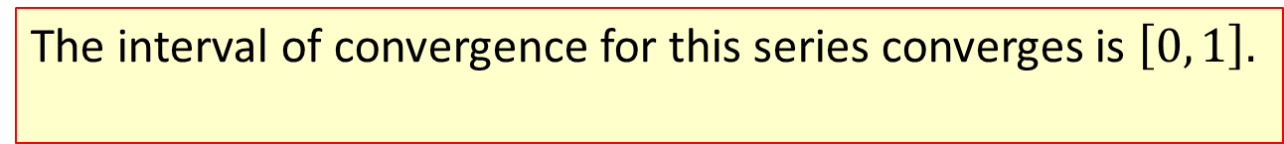
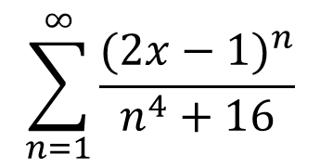

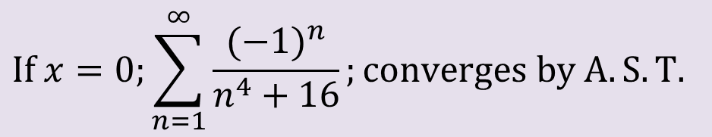
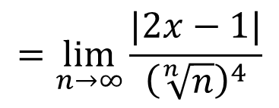

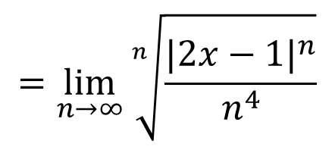

Example
$$\sum_{n=1}^{∞}{\frac{{(2x−1)}^{n}}{n^{4}+16}}$$
In this case $x$ has been replaced with $2x−1$, so the center of the symmetric interval would be at $x=1/2.$
$$\lim_{n→∞}{\sqrt[n]{\frac{{|2x−1|}^{n}}{n^{4}+16}}}$$
$$=\lim_{n→∞}{\sqrt[n]{\frac{{|2x−1|}^{n}}{n^{4}}}}$$
$$=\lim_{n→∞}{\frac{|2x−1|}{{\left(\sqrt[n]{n}\right)}^{4}}}$$
$$=\left|2x−1\right|<1$$
$$−1<2x−1<1$$
Check the endpoints.
$$0<2x<2$$
$$If x=0;\sum_{n=1}^{∞}{\frac{{(−1)}^{n}}{n^{4}+16}};converges by A.S.T.$$
$$0<x<1$$
$$If x=1;\sum_{n=1}^{∞}{\frac{{(1)}^{n}}{n^{4}+16}};compares to convergent p−series$$
The interval of convergence for this series converges is $\left[0, 1\right].$
The radius of convergence is 1/2.

Slide 13

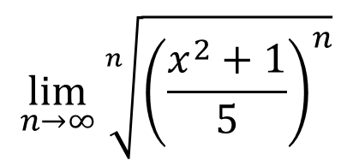

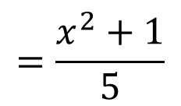
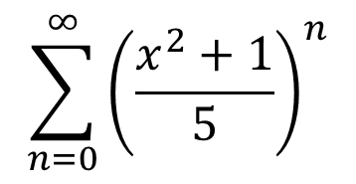
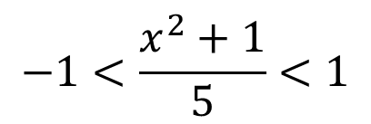


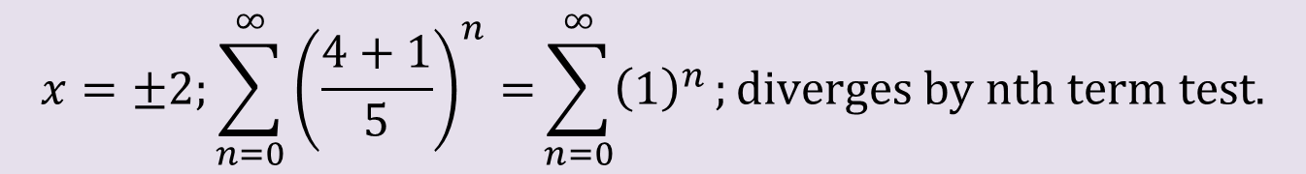
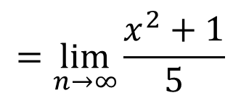

Example
$$\sum_{n=0}^{∞}{{\left(\frac{x^{2}+1}{5}\right)}^{n}}$$
$$\lim_{n→∞}{\sqrt[n]{{\left(\frac{x^{2}+1}{5}\right)}^{n}}}$$
$$=\lim_{n→∞}{\frac{x^{2}+1}{5}}$$
$$=\frac{x^{2}+1}{5}$$
$$<1$$
$$−1<\frac{x^{2}+1}{5}<1$$
$${−5<x}^{2}+1<5$$
Check the endpoints.
$${−6<x}^{2}<4$$
$$→−2<x<2$$
$$x=±2;\sum_{n=0}^{∞}{{\left(\frac{4+1}{5}\right)}^{n}=}\sum_{n=0}^{∞}{{\left(1\right)}^{n}};diverges by nth term test.$$
The interval of convergence is $\left(−2, 2\right).$

Slide 14
p. 623 #’s 1-33 odd

