Slide 1
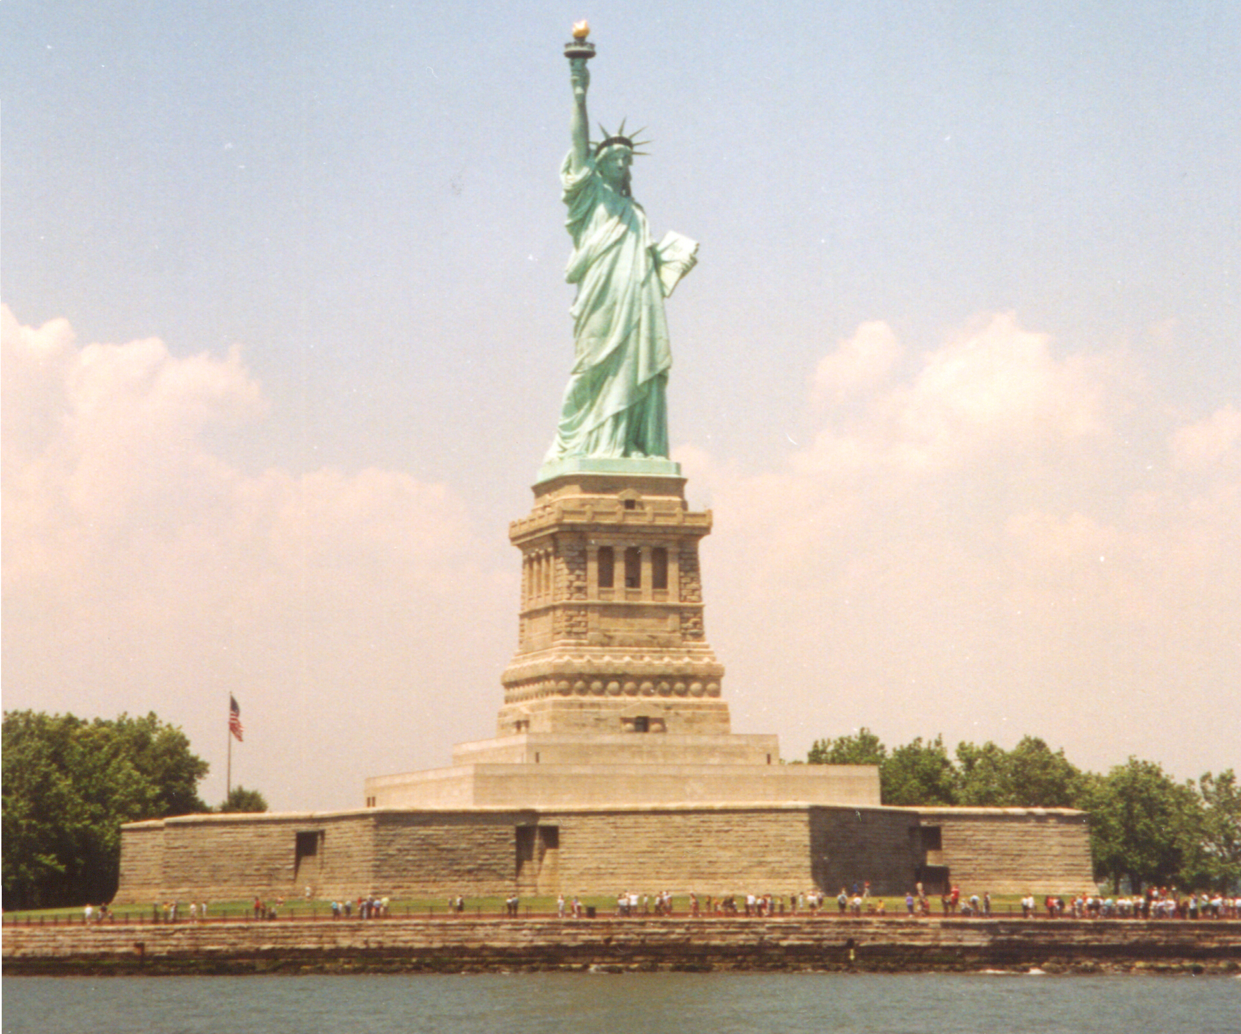
Power Series
8.8 Day 2

Slide 2
Properties of Functions Defined by Power Series

Slide 4
Example

Slide 5
For Intervals of convergence for f(x), f’(x) and the
integral of f(x), refer to example 8 on p. 622.

Slide 6
HW: p. 623 #’s 35-42, 47

