Slide 1
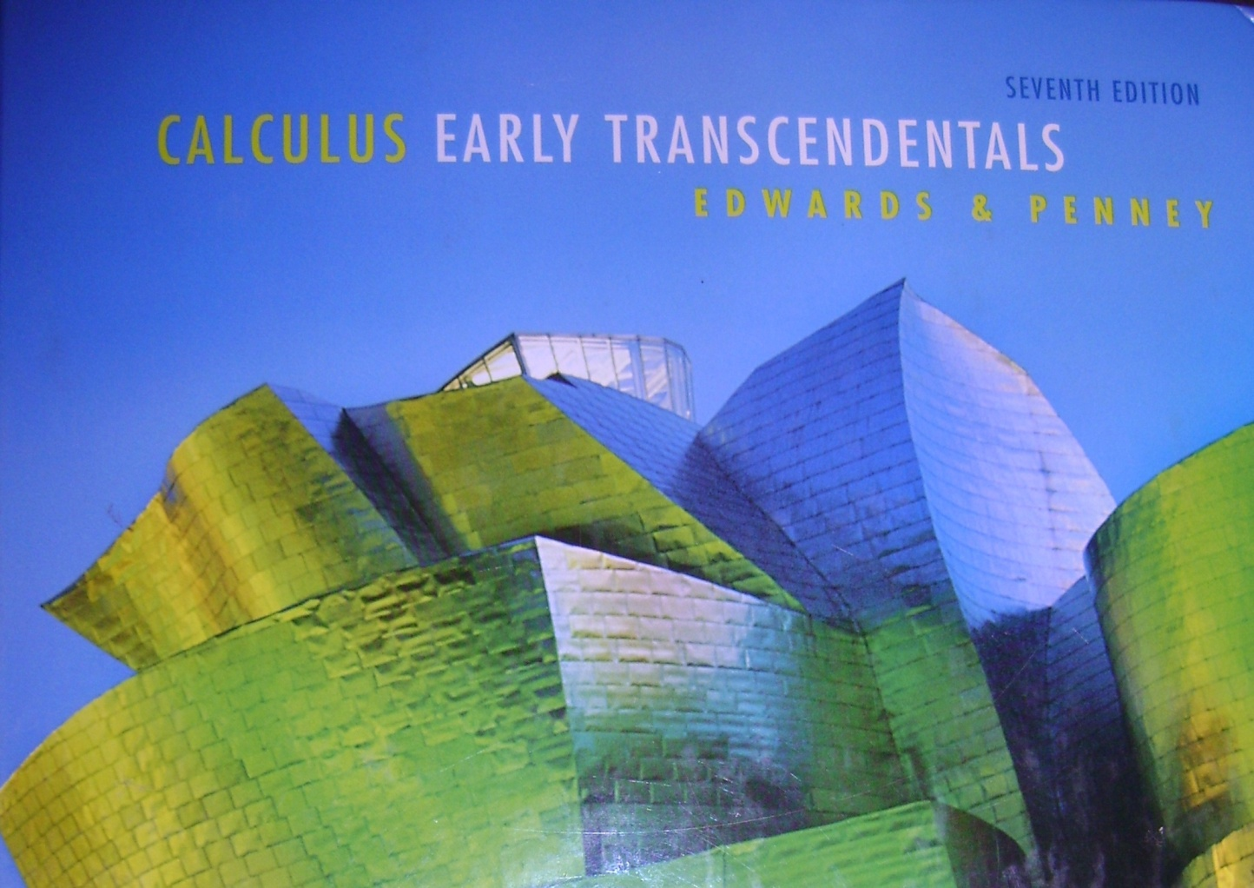
Section 8.6
Ratio and Root Tests

Slide 2
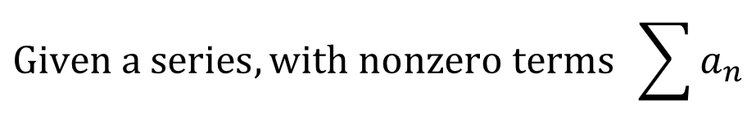
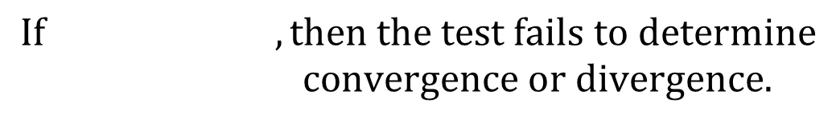
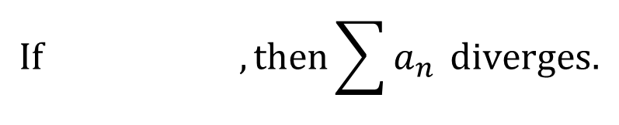
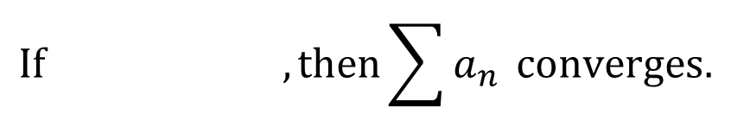
The Ratio Test
$$Given a series, with nonzero terms \sum{a_{n}}$$
$$If , then\sum{a_{n}} converges.$$
$$If , then\sum{a_{n}} diverges.$$
$$If , then the test fails to determine$$
$$convergence or divergence.$$
This method works well if $a_{n} contains$ any factorials.

Slide 3




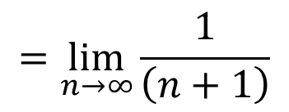
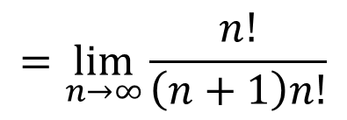
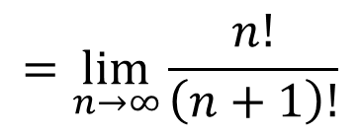
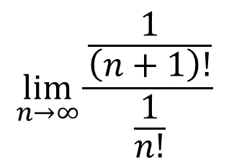
Example:
$$\sum{\frac{1}{n!}}$$
$$\lim_{n→∞}{\frac{\frac{1}{\left(n+1\right)!}}{\frac{1}{n!}}}$$
$$=\lim_{n→∞}{\frac{n!}{\left(n+1\right)!}}$$
$$=\lim_{n→∞}{\frac{n!}{\left(n+1\right)n!}}$$
$$=\lim_{n→∞}{\frac{1}{\left(n+1\right)}}$$
$$=0<1$$
The series converges by the ratio test.

Slide 4


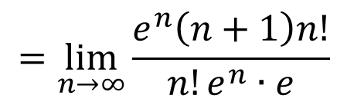
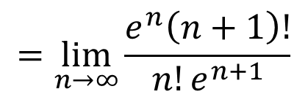
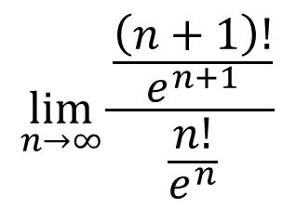


Example:
$$\sum{e^{−n}n!}$$
$$\lim_{n→∞}{\frac{\frac{\left(n+1\right)!}{e^{n+1}}}{\frac{n!}{e^{n}}}}$$
$$=\lim_{n→∞}{\frac{e^{n}\left(n+1\right)!}{{n!e}^{n+1}}}$$
$$=\lim_{n→∞}{\frac{e^{n}\left(n+1\right)n!}{{n!e}^{n}∙e}}$$
$$=∞>1$$
This series diverges by the ratio test.

Slide 5



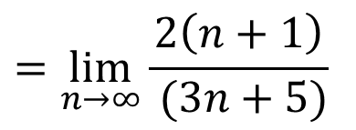
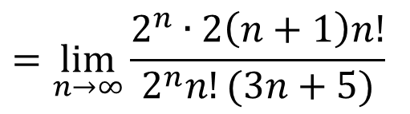
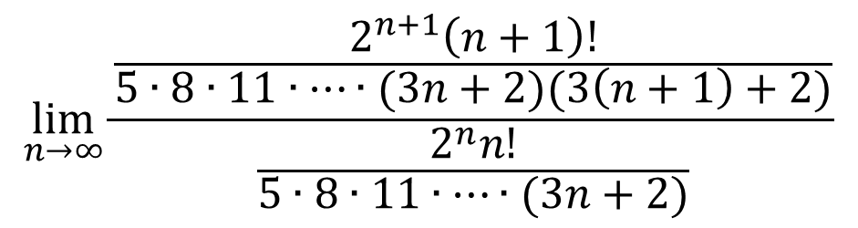
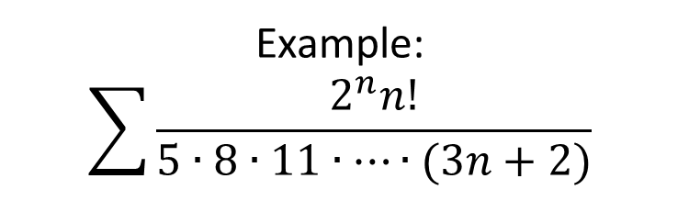
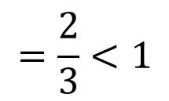
Example:
$$\sum{\frac{2^{n}n!}{5∙8∙11∙…∙(3n+2)}}$$
$$\lim_{n→∞}{\frac{\frac{2^{n+1}\left(n+1\right)!}{5∙8∙11∙…∙(3n+2)(3\left(n+1\right)+2)}}{\frac{2^{n}n!}{5∙8∙11∙…∙(3n+2)}}}$$
$$=\lim_{n→∞}{\frac{2^{n}∙2\left(n+1\right)n!}{2^{n}n!(3n+5)}}$$
$$=\lim_{n→∞}{\frac{2\left(n+1\right)}{ (3n+5)}}$$
$$=\frac{2}{3}<1$$
The series converges by the ratio test.

Slide 6
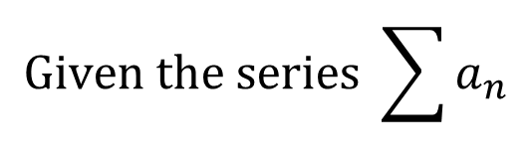
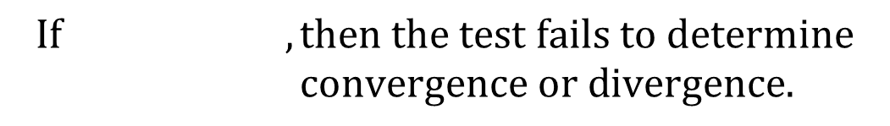
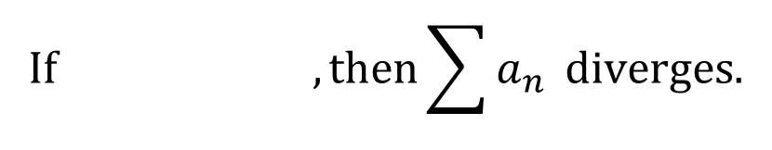
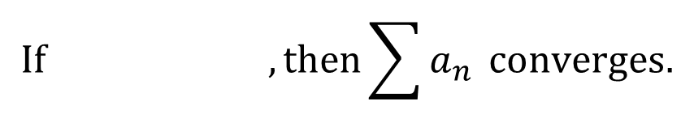
The Root Test
$$Given the series \sum{a_{n}}$$
$$If ,then\sum{a_{n}} converges.$$
$$If , then\sum{a_{n}} diverges.$$
$$If , then the test fails to determine$$
$$convergence or divergence.$$
This method works well if $a_{n}$has many exponents.

Slide 7



Example:
$$\sum{\frac{3^{n}}{n^{3}}}$$
$$\lim_{n→∞}{\sqrt[n]{n}}=1$$
$$=\lim_{n→∞}{\frac{\sqrt[n]{3^{n}}}{\sqrt[n]{n^{3}}}}$$
$$=\lim_{n→∞}{\frac{3}{{\left(\sqrt[n]{n}\right)}^{3}}}$$
$$\lim_{n→∞}{\sqrt[n]{{3^{n}}/{n^{3}}}}$$
$$=3$$
$$>1$$
$$1$$
This series diverges by the root test.

Slide 8
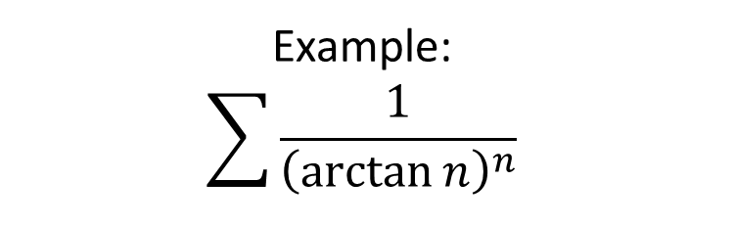
Example:
$$\sum{\frac{1}{{\left(\arctan{n}\right)}^{n}}}$$
$$\lim_{n→∞}{\sqrt[n]{\frac{1}{{\left(\arctan{n}\right)}^{n}}}}$$
$$= \lim_{n→∞}{\frac{1}{\arctan{n}}}$$
$$=\frac{1}{π/2}$$
$$=\frac{2}{π}$$
$$<1$$
This series converges by the root test.

Slide 9


If there is an $n!$anywhere in the term,
the root test is not appropriate.

Slide 10

Series
Susan Cantey © 2007
Series are serious business; the terms are the first thing you check,
If they don’t go to zero, divergence is a sure bet,
Alternating series are the next best, ‘cause if the terms (decreasing) go to zero,
they will converge,
Moreover the error in S sub n is less than the very next term.
Positive series are tougher; you’ll need a bevy of tests,
The terms need to shrink so much faster sometimes it’s hard to know which test is best,
P-series, p-series, one over n to the power of p,
They will converge if p’s greater than one; if not it’s a divergent sum.
If last comes to last, you can always compare,
Your series to one from the past,
If the limit of their ratio has a positive value,
What the old one must do, the new one will too!
Factorials necessitate the ratio test; exponents require the root test,
One is the cut off for both of them; convergence when the limit is less,
Or you can make a sub n into a function and its integral examine,
If you get a real number positive result then the series convergences to some unknown sum.

Slide 11
HW on p. 603 #’s 13-41 odd

