Slide 1

Section 8.3
Integral Test

Slide 2
For the next few lessons, we will be concerned with testing many different types of series for convergence.
We will not be particularly concerned with finding the sums of the series that do happen to converge.
Feel free to compute the infinite sums of convergent series in your copious spare time.
…just don’t forget to eat…

Slide 3





The integral Test is the first of many tests for convergence.
It is elegant and simple, but unfortunately has limited application.
It only works if the expression can be integrated when $x$replaces $n$ in the term that defines the given series.
Example:
$$\sum{\frac{1}{n^{2}}}$$
$$→\int{\frac{1}{x^{2}}dx}$$
Integral Test is appropriate.
Example:
$$\sum{\frac{1}{n!}}$$
$$→\int{\frac{1}{x!}dx}$$
Integral Test is NOT appropriate.

Slide 4
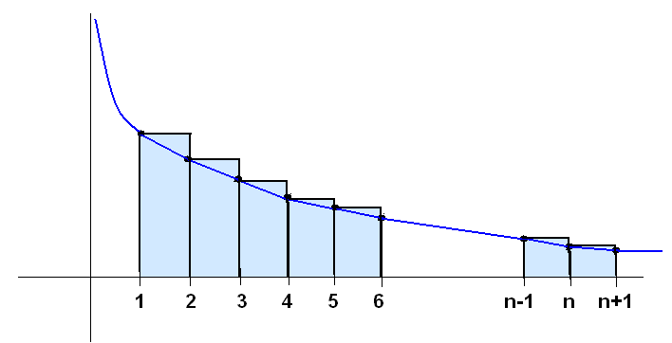
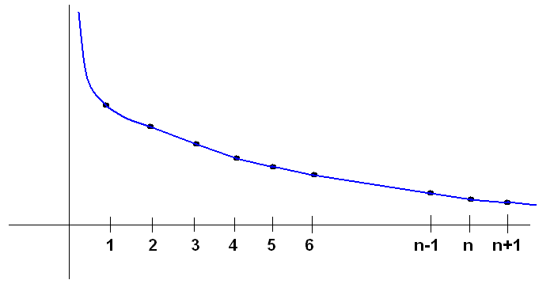
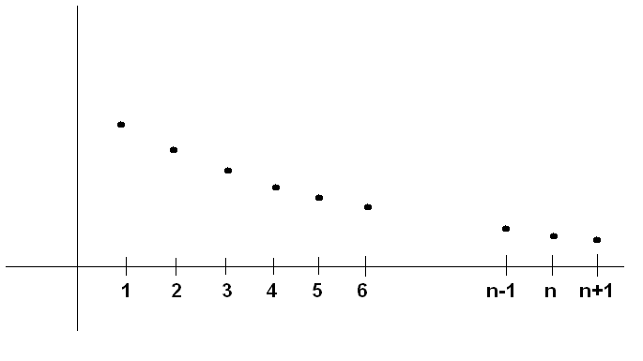
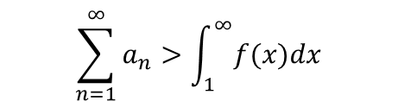
$a_{1} a_{2} a_{3} a_{4} a_{5} . . . a_{n}$
Here’s a graph of a series with $a_{n}→0,$ which therefore MIGHT converge.
The blue curve represents the equivalent expression where $x$ replaces $n.$
$$\sum_{n=1}^{∞}{a_{n}}>\int_{1}^{∞}{f(x)dx}$$
The terms of the series can form an upper sum.
If the integral diverges…so does the “larger” series.
The same terms can also form a lower sum.

Slide 5
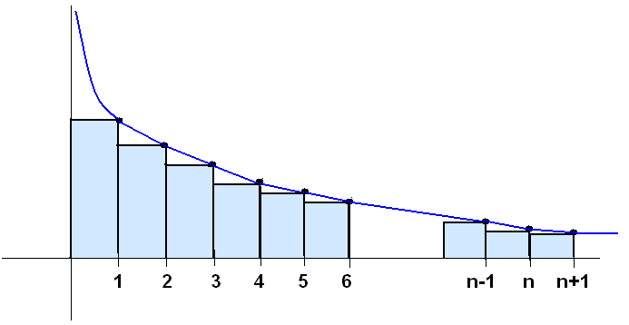

$$a_{1} a_{2} a_{3} a_{4} a_{5} a_{6} . . . a_{n}$$
Here’s a graph of a series with $a_{n}→0,$ which therefore MIGHT converge.
The blue curve represents the equivalent expression where $x$ replaces $n.$
$$\sum_{n=1}^{∞}{a_{n}}>\int_{1}^{∞}{f(x)dx}$$
The terms of the series can form an upper sum.
If the integral converges…so does the “larger” series.
$$\sum_{n=2}^{∞}{a_{n}}<\int_{1}^{∞}{f(x)dx}$$
The same terms can also form a lower sum.
If the integral converges…so does the series.

Slide 6
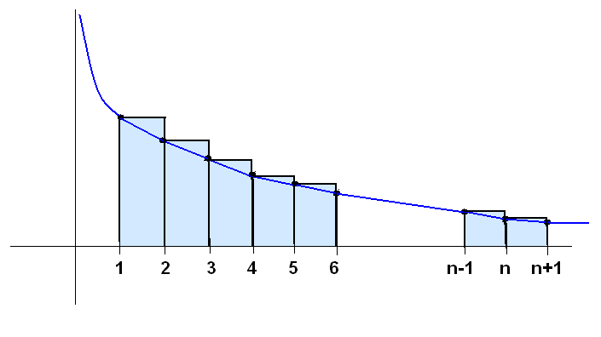
Because the series can be drawn as either an upper or lower sum, we can conclude that whatever the integral does (converges or diverges), the series does too.

Slide 7
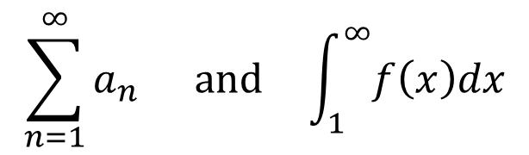
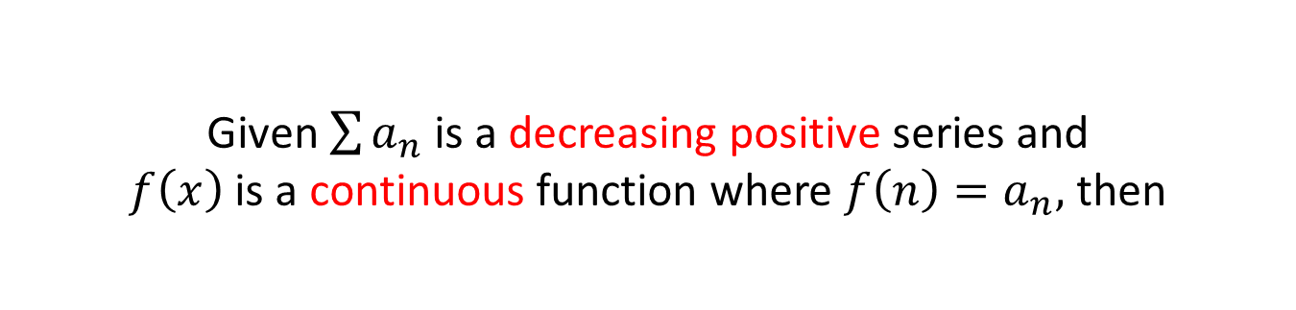
Integral Test
Given $\sum{a_{n}}$ is a decreasing positive series and
$f\left(x\right)$ is a continuous function where $f\left(n\right)=a_{n},$ then
$$\sum_{n=1}^{∞}{a_{n}} and \int_{1}^{∞}{f\left(x\right)dx}$$
either both converge or both diverge.

Slide 8
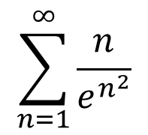
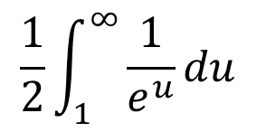
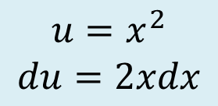
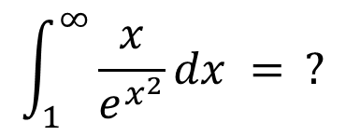
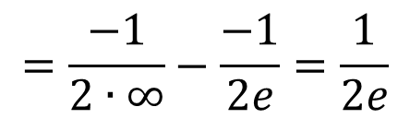
Example: Determine whether or not the following series converges:
$$\sum_{n=1}^{∞}{\frac{n}{e^{n^{2}}}}$$
$$\int_{1}^{∞}{\frac{x}{e^{x^{2}}}dx }= ?$$
$$\frac{1}{2}\int_{1}^{∞}{\frac{1}{e^{u}}du }$$
$$u=x^{2}$$
$$du=2xdx$$
$$=\frac{−1}{2∙∞}−\frac{−1}{2e}=\frac{1}{2e}$$
Since the integral converges, so does the series.

Slide 9
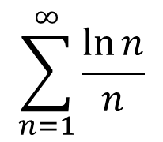

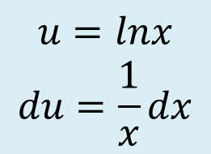
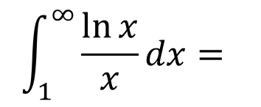
Example: Does the following converge or diverge?
$$\sum_{n=1}^{∞}{\frac{\ln{n}}{n}}$$
$$\int_{1}^{∞}{\frac{\ln{x}}{x}}dx=$$
$$=∞−0=∞$$
$$u=lnx$$
$$du=\frac{1}{x}dx$$
Since the integral diverges, so does the series.
The only thing that can make these problems difficult
is if the integral itself is difficult.

Slide 10

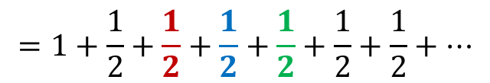
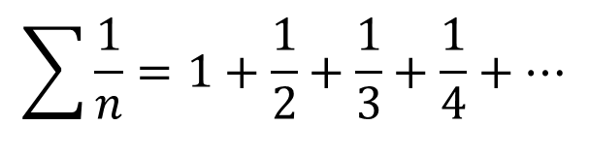
Due to it’s unique qualities, the Harmonic Series
is useful when studying more complicated series.
$$\sum{\frac{1}{n}=1+\frac{1}{2}+\frac{1}{3}+\frac{1}{4}+…}$$
Do you think this series converges or diverges?
$$1+\frac{1}{2}+\frac{1}{3}+\frac{1}{4}+\frac{1}{5}+\frac{1}{6}+\frac{1}{7}+\frac{1}{8}+\frac{1}{9}+\frac{1}{10}+\frac{1}{11}+\frac{1}{12}+\frac{1}{13}+\frac{1}{14}+\frac{1}{15}+\frac{1}{16}+…≥$$
$$1+\frac{1}{2}+\frac{1}{4}+\frac{1}{4}+\frac{1}{8}+\frac{1}{8}+\frac{1}{8}+\frac{1}{8}+\frac{1}{16}+\frac{1}{16}+\frac{1}{16}+\frac{1}{16}+\frac{1}{16}+\frac{1}{16}+\frac{1}{16}+\frac{1}{16}+…$$
$$1+\frac{1}{2}+\frac{1}{4}+\frac{1}{4}+\frac{1}{8}+\frac{1}{8}+\frac{1}{8}+\frac{1}{8}+\frac{1}{16}+\frac{1}{16}+\frac{1}{16}+\frac{1}{16}+\frac{1}{16}+\frac{1}{16}+\frac{1}{16}+\frac{1}{16}+…$$
Continue this pattern, replacing twice as many terms each time.
$$=1+\frac{1}{2}+\frac{1}{2}+\frac{1}{2}+\frac{1}{2}+\frac{1}{2}+\frac{1}{2}+…$$
The Harmonic Series
is divergent.
$$=∞$$

Slide 11

p-Series
$$\sum{\frac{1}{n^{p}}}$$
Any series of the form where p is a real number.
p-series converge if and only if $p>1$
And diverges if 0 < p < 1

Slide 12

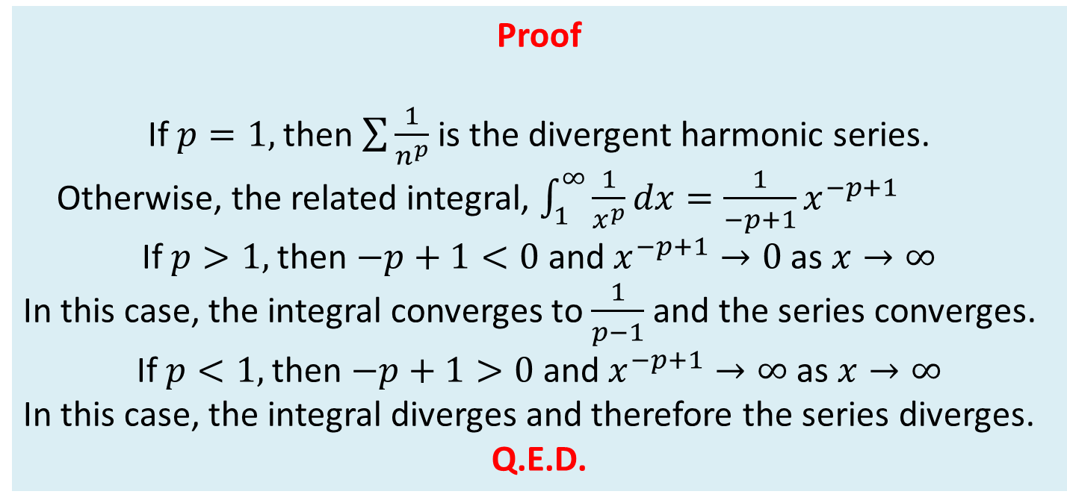
Proof for the divergence and convergence of the p-series
Proof
If $p=1,$ then $\sum{\frac{1}{n^{p}}}$ is the divergent harmonic series.
Otherwise, the related integral, $\int_{1}^{∞}{\frac{1}{x^{p}}dx}=\frac{1}{−p+1}x^{−p+1}$
If $p>1,$then $−p+1<0$and $x^{−p+1}→0$ as $x→∞$
In this case, the integral converges to $\frac{1}{p−1}$ and the series converges.
If $p<1,$then $−p+1>0$and $x^{−p+1}→∞$ as $x→∞$
In this case, the integral diverges and therefore the series diverges.
Q.E.D.
$$∞$$
1

Slide 13
p. 580 #’s 1-19 odd, 21-24

Slide 14
Day 2

Slide 15
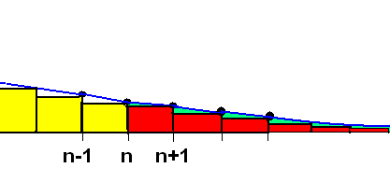
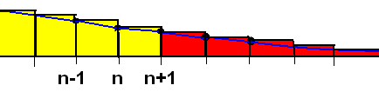

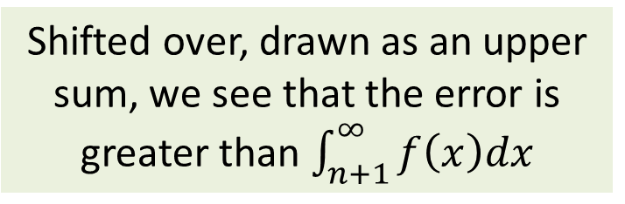

If we stop evaluating a convergent positive series after adding n terms, the difference between the true infinite sum and our partial sum is called the error or remainder.
$$R_{n}=S−S_{n}$$
In the case where all the terms are positive,
the error (or remainder) will be positive.
Here’s a representation of the series (Riemann Sum) and it’s related integral for n large.
Drawn as a lower sum, the partial sum stops at the last yellow box.
The error (shown in red) is less than $\int_{n}^{∞}{f\left(x\right)dx}.$
Shifted over, drawn as an upper sum, we see that the error is greater than $\int_{n+1}^{∞}{f\left(x\right)dx}$

Slide 16
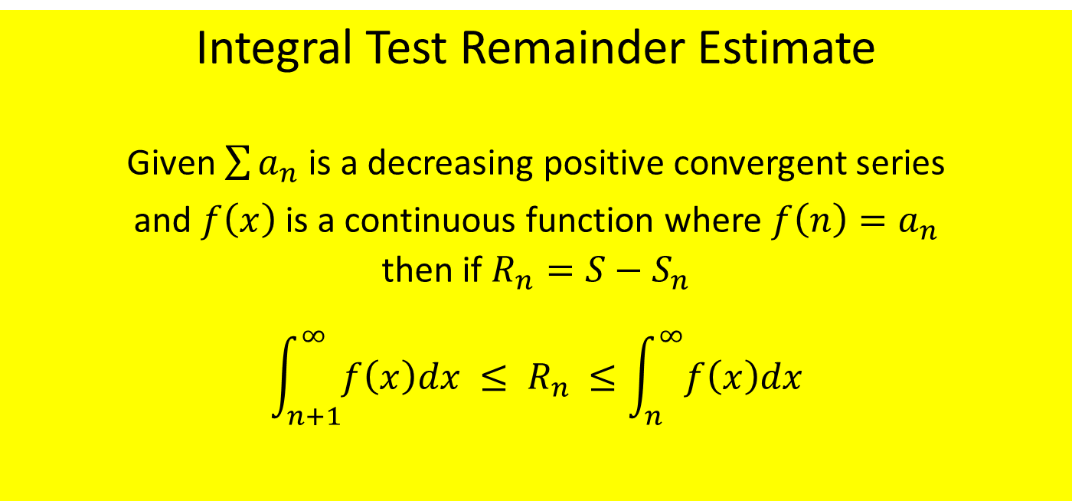
Integral Test Remainder Estimate
Given $\sum{a_{n}}$ is a decreasing positive convergent series
and $f\left(x\right)$ is a continuous function where $f\left(n\right)=a_{n}$
then if $R_{n}=S−S_{n}$
$$\int_{n+1}^{∞}{f\left(x\right)dx} {≤ R}_{n} ≤\int_{n}^{∞}{f\left(x\right)dx}$$

Slide 17
Example: Approximate the sum of the convergent series using the indicated number of terms. Include an estimate of the maximum error for your approximation.

Slide 18
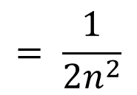

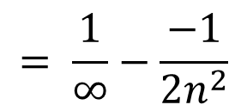

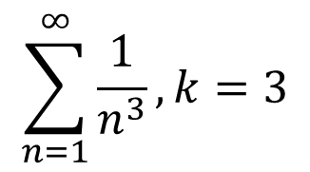


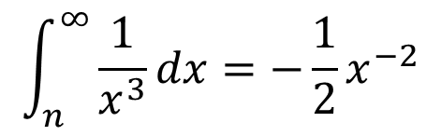

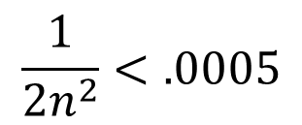
Example for #43
Find N such that R_{n} is less than the given error.
$$\sum_{n=1}^{∞}{\frac{1}{n^{3}}}, k=3$$
We want ${ R}_{n}<.0005$
It is sufficient is to find $n$ such that$\int_{n}^{∞}{\frac{1}{x^{3}}dx}<.0005$
$$∞$$
$$n$$
$$\int_{n}^{∞}{\frac{1}{x^{3}}dx}=−\frac{1}{2}x^{−2}$$
$$= \frac{1}{∞}−\frac{−1}{2n^{2}}$$
$$= \frac{1}{2n^{2}}$$
$$\frac{1}{2n^{2}}<.0005$$
$$→1<.001n^{2}$$
$$→1000<n^{2}$$
$$→n>31.623$$
The minimum number of terms needed is 32.

Slide 19
p.581 #’s 37-47 odd, 53-64

Slide 20
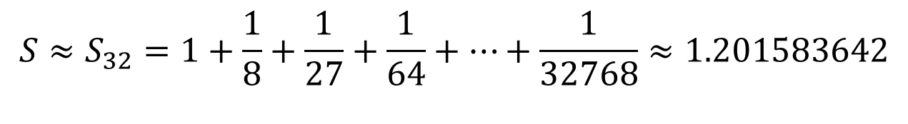
Example for #43
Find N such that R_{n} is less than the given error.
$$\sum_{n=1}^{∞}{\frac{1}{n^{3}}}, k=3$$
We want ${ R}_{n}<.0005$
It is sufficient is to find $n$ such that$\int_{n}^{∞}{\frac{1}{x^{3}}dx}<.0005$
$$∞$$
$$n$$
$$\int_{n}^{∞}{\frac{1}{x^{3}}dx}=−\frac{1}{2}x^{−2}$$
$$= \frac{1}{∞}−\frac{−1}{2n^{2}}$$
$$= \frac{1}{2n^{2}}$$
$$\frac{1}{2n^{2}}<.0005$$
$$→1<.001n^{2}$$
$$→1000<n^{2}$$
$$→n>31.623$$
The minimum number of terms needed is 32.
$${S≈S}_{32}=1+\frac{1}{8}+\frac{1}{27}+\frac{1}{64}+…+\frac{1}{32768}≈1.201583642$$

