Slide 1
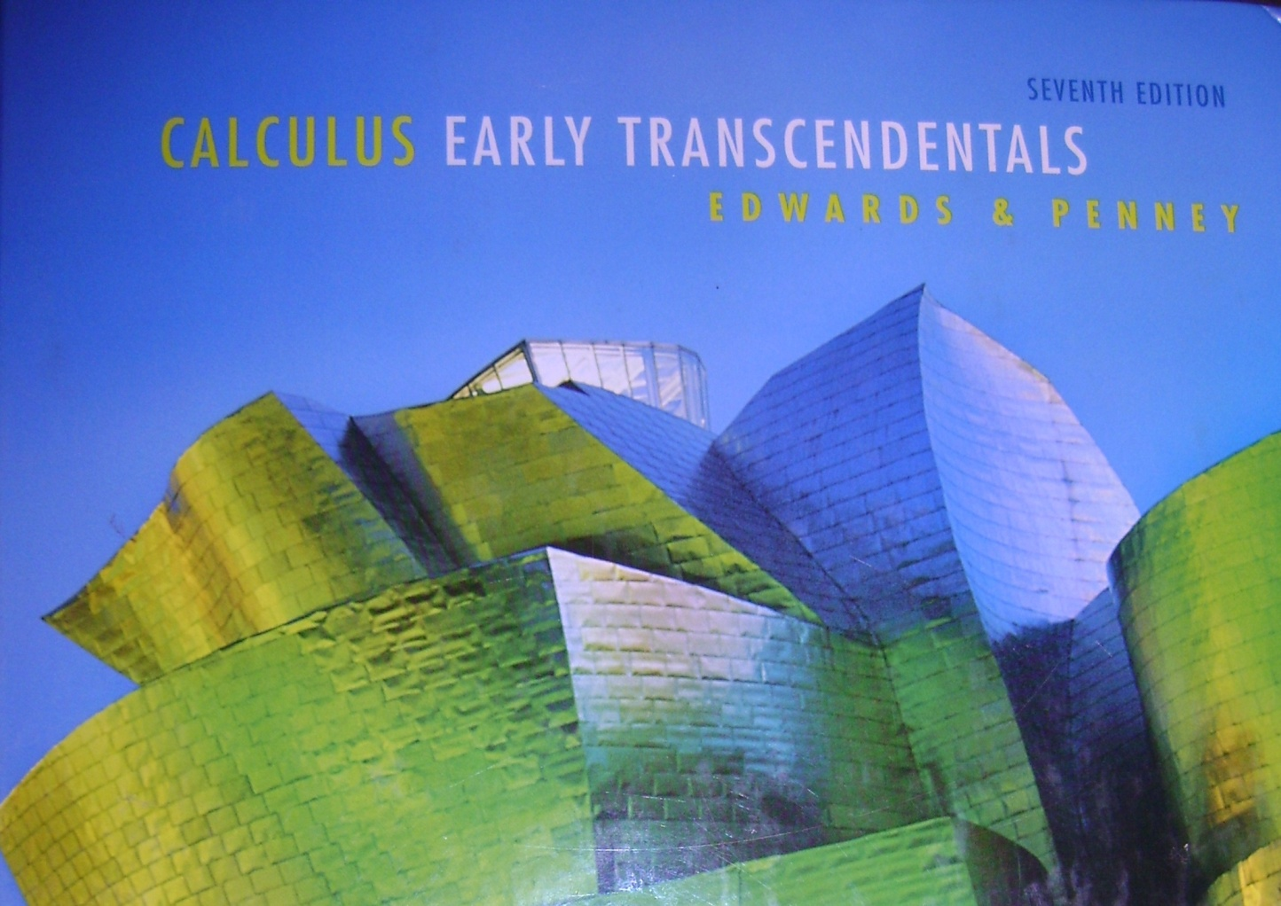
Section 8.2
Series Day 2

Slide 2
The Telescoping Series
Write out the first few terms and see what happens.

Slide 3
The relationship between stopping at the 4th term and the denominators of 5 and 6 in terms of n are:?

Slide 5
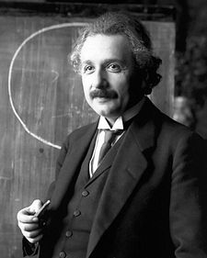

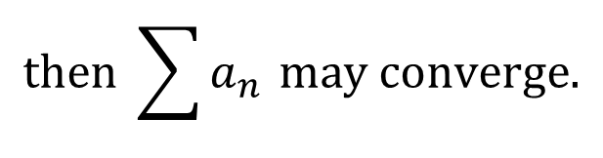

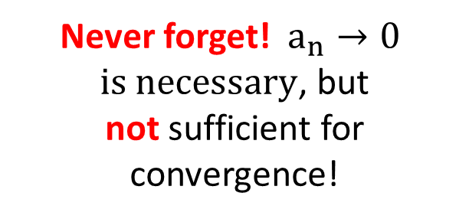
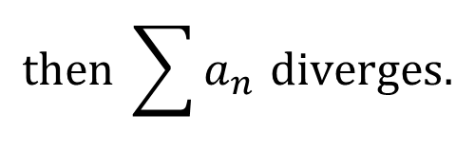
nth term test for divergence
$$If \lim_{n→∞}{a_{n}≠0}$$
$$then \sum{a_{n }diverges.}$$
nth term test for convergence
$$If \lim_{n→∞}{a_{n}=0}$$
$$then \sum{a_{n }may converge.}$$
Never forget!$a_{n}→0$
$is necessary$, but
not sufficient for convergence!

Slide 6
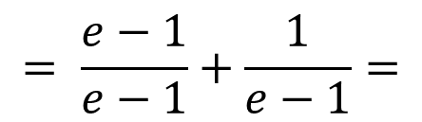
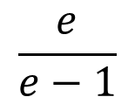
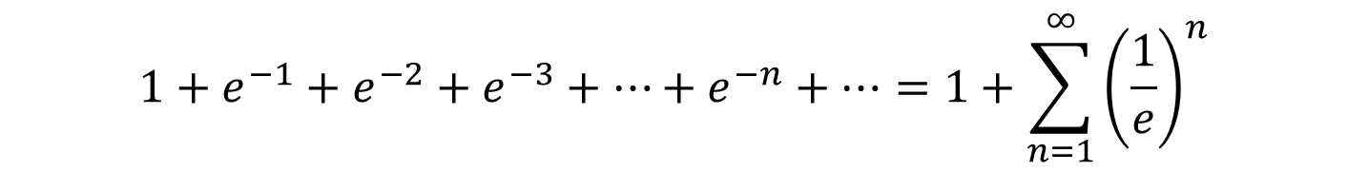
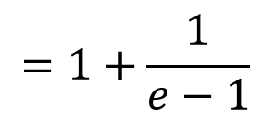
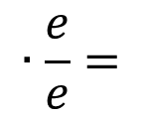

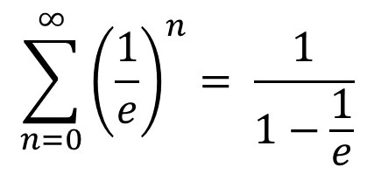
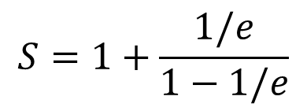
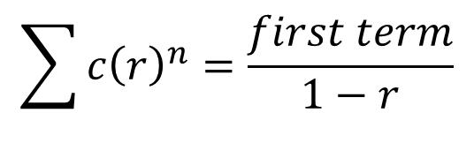
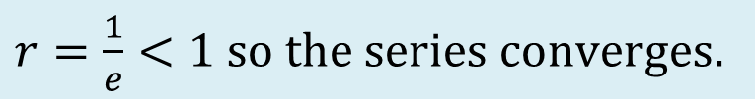
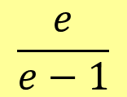
Example:
$$1+e^{−1}+e^{−2}+e^{−3}+…+e^{−n}+…$$
Can the series be written as a geometric series in standard form?
$$1+e^{−1}+e^{−2}+e^{−3}+…+e^{−n}+…=1+\sum_{n=1}^{∞}{{\left(\frac{1}{e}\right)}^{n}}$$
$$r=\frac{1}{e}<1 so the series converges.$$
$$S=1+\frac{1/e}{1−1/e}$$
$$∙\frac{e}{e}$$
$$=1+\frac{1}{e−1}$$
$$= \frac{e−1}{e−1}+\frac{1}{e−1}=$$
$$\frac{e}{e−1}$$
Short cut formula:
$$\sum{c{\left(r\right)}^{n}}=\frac{first term}{1−r}$$
$$\sum_{n=0}^{∞}{{\left(\frac{1}{e}\right)}^{n}= \frac{1}{1−\frac{1}{e}}}$$
$$∙\frac{e}{e}=$$
$$\frac{e}{e−1}$$
So this is much faster!

Slide 7
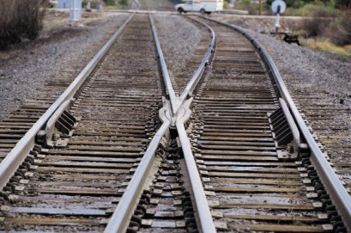



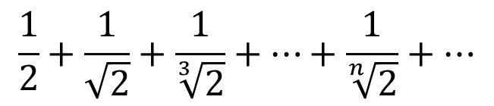





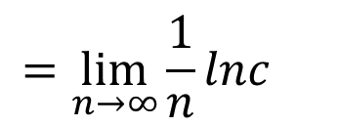
$$\frac{1}{2}+\frac{1}{\sqrt{2}}+\frac{1}{\sqrt[3]{2}}+…+\frac{1}{\sqrt[n]{2}}+…$$
Ex: #4
Is this a geometric series?
no
Telescoping?
no
Does $a_{n}→0$?
?
$$\lim_{n→∞}{\sqrt[n]{c}}= ?$$
$$=\lim_{n→∞}{c^{1/n}}$$
$$→\lim_{n→∞}{{lnc}^{1/n}}$$
$$=\lim_{n→∞}{{\frac{1}{n}lnc}^{}}$$
$$=0$$
The terms of this series go to 1 NOT 0, therefore it diverges
by the nth term test.
$$\lim_{n→∞}{\sqrt[n]{c}}=1$$
by the same method we can show:
$$\lim_{n→∞}{\sqrt[n]{n}}=1$$

Slide 8


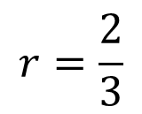
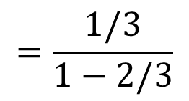
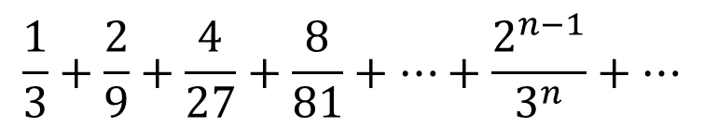
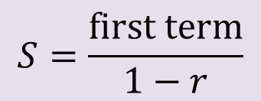
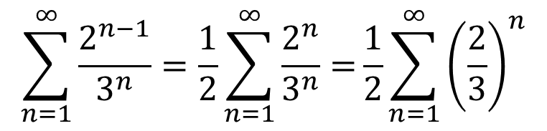
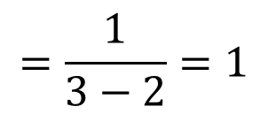
Example
$$\frac{1}{3}+\frac{2}{9}+\frac{4}{27}+\frac{8}{81}+…+\frac{2^{n−1}}{3^{n}}+…$$
$$r=\frac{2}{3}$$
Is this series geometric?
Yes!
$$\sum_{n=1}^{∞}{\frac{2^{n−1}}{3^{n}}=\frac{1}{2}\sum_{n=1}^{∞}{\frac{2^{n}}{3^{n}}=}\frac{1}{2}}\sum_{n=1}^{∞}{{\left(\frac{2}{3}\right)}^{n}}$$
$$S=\frac{first term}{1−r}$$
$$=\frac{1/3}{1−2/3}$$
$$∙\frac{3}{3}$$
$$=\frac{1}{3−2}=1$$
The sum of this infinite geometric series is 1.

Slide 9

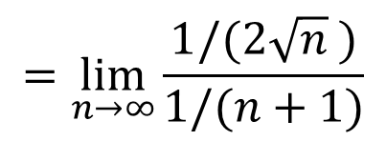


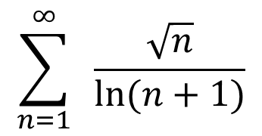

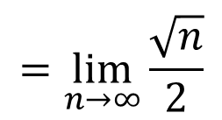

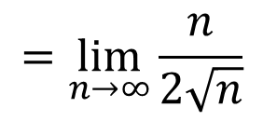
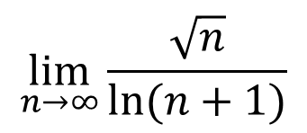
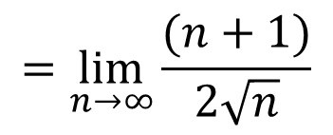
Example
$$\sum_{n=1}^{∞}{ \frac{\sqrt{n}}{ln⁡(n+1)}}$$
Let’s investigate the limit of the terms…
$$∞$$
$$\lim_{n→∞}{\frac{\sqrt{n}}{ln⁡(n+1)}}$$
$$=\lim_{n→∞}{\frac{1/(2\sqrt{n} )}{1/⁡(n+1)}}$$
$$=\lim_{n→∞}{\frac{(n+1)}{2\sqrt{n}}}$$
$$∞$$
$$=\lim_{n→∞}{\frac{\sqrt{n}}{2}}$$
$$=\lim_{n→∞}{\frac{n}{2\sqrt{n}}}$$
$$=∞$$
Since the terms of this series $→∞$NOT zero,
this series diverges by the nth term test.

Slide 10

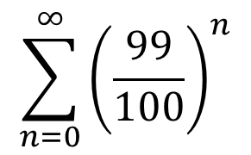
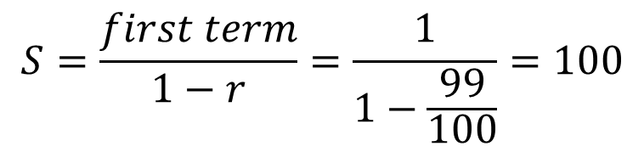
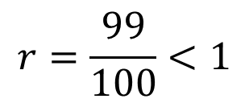
Example
$$\sum_{n=0}^{∞}{{\left(\frac{99}{100}\right)}^{n}}$$
Ah ha! A simple geometric series!
We do the dance of joy!
$$r=\frac{99}{100}<1$$
$$S=\frac{first term}{1−r}=\frac{1}{1−\frac{99}{100}}=100$$
The sum of this convergent geometric series is 100.

Slide 11
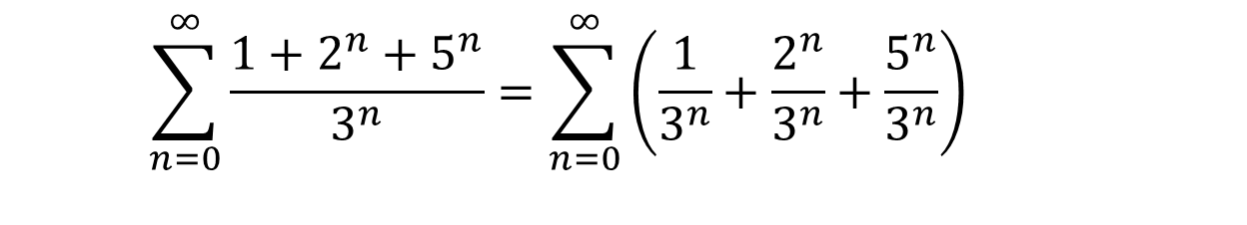
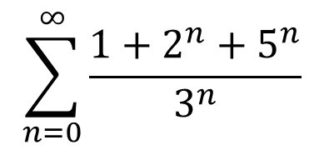
Example
$$\sum_{n=0}^{∞}{\frac{1+2^{n}+5^{n}}{3^{n}}}$$
$$\sum_{n=0}^{∞}{\frac{1+2^{n}+5^{n}}{3^{n}}}=\sum_{n=0}^{∞}{\left(\frac{1}{3^{n}}+\frac{2^{n}}{3^{n}}+\frac{5^{n}}{3^{n}}\right) }$$
Divergent geometric series
Convergent geometric series
This series diverges.

Slide 12
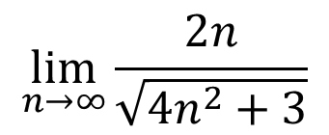
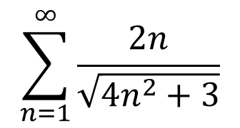

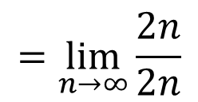
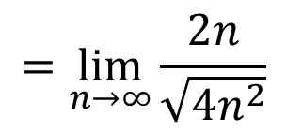
Example
$$\sum_{n=1}^{∞}{\frac{2n}{\sqrt{4n^{2}+3}}}$$
Not geometric, sigh…
$$\lim_{n→∞}{\frac{2n}{\sqrt{4n^{2}+3}}}$$
$$=\lim_{n→∞}{\frac{2n}{\sqrt{4n^{2}}}}$$
$$=\lim_{n→∞}{\frac{2n}{2n}}$$
$$=1$$
This series diverges by the nth term test.

Slide 13
HW # p. 573 # 11-15, 21-25 odd, 33-36, 49-61 odd

Slide 14

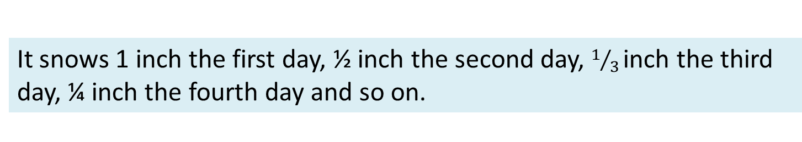
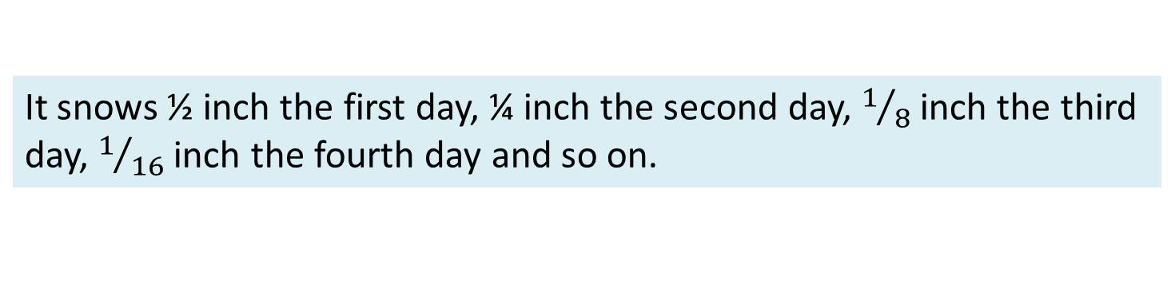
Snow Scenarios
It snows a little more each day.
divergent
divergent
It snows the same small amount each day.
It snows less and less each day towards .01 inches per day.
divergent
It snows 1 inch the first day, ½ inch the second day, $1/{3 }$inch the third day, ¼ inch the fourth day and so on.
divergent
It snows ½ inch the first day, ¼ inch the second day, $1/8$ inch the third day, $1/{16}$ inch the fourth day and so on.
convergent
It snows some unspecified amount on the first day. Each proceeding day it snows less and less with these amounts approaching zero.
MIGHT be convergent – depends on how quickly $a_{n}→0$

Slide 15

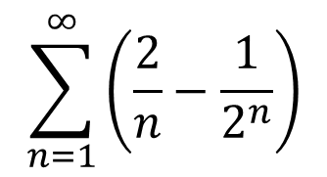

Example
$$\sum_{n=1}^{∞}{\left(\frac{2}{n}−\frac{1}{2^{n}}\right)}$$
Looks like our most famous geometric series
Looks like the Harmonic Series
However…
$$∞−1 is still ∞$$
This series diverges.

