Slide 1
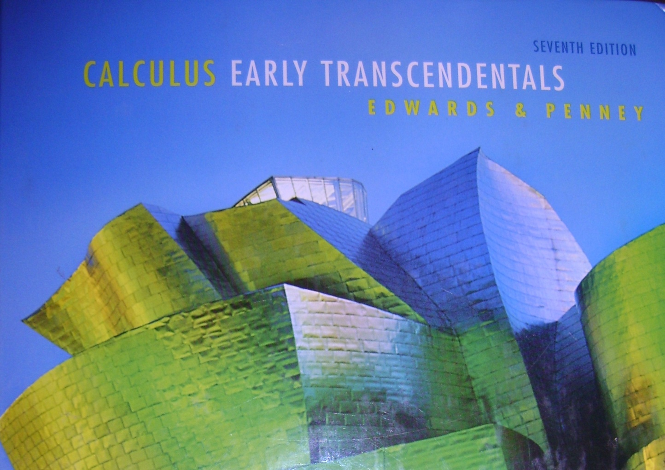
Section 8.2
Series

Slide 2
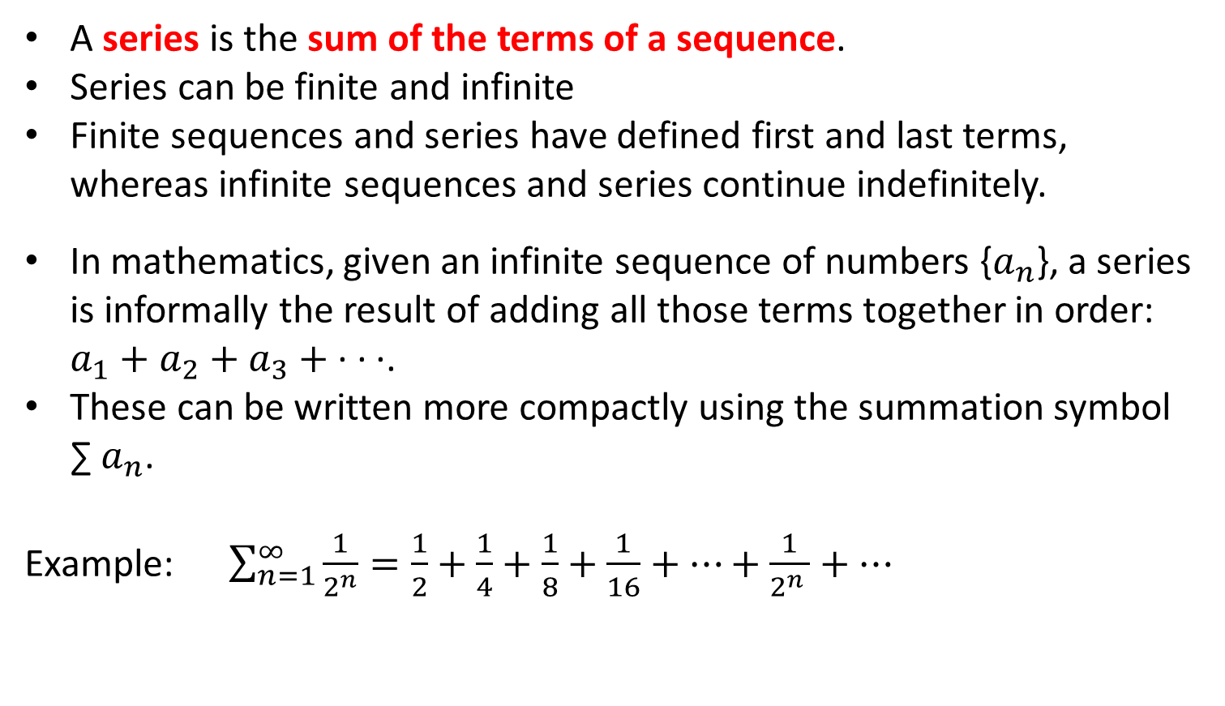
A series is the sum of the terms of a sequence.
Series can be finite and infinite
Finite sequences and series have defined first and last terms, whereas infinite sequences and series continue indefinitely.
In mathematics, given an infinite sequence of numbers {$a_{n}$}, a series is informally the result of adding all those terms together in order: $a_{1}+a_{2}+a_{3}+$· · ·.
These can be written more compactly using the summation symbol ∑${ a}_{n}$.
Example: $\sum_{n=1}^{∞}{\frac{1}{2^{n}}=\frac{1}{2}+\frac{1}{4}+\frac{1}{8}+\frac{1}{16}+…+\frac{1}{2^{n }}+…}$

Slide 3



Once upon a time there was a magic tree in a fairy forest.
The first year of its life, the magic tree grew to half a cubit.
During it’s second year, the tree grew an additional ¼ cubit.
$$\frac{1}{2}$$

Slide 4


Once upon a time there was a magic tree in a fairy forest.
The first year of its life, the magic tree grew to half a cubit.
During it’s second year, the tree grew an additional 1/4 cubit.
The next year it grew an additional 1/8 of a cubit.
$$\frac{3}{4}$$

Slide 5


Once upon a time there was a magic tree in a fairy forest.
The first year of its life, the magic tree grew to half a cubit.
During it’s second year, the tree grew an additional 1/4 cubit.
The next year it grew an additional 1/8 of a cubit.
Then 1/16 of a cubit…
$$\frac{7}{8}$$

Slide 6

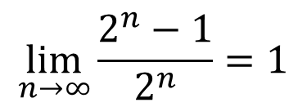

Once upon a time there was a magic tree in a fairy forest.
The first year of its life, the magic tree grew to half a cubit.
During it’s second year, the tree grew an additional 1/4 cubit.
The next year it grew an additional 1/8 of a cubit.
Then 1/16 of a cubit…
…and so on forever.
$$\frac{15}{16}$$
How tall will the tree get?
$$\lim_{n→∞}{\frac{2^{n}−1}{2^{n}}=1}$$
If it grows “forever”,
it will reach 1 cubit in height.

Slide 7


Once upon a time there was a magic tree in a fairy forest.
The first year of its life, the magic tree grew to half a cubit.
During it’s second year, the tree grew an additional 1/4 cubit.
The next year it grew an additional 1/8 of a cubit.
Then 1/16 of a cubit…
…and so on forever.
1 cubit
How tall will the tree get?
$$\lim_{n→∞}{\frac{2^{n}−1}{2^{n}}=1}$$
If it grows “forever”,
it will reach 1 cubit in height.

Slide 8

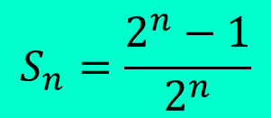
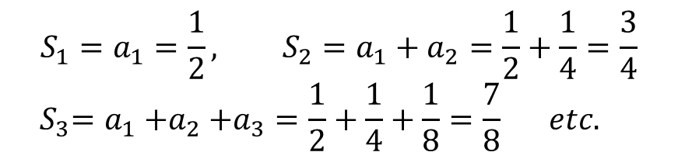
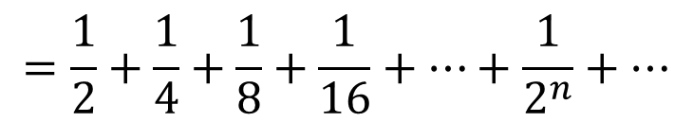
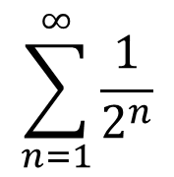
$$Same problem, but without the story…$$
$$\sum_{n=1}^{∞}{\frac{1}{2^{n}}}$$
$$=\frac{1}{2}+\frac{1}{4}+\frac{1}{8}+\frac{1}{16}+…+\frac{1}{2^{n}}+…$$
Partial Sums are denoted as follows:
$$S_{1}=a_{1}=\frac{1}{2}, S_{2}=a_{1}+a_{2}=\frac{1}{2}+\frac{1}{4}=\frac{3}{4}$$
$${ S}_{3}=a_{1}{+a}_{2}+a_{3}=\frac{1}{2}+\frac{1}{4}+\frac{1}{8}=\frac{7}{8} etc.$$
We must cleverly find a general expression for any partial sum.
$$S_{n}=\frac{2^{n}−1}{2^{n}}$$
The sum of the series is…
S =
$$\lim_{n→∞}{\frac{2^{n}−1}{2^{n}}=1}$$

Slide 9
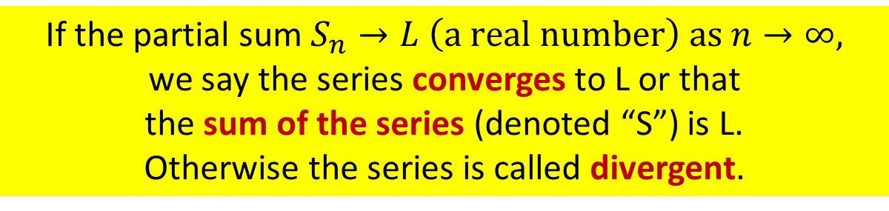
If the partial sum $S_{n}→L \left(a real number\right) as n→∞,$
we say the series converges to L or that
the sum of the series (denoted “S”) is L.
Otherwise the series is called divergent.

Slide 10

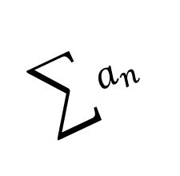
If the partial sum $S_{n}→L \left(a real number\right) as n→∞,$
we say the series converges to L or that
the sum of the series (denoted “S”) is L.
Otherwise the series is called divergent.
Student’s are serious about series!
$$\sum{a_{n}}$$
Diverge
NO!
Converge
NOW!

Slide 11
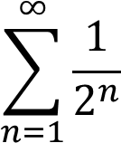
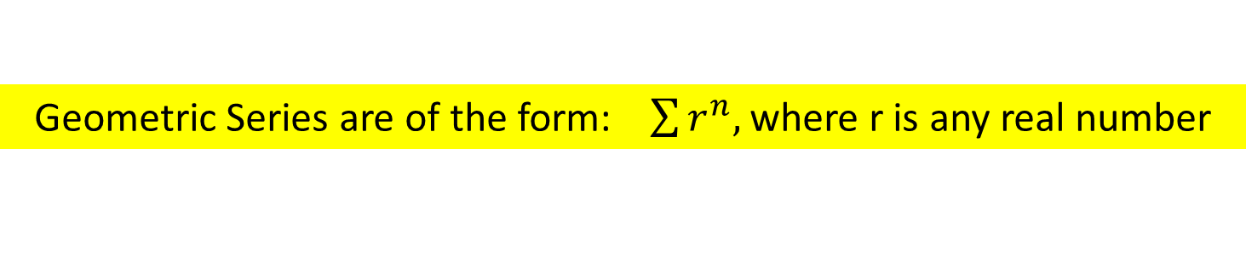
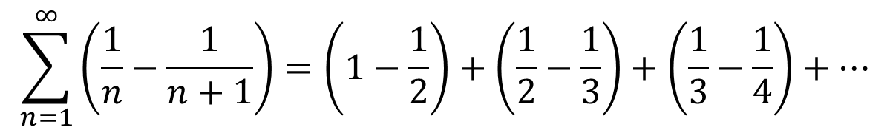
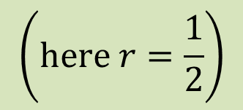
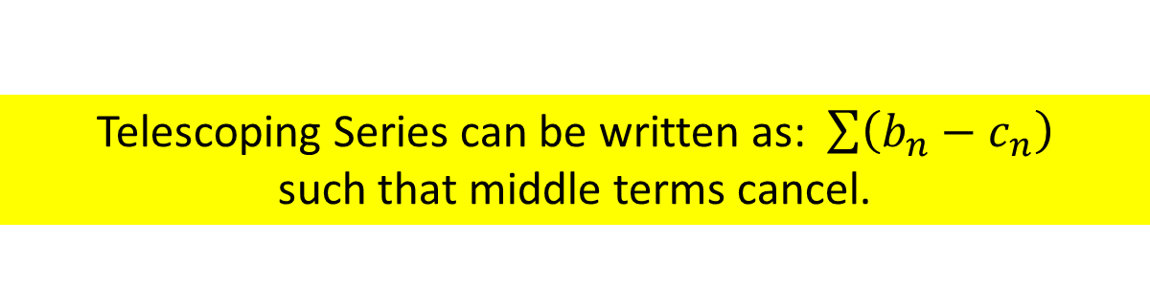

Special Series include: Geometric, Telescoping & Harmonic
Geometric Series are of the form: $\sum{r^{n}, }$where r is any real number
Example:
$$\left(here r=\frac{1}{2}\right)$$
Telescoping Series can be written as: $\sum{\left(b_{n}−c_{n}\right)}$
such that middle terms cancel.
Example:
$$\sum_{n=1}^{∞}{\left(\frac{1}{n}−\frac{1}{n+1}\right)=\left(1−\frac{1}{2}\right)+\left(\frac{1}{2}−\frac{1}{3}\right)+\left(\frac{1}{3}−\frac{1}{4}\right)+…}$$
The Harmonic Series is:
$$\sum{\frac{1}{n}}$$

Slide 12
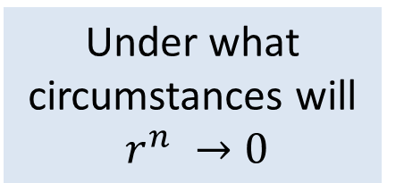

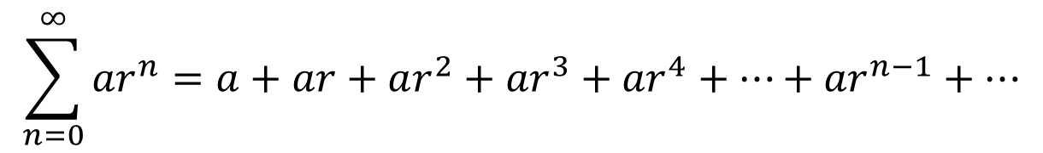

Let’s construct a formula for $S_{n}$for any Geometric Series.
$$\sum_{n=0}^{∞}{{ar}^{n}}=a+ar+ar^{2}+{ar}^{3}+{ar}^{4}+…+{ar}^{n−1}+…$$
$$S_{n}=a+ar+{ar}^{2}+{ar}^{3}+…+{ar}^{n−1}$$
(multiply both sides by r)
(now subtract)
$$(1−r{)S}_{n}=a−{ar}^{n}$$
If $−1<r<1, S_{n}→\frac{a}{1−r}$but if $\left|r\right|≥1$, the series diverges.
$$\sum_{n=0}^{∞}{\frac{3}{2^{n}}}=\frac{3}{1−\frac{1}{2}}=\frac{ 3}{ \frac{1}{2} }=6$$
Example:

Slide 13
-

Slide 14
So the general formula becomes:

Slide 15
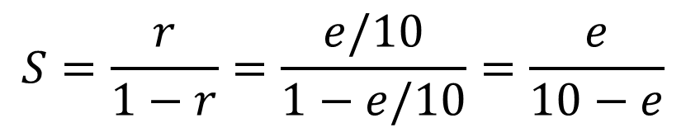
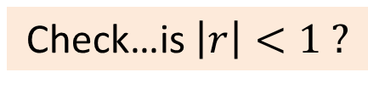
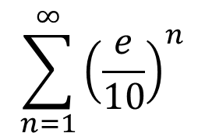
Ex: Find the sum for the following geometric series:
$$\sum_{n=1}^{∞}{{\left(\frac{e}{10}\right)}^{n}}$$
Check…is $\left|r\right|<1 ?$
Yes!

Slide 16
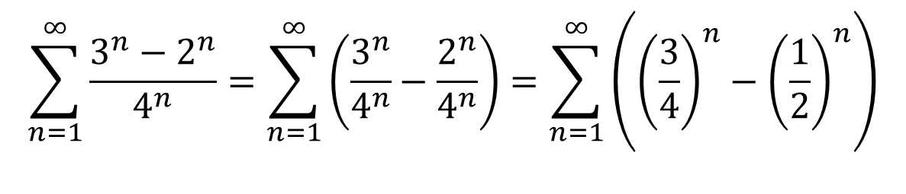
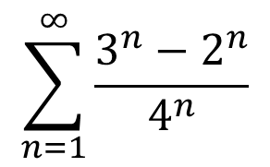

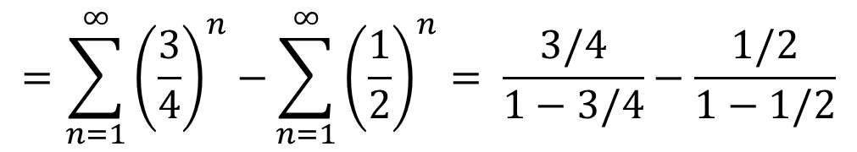
Ex:
Find the Sum
$$\sum_{n=1}^{∞}{\frac{3^{n}−2^{n}}{4^{n}}}$$
$$\sum_{n=1}^{∞}{\frac{3^{n}−2^{n}}{4^{n}}}=\sum_{n=1}^{∞}{\left(\frac{3^{n}}{4^{n}}−\frac{2^{n}}{4^{n}}\right)}=\sum_{n=1}^{∞}{\left({\left(\frac{3}{4}\right)}^{n}−{\left(\frac{1}{2}\right)}^{n}\right)}$$
The sum or difference of terms can be split into two separate series as long as each individual series converges.
$$=\sum_{n=1}^{∞}{{\left(\frac{3}{4}\right)}^{n}−}\sum_{n=1}^{∞}{{\left(\frac{1}{2}\right)}^{n}= \frac{3/4}{1−3/4}−\frac{1/2}{1−1/2}}$$
$$=3−1=2$$
The sum of this series is 2.

Slide 17
HW # p. 573 # 1-10, 17-20, 37, 39, 41, 42

Slide 18
The Telescoping Series

Slide 21
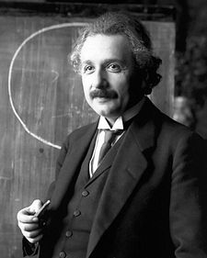

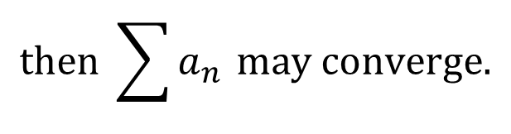

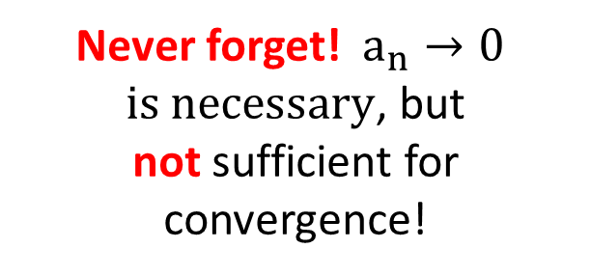
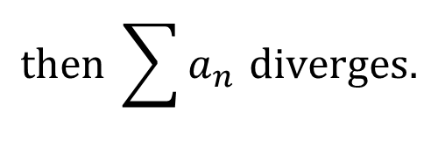
nth term test for divergence
$$If \lim_{n→∞}{a_{n}≠0}$$
$$then \sum{a_{n }diverges.}$$
nth term test for convergence
$$If \lim_{n→∞}{a_{n}=0}$$
$$then \sum{a_{n }may converge.}$$
Never forget!$a_{n}→0$
$is necessary$, but
not sufficient for convergence!

Slide 22
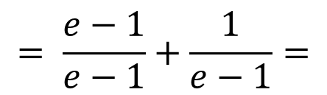
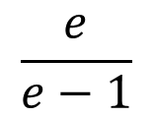
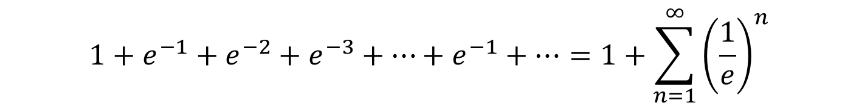
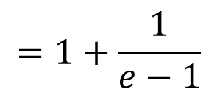
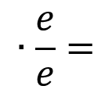

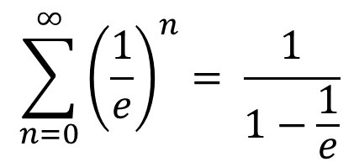
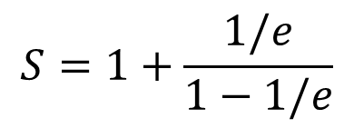
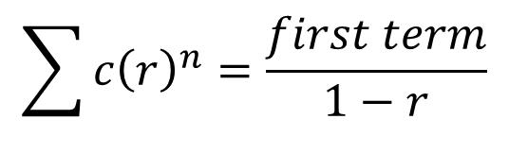
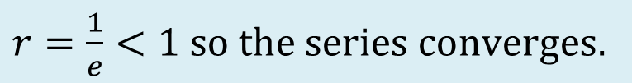
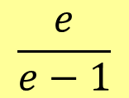
Example:
$$1+e^{−1}+e^{−2}+e^{−3}+…+e^{−n}+…$$
Can the series be written as a geometric series in standard form?
$$1+e^{−1}+e^{−2}+e^{−3}+…+e^{−1}+…=1+\sum_{n=1}^{∞}{{\left(\frac{1}{e}\right)}^{n}}$$
$$r=\frac{1}{e}<1 so the series converges.$$
$$S=1+\frac{1/e}{1−1/e}$$
$$∙\frac{e}{e}$$
$$=1+\frac{1}{e−1}$$
$$= \frac{e−1}{e−1}+\frac{1}{e−1}=$$
$$\frac{e}{e−1}$$
Short cut formula:
$$\sum{c{\left(r\right)}^{n}}=\frac{first term}{1−r}$$
$$\sum_{n=0}^{∞}{{\left(\frac{1}{e}\right)}^{n}= \frac{1}{1−\frac{1}{e}}}$$
$$∙\frac{e}{e}=$$
$$\frac{e}{e−1}$$
So this is much faster!

Slide 23




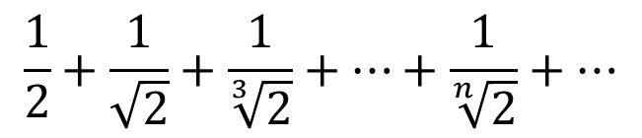





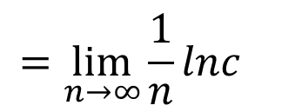
$$\frac{1}{2}+\frac{1}{\sqrt{2}}+\frac{1}{\sqrt[3]{2}}+…+\frac{1}{\sqrt[n]{2}}+…$$
Ex: #4
Is this a geometric series?
no
Telescoping?
no
Does $a_{n}→0$?
?
$$\lim_{n→∞}{\sqrt[n]{c}}= ?$$
$$=\lim_{n→∞}{c^{1/n}}$$
$$→\lim_{n→∞}{{lnc}^{1/n}}$$
$$=\lim_{n→∞}{{\frac{1}{n}lnc}^{}}$$
$$=0$$
The terms of this series go to 1 NOT 0, therefore it diverges
by the nth term test.
$$\lim_{n→∞}{\sqrt[n]{c}}=1$$
by the same method we can show:
$$\lim_{n→∞}{\sqrt[n]{n}}=1$$

Slide 24


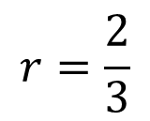
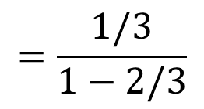
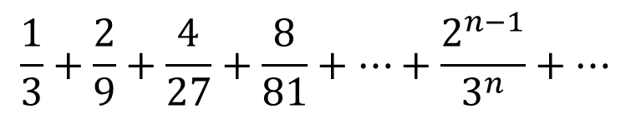
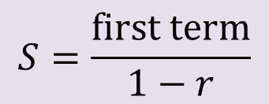
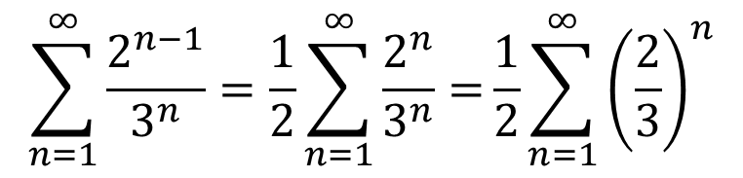
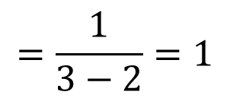
Example
$$\frac{1}{3}+\frac{2}{9}+\frac{4}{27}+\frac{8}{81}+…+\frac{2^{n−1}}{3^{n}}+…$$
$$r=\frac{2}{3}$$
Is this series geometric?
Yes!
$$\sum_{n=1}^{∞}{\frac{2^{n−1}}{3^{n}}=\frac{1}{2}\sum_{n=1}^{∞}{\frac{2^{n}}{3^{n}}=}\frac{1}{2}}\sum_{n=1}^{∞}{{\left(\frac{2}{3}\right)}^{n}}$$
$$S=\frac{first term}{1−r}$$
$$=\frac{1/3}{1−2/3}$$
$$∙\frac{3}{3}$$
$$=\frac{1}{3−2}=1$$
The sum of this infinite geometric series is 1.

Slide 25

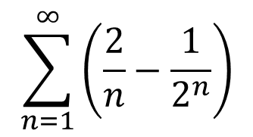

Example
$$\sum_{n=1}^{∞}{\left(\frac{2}{n}−\frac{1}{2^{n}}\right)}$$
Looks like our most famous geometric series
Looks like the Harmonic Series
However…
$$∞−1 is still ∞$$
This series diverges.

Slide 26

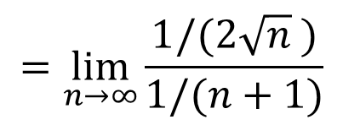


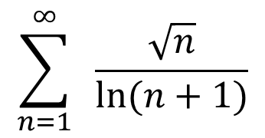






Example
$$\sum_{n=1}^{∞}{ \frac{\sqrt{n}}{ln⁡(n+1)}}$$
Let’s investigate the limit of the terms…
$$∞$$
$$\lim_{n→∞}{\frac{\sqrt{n}}{ln⁡(n+1)}}$$
$$=\lim_{n→∞}{\frac{1/(2\sqrt{n} )}{1/⁡(n+1)}}$$
$$=\lim_{n→∞}{\frac{(n+1)}{2\sqrt{n}}}$$
$$∞$$
$$=\lim_{n→∞}{\frac{\sqrt{n}}{2}}$$
$$=\lim_{n→∞}{\frac{n}{2\sqrt{n}}}$$
$$=∞$$
Since the terms of this series $→∞$NOT zero,
this series diverges by the nth term test.

Slide 27




Example
$$\sum_{n=0}^{∞}{{\left(\frac{99}{100}\right)}^{n}}$$
Ah ha! A simple geometric series!
We do the dance of joy!
$$r=\frac{99}{100}<1$$
$$S=\frac{first term}{1−r}=\frac{1}{1−\frac{99}{100}}=100$$
The sum of this convergent geometric series is 100.

Slide 28


Example
$$\sum_{n=0}^{∞}{\frac{1+2^{n}+5^{n}}{3^{n}}}$$
$$\sum_{n=0}^{∞}{\frac{1+2^{n}+5^{n}}{3^{n}}}=\sum_{n=0}^{∞}{\left(\frac{1}{3^{n}}+\frac{2^{n}}{3^{n}}+\frac{5^{n}}{3^{n}}\right) }$$
Divergent geometric series
Convergent geometric series
This series diverges.

Slide 29





Example
$$\sum_{n=1}^{∞}{\frac{2n}{\sqrt{4n^{2}+3}}}$$
Not geometric, sigh…
$$\lim_{n→∞}{\frac{2n}{\sqrt{4n^{2}+3}}}$$
$$=\lim_{n→∞}{\frac{2n}{\sqrt{4n^{2}}}}$$
$$=\lim_{n→∞}{\frac{2n}{2n}}$$
$$=1$$
This series diverges by the nth term test.

Slide 30
HW # p. 573 # 11-15, 21-25 odd, 33-36, 49-61 odd

Slide 31



Due to it’s unique qualities, the Harmonic Series
is useful when studying more complicated series.
$$\sum{\frac{1}{n}=1+\frac{1}{2}+\frac{1}{3}+\frac{1}{4}+…}$$
Do you think this series converges or diverges?
$$1+\frac{1}{2}+\frac{1}{3}+\frac{1}{4}+\frac{1}{5}+\frac{1}{6}+\frac{1}{7}+\frac{1}{8}+\frac{1}{9}+\frac{1}{10}+\frac{1}{11}+\frac{1}{12}+\frac{1}{13}+\frac{1}{14}+\frac{1}{15}+\frac{1}{16}+…≥$$
$$1+\frac{1}{2}+\frac{1}{4}+\frac{1}{4}+\frac{1}{8}+\frac{1}{8}+\frac{1}{8}+\frac{1}{8}+\frac{1}{16}+\frac{1}{16}+\frac{1}{16}+\frac{1}{16}+\frac{1}{16}+\frac{1}{16}+\frac{1}{16}+\frac{1}{16}+…$$
$$1+\frac{1}{2}+\frac{1}{4}+\frac{1}{4}+\frac{1}{8}+\frac{1}{8}+\frac{1}{8}+\frac{1}{8}+\frac{1}{16}+\frac{1}{16}+\frac{1}{16}+\frac{1}{16}+\frac{1}{16}+\frac{1}{16}+\frac{1}{16}+\frac{1}{16}+…$$
Continue this pattern, replacing twice as many terms each time.
$$=1+\frac{1}{2}+\frac{1}{2}+\frac{1}{2}+\frac{1}{2}+\frac{1}{2}+\frac{1}{2}+…$$
The Harmonic Series
is divergent.
$$=∞$$

Slide 32



Snow Scenarios
It snows a little more each day.
divergent
divergent
It snows the same small amount each day.
It snows less and less each day towards .01 inches per day.
divergent
It snows 1 inch the first day, ½ inch the second day, $1/{3 }$inch the third day, ¼ inch the fourth day and so on.
divergent
It snows ½ inch the first day, ¼ inch the second day, $1/8$ inch the third day, $1/{16}$ inch the fourth day and so on.
convergent
It snows some unspecified amount on the first day. Each proceeding day it snows less and less with these amounts approaching zero.
MIGHT be convergent – depends on how quickly $a_{n}→0$

