Slide 1
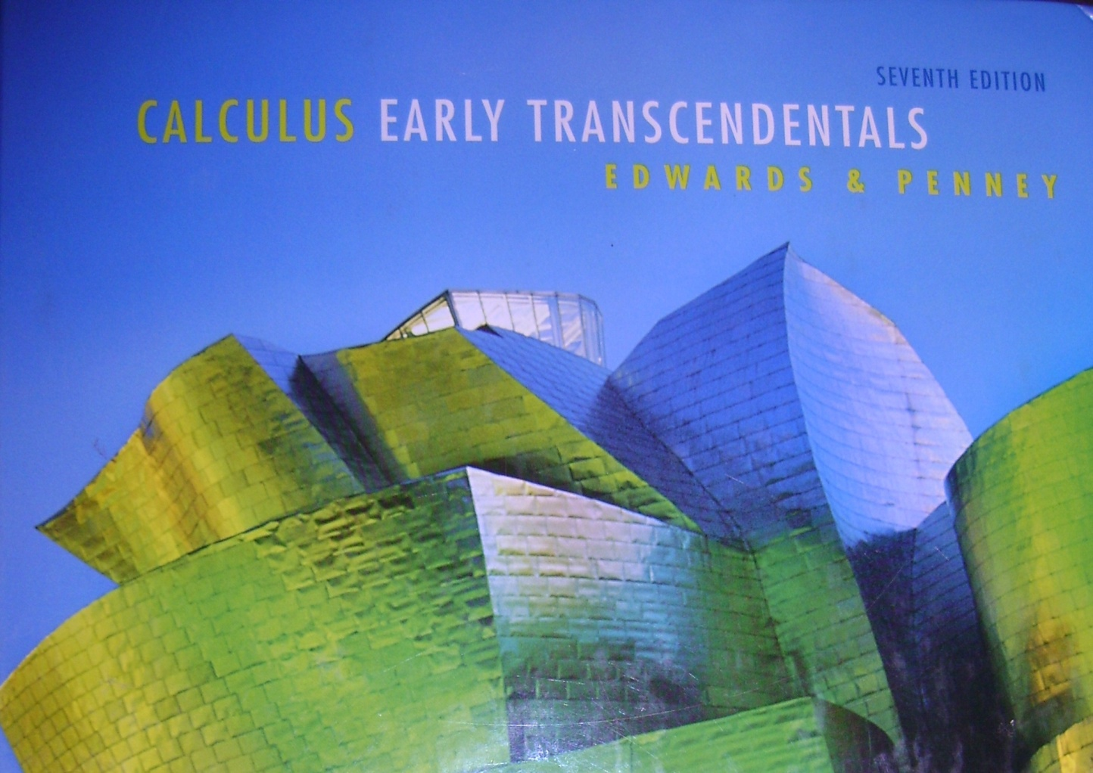
8.1 Day 2
Sequences

Slide 2
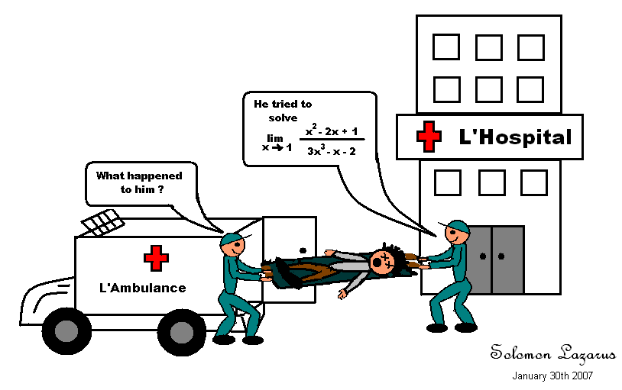
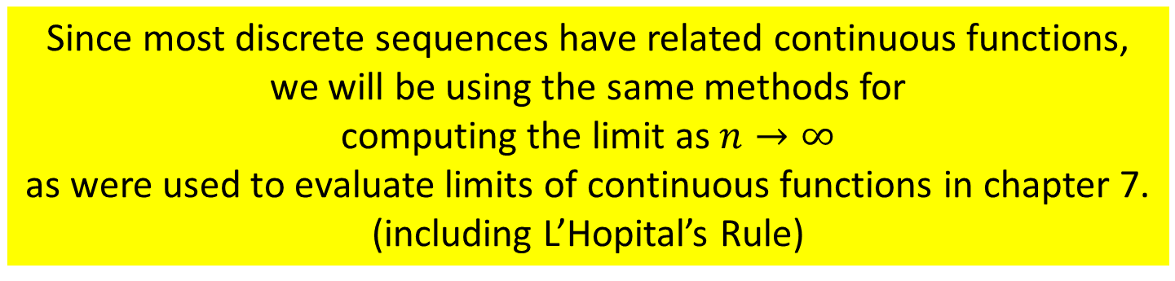
What interests us most is what happens to the terms as $n→∞$
Since most discrete sequences have related continuous functions, we will be using the same methods for
computing the limit as $n→∞$
as were used to evaluate limits of continuous functions in chapter 7.
(including L’Hopital’s Rule)

Slide 3


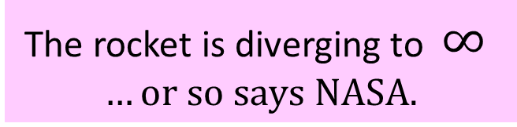
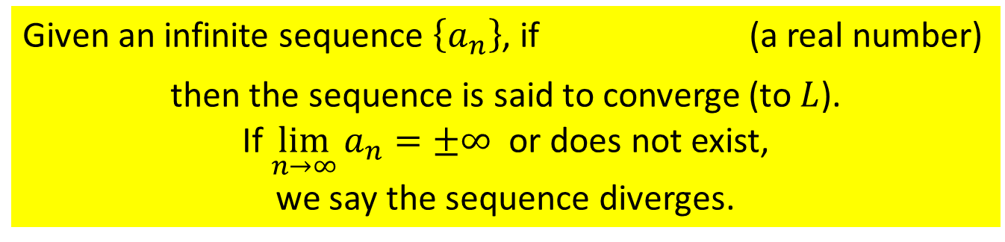
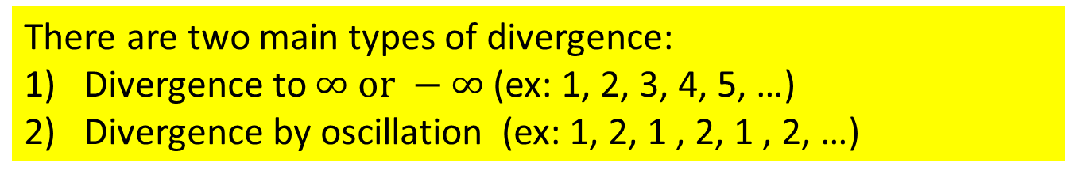
Given an infinite sequence $\left\{a_{n}\right\}$, if (a real number)
then the sequence is said to converge (to $L$).
If $\lim_{n→∞}{a_{n}=±∞ }$ or does not exist,
we say the sequence diverges.
$$\lim_{n→∞}{a_{n}=L }$$
There are two main types of divergence:
Divergence to $∞ or −∞$(ex: 1, 2, 3, 4, 5, …)
Divergence by oscillation (ex: 1, 2, 1 , 2, 1 , 2, …)
Some oscillating sequences never settle down to approach a single number.
The rocket is diverging to $∞$
$$…or so says NASA.$$
The car converged to the tree.

Slide 4
Finding the limit of a sequence
Does converge?
The sequence converges and its limit is 2.

Slide 5

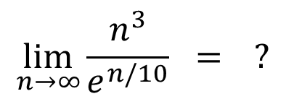
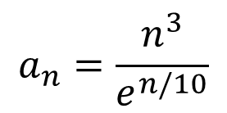


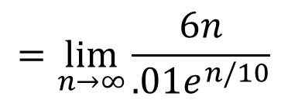
$$a_{n}=\frac{n^{3}}{e^{n/10}}$$
Finding the limit of a sequence
Use L’Hopital’s Rule
$$∞$$
$$∞$$
$$\lim_{n→∞}{\frac{n^{3}}{e^{n/10}} = ?}$$
$$\lim_{n→∞}{\frac{{3n}^{2}}{{.1e}^{n/10}} }$$
L’Hopital again…
$$∞$$
$$∞$$
$$=\lim_{n→∞}{\frac{6n}{{.01e}^{n/10}} }$$
One more time!
$$=\lim_{n→∞}{\frac{6}{{.001e}^{n/10}} }$$
$$=0$$
This sequence converges to zero.

Slide 6
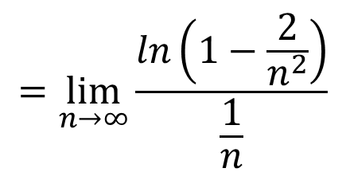
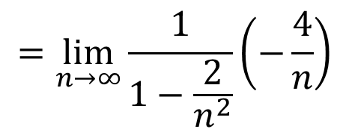
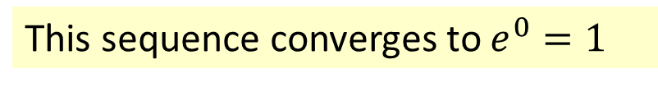
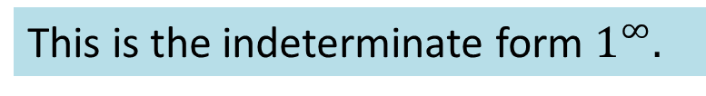
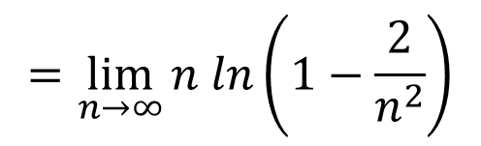
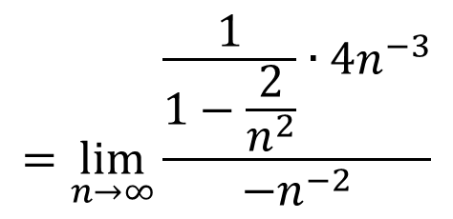

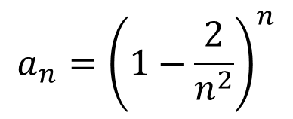
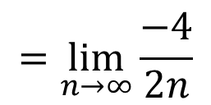
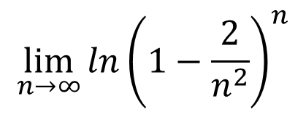
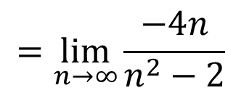


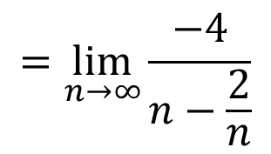
Finding the limit of a sequence
$$a_{n}={\left(1−\frac{2}{n^{2}}\right)}^{n}$$
This is the indeterminate form $1^{∞}.$
$$=\lim_{n→∞}{\frac{ln\left(1−\frac{2}{n^{2}}\right)}{\frac{1}{n}}}$$
$$0$$
$$\lim_{n→∞}{ln}{\left(1−\frac{2}{n^{2}}\right)}^{n}$$
$$=\lim_{n→∞}{n ln}\left(1−\frac{2}{n^{2}}\right)$$
$$=\lim_{n→∞}{\frac{\frac{1}{1−\frac{2}{n^{2}}}∙4n^{−3}}{−n^{−2}}}$$
$$0$$
$$=\lim_{n→∞}{\frac{1}{1−\frac{2}{n^{2}}}\left(−\frac{4}{n}\right)}$$
$$=\lim_{n→∞}{\frac{−4}{n−\frac{2}{n}}}$$
$$=\lim_{n→∞}{\frac{−4n}{n^{2}−2}}$$
$$=\lim_{n→∞}{\frac{−4}{2n}}$$
$$=0$$
Don’t forget to anti-
This sequence converges to $e^{0}=1$

Slide 7
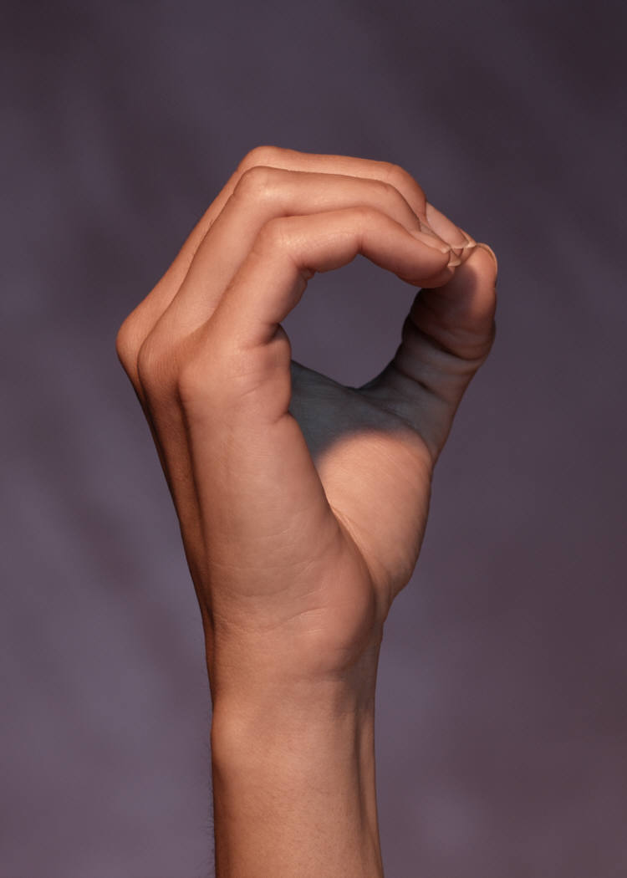
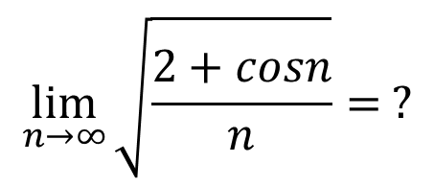
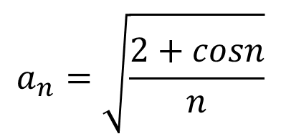
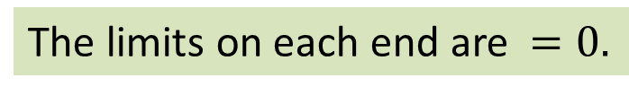
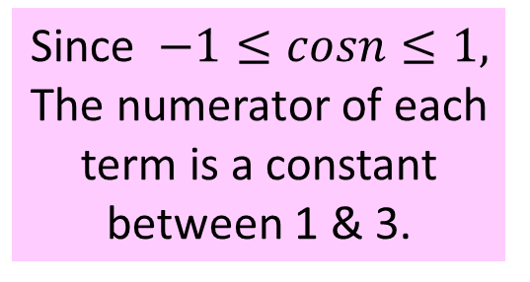
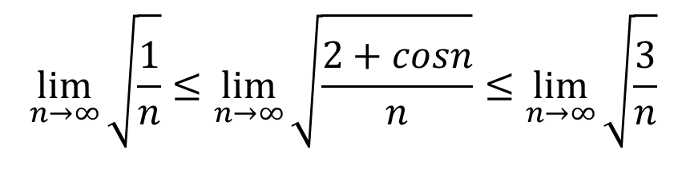
Find the Limit given:
$$a_{n}=\sqrt{\frac{2+cosn}{n}}$$
We will use the
Squeeze Theorem!
Since $−1≤cosn≤1,$
The numerator of each term is a constant between 1 & 3.
$$\lim_{n→∞}{\sqrt{\frac{2+cosn}{n}}}= ?$$
$$\lim_{n→∞}{\sqrt{\frac{1}{n}}}≤\lim_{n→∞}{\sqrt{\frac{2+cosn}{n}}}≤\lim_{n→∞}{\sqrt{\frac{3}{n}}}$$
The limits on each end are $=0.$
Final answer: this sequence converges to zero
by the Squeeze Theorem.

Slide 8
Absolute Value Theorem for Sequences
If the absolute values of the terms of a sequence converge to zero, then the sequence converges to zero.
π

Slide 9
p. 564 #'s 37-65 odd, 75-85 odd, 113-116

Slide 10
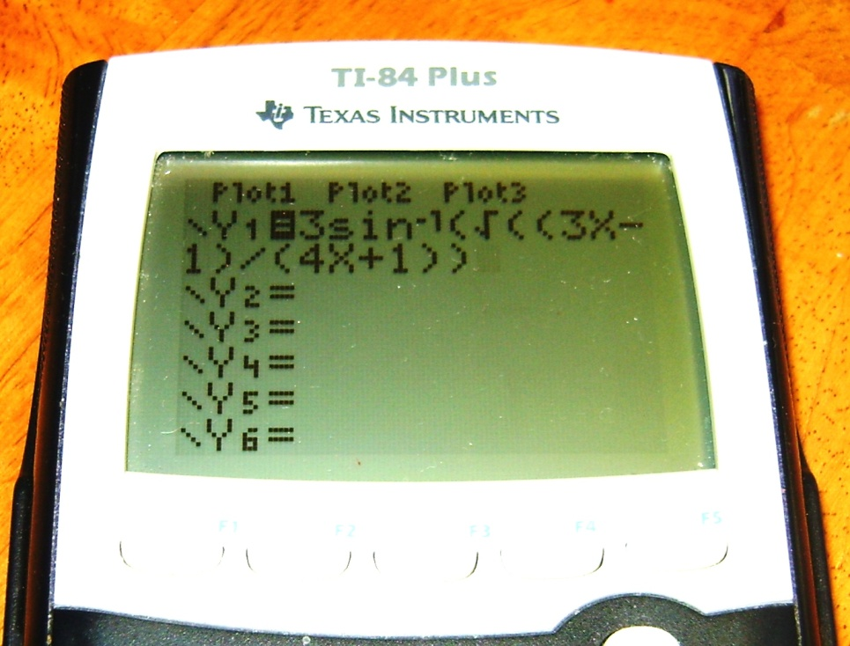
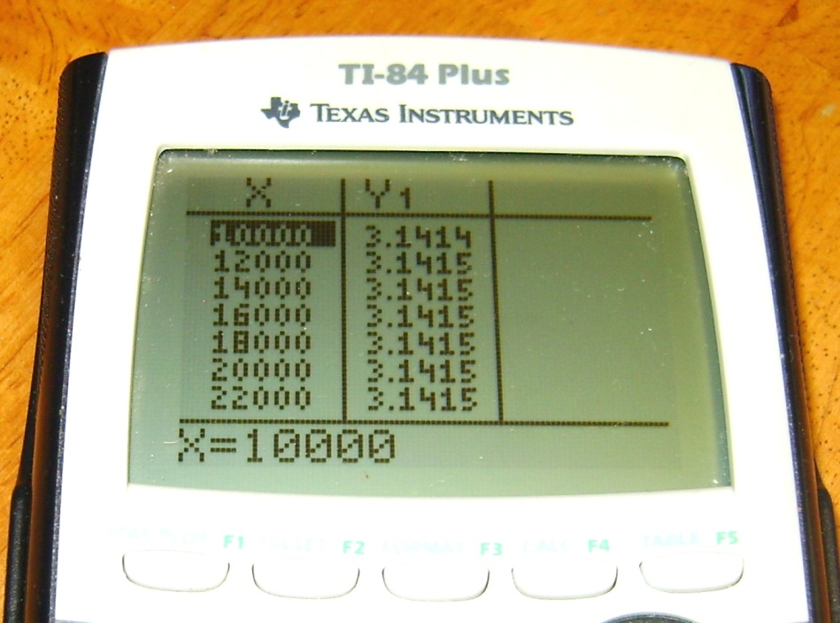
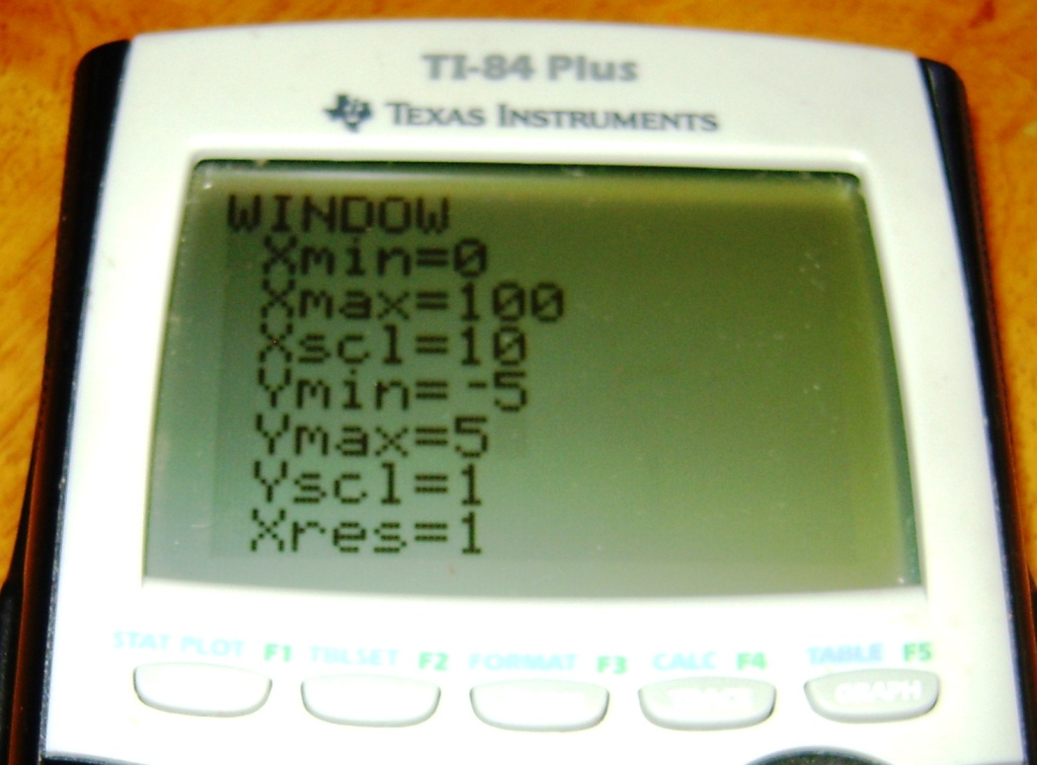
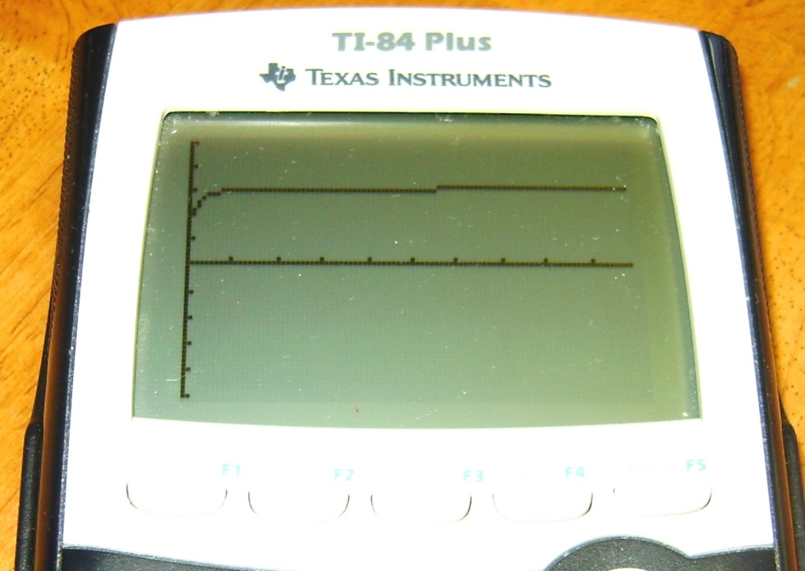

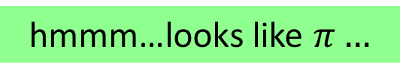
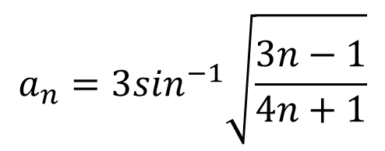
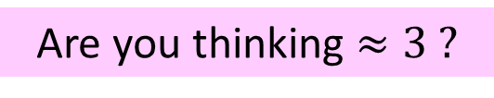
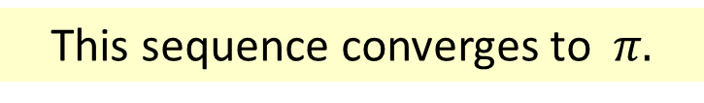
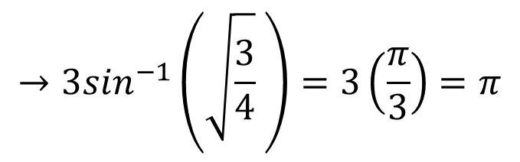
Warm-up Find the Limit
$$a_{n}=3\sin^{−1}\sqrt{\frac{3n−1}{4n+1}}$$
$$→3\sin^{−1}\left(\sqrt{\frac{3}{4}} \right)=3\left(\frac{π}{3}\right)=π$$
hmmm…looks like $π…$
This sequence converges to $π.$
Are you thinking $≈3 ?$

