Slide 1
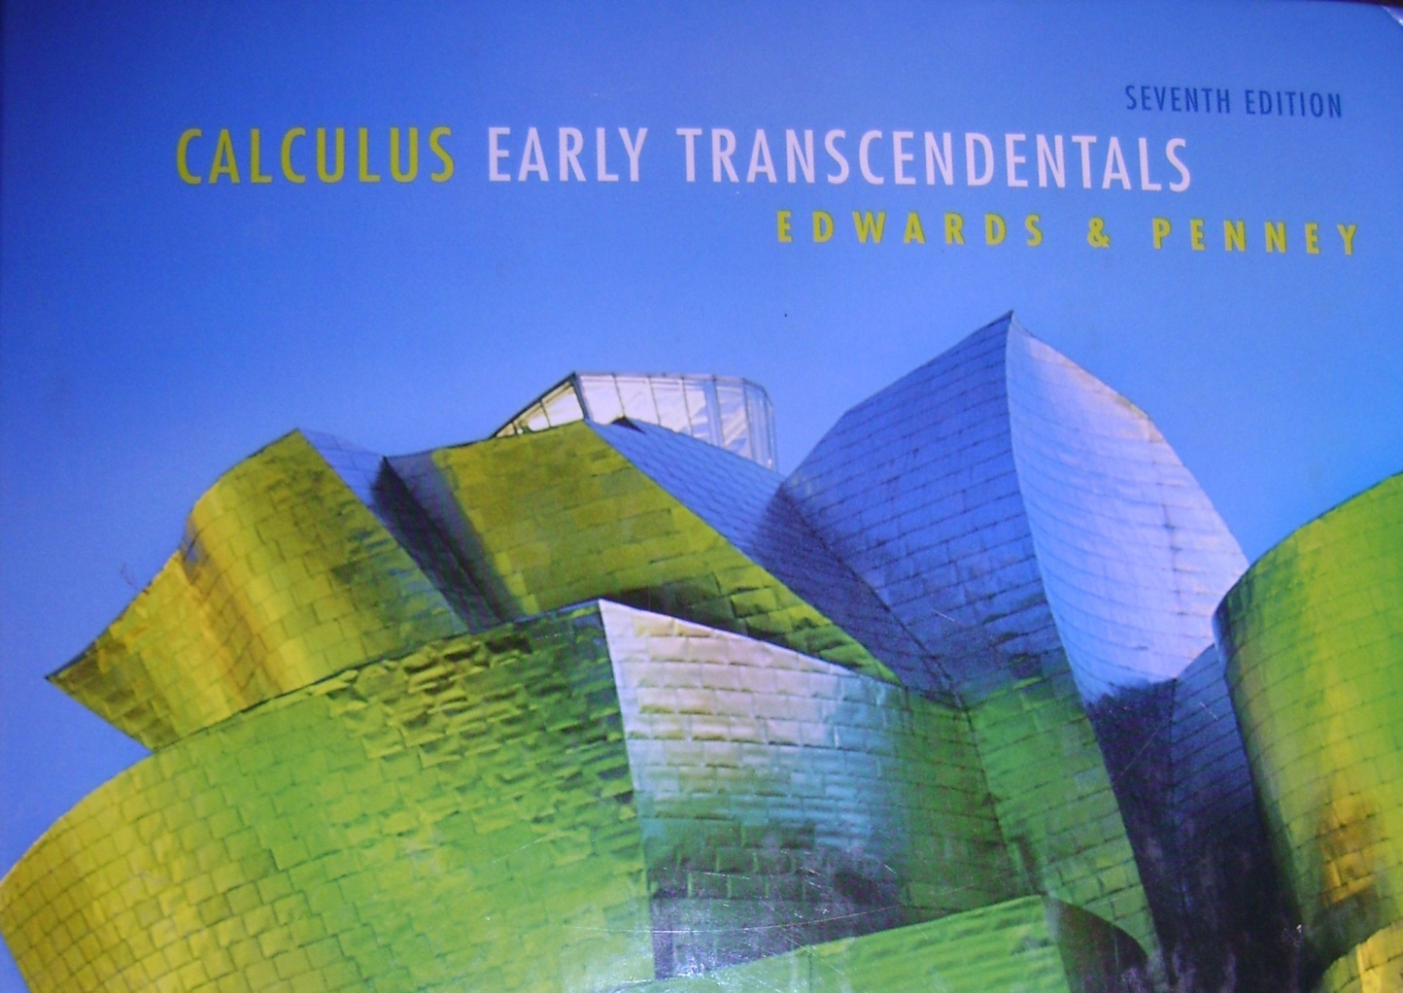
8.1
Sequences

Slide 2
In mathematics, a sequence is an ordered list of objects (or events). Like a set, it contains members (also called elements or terms). Unlike a set, order matters, and exactly the same elements can appear multiple times at different positions in the sequence. A sequence is a discrete function.
In this course we will only be interested in infinite sequences with a rule for generating the terms (range values)
and using the set of whole numbers
or counting numbers as the domain.

Slide 3
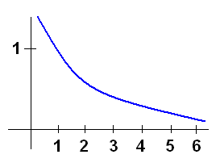
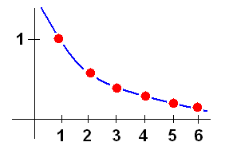
Don’t let the new notation confuse you…
$$f(x)$$
$$→a(x)$$
$$→a(n)$$
$${→a}_{n}$$
$$f\left(x\right)=\frac{1}{x}$$
$$→a_{n}=\frac{1}{n}$$
$$f\left(x\right)is continuous$$
$$a_{n} is discrete$$
$$∞$$
1
or simply just $\left\{a_{n}\right\}$
Other notation:
$$\left\{a_{n}\right\}$$
expanded form: $a_{1},a_{2},a_{3},…a_{n},$…
nth term
In our example: $\left\{\frac{1}{n}\right\}=1,\frac{1}{2},\frac{1}{3},\frac{1}{4},…,\frac{1}{n}, …$

Slide 4
A sequence is defined explicitly if there is a formula that allows you to find individual terms independently.
Example:
To find the 100th term, plug 100 in for n:

Slide 5
A sequence is defined recursively if there is a formula that relates a_{n} to previous terms.
Example:
We find each term by looking at the term or terms before it:
You have to keep going this way until you get the term you need.

Slide 6
An arithmetic sequence has a common difference between terms.
Example:
Arithmetic sequences can be defined recursively:
or explicitly:

Slide 7
An geometric sequence has a common ratio between terms.
Example:
Geometric sequences can be defined recursively:
or explicitly:

Slide 8
Example:
If the second term of a geometric sequence is 6 and the fifth term is -48, find an explicit rule for the nth term.

Slide 9
Find the formula for the given sequence: 1, $−\frac{1}{2},\frac{1}{4}, −\frac{1}{8},…$
Step 1: line up the most reasonable domain #’s.
0 1 2 3 …
$$\frac{1}{?}$$
The numerators are all 1’s.
The denominators are
all powers of “2”.
$$\frac{1}{2^{n}}$$
We need the “universal alternator” ${(−1)}^{n}$
Final answer: $a_{n}=\frac{{(−1)}^{n}}{2^{n}}$
$$a_{n}=\frac{{(−1)}^{n+1}}{2^{n−1}}$$
If we started with n=1…

Slide 10
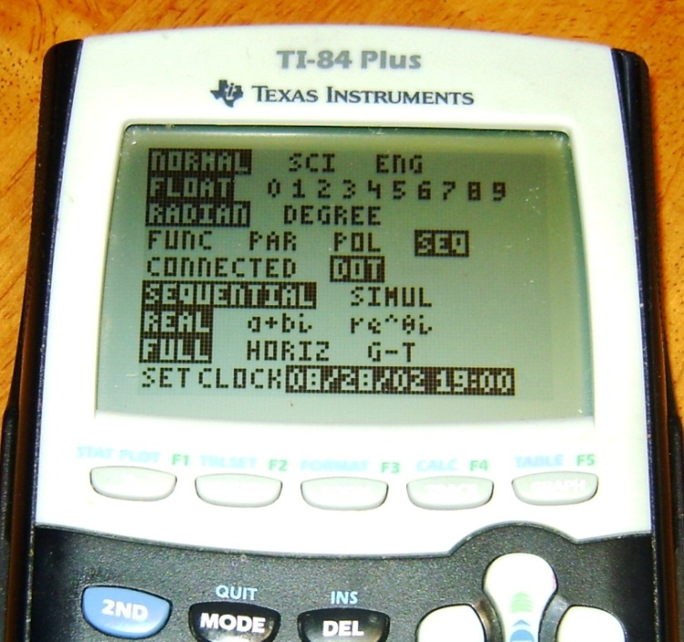
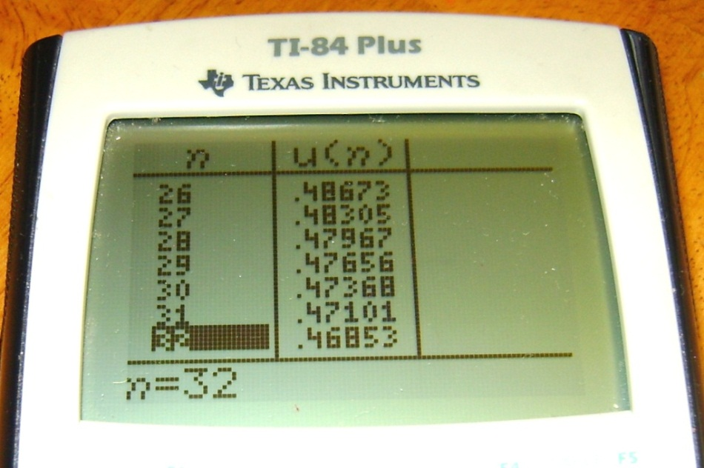
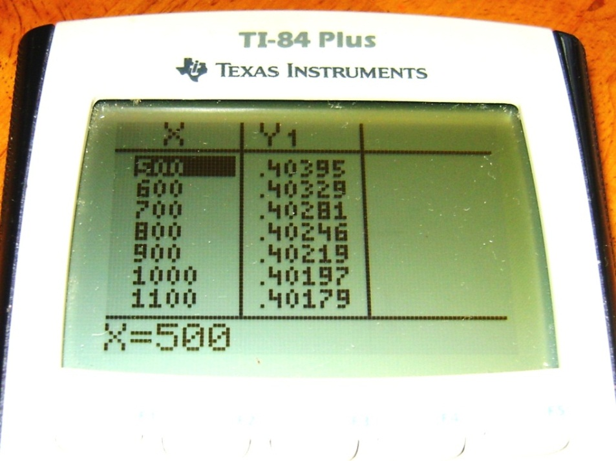
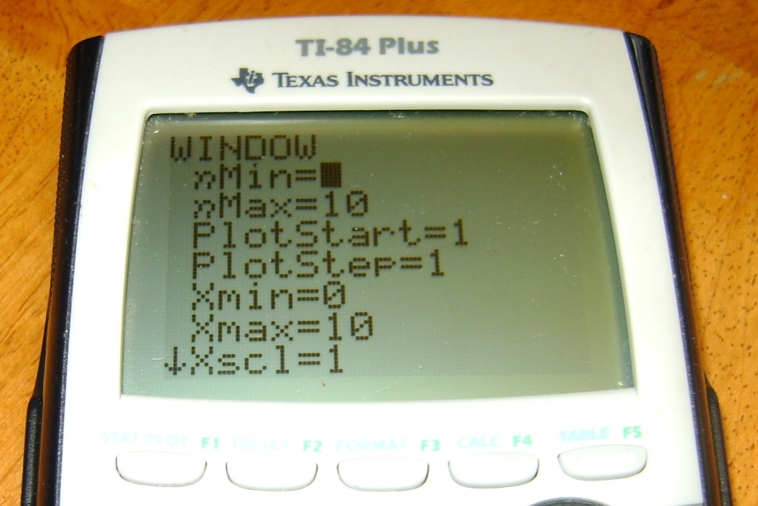
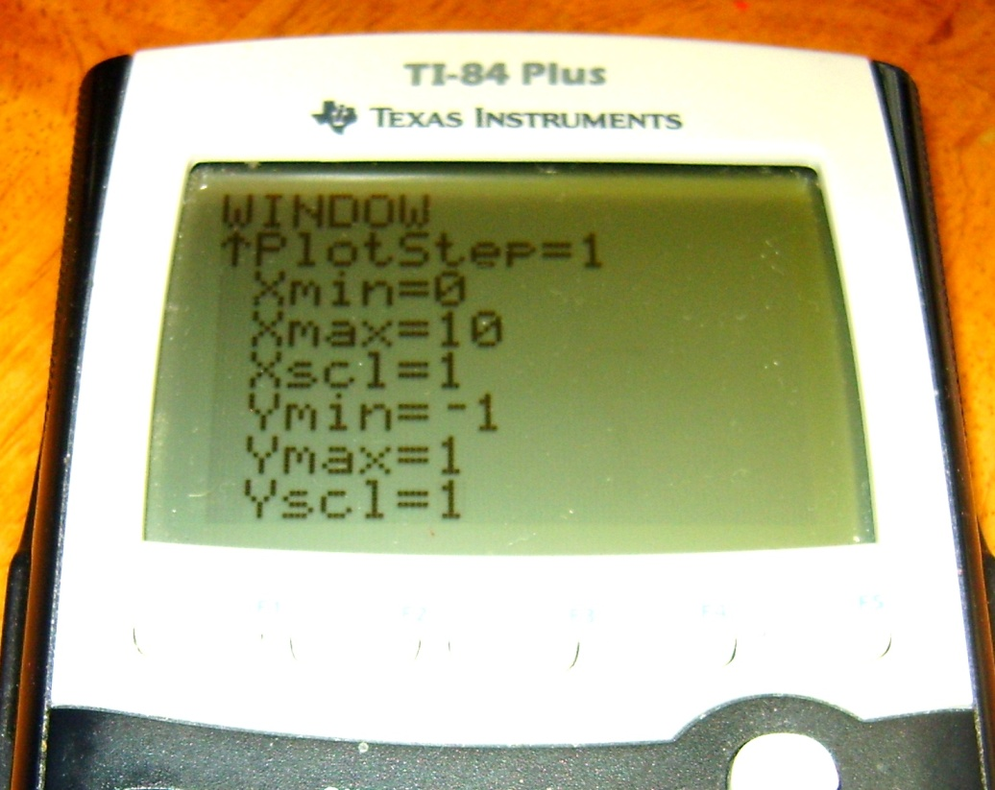
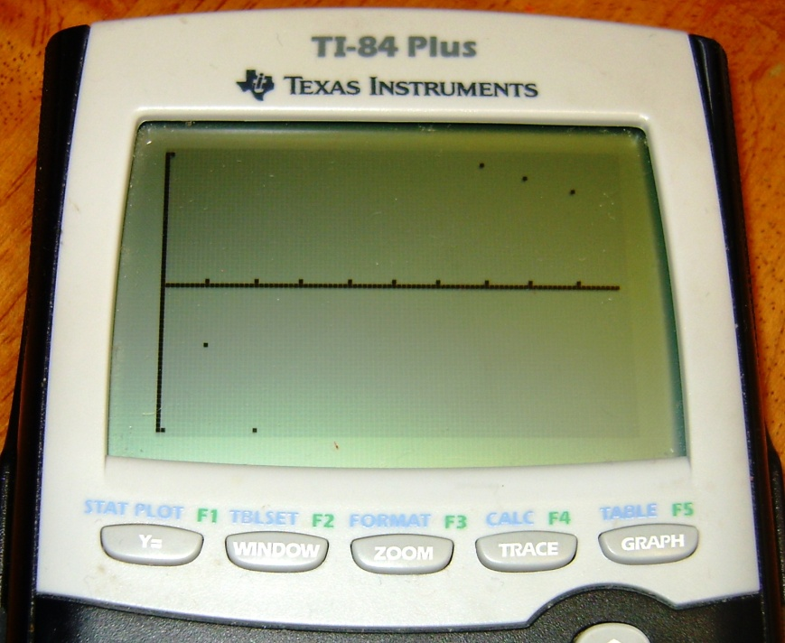
Using your Calculator
$$a_{n}=\frac{2n+3}{5n−17}$$
$$\frac{2}{5}$$
Verify that as n gets larger, the sequence approaches
Sequence mode is way too slow at creating tables…so let’s switch back to function mode!

Slide 11
Other Review

Slide 12
HW p. 564 #’s 7-35 odd, 67-79 odd

