Slide 1
6.5
Work and Pumping Liquids

Slide 2
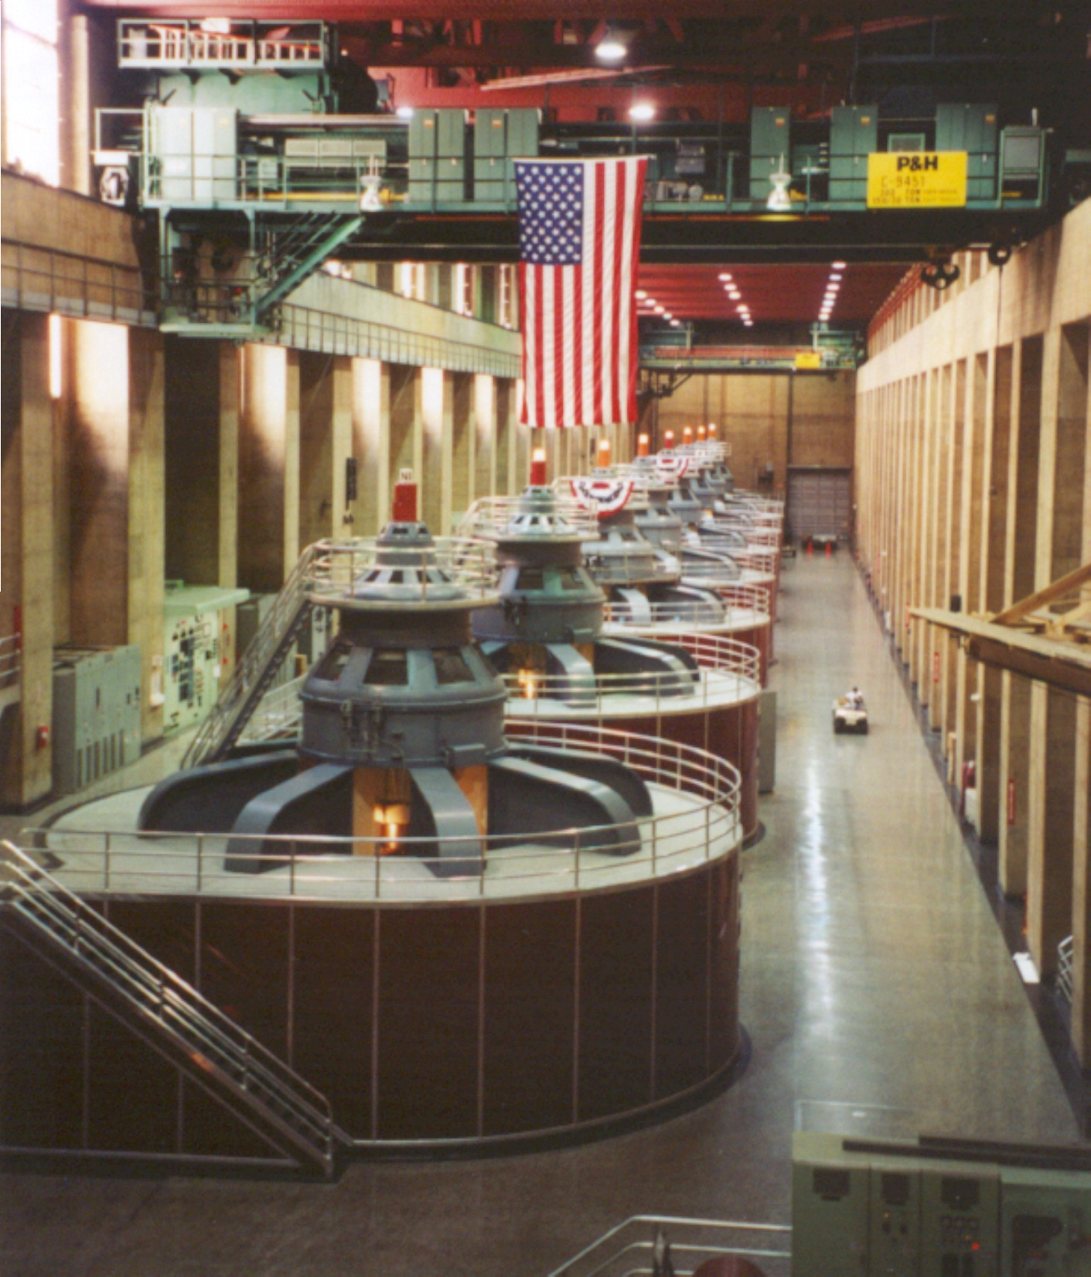
Hoover Dam Powerhouse
Nevada & Arizona
Greg Kelly, Hanford High School, Richland, Washington

Slide 3
Work

Slide 4
Work Done by a Constant Force

Slide 5
Example

Slide 6
Work Done by a Variable Force
Over a very short distance, even a non-constant force doesn’t change much, so work becomes:
If we add up all these small bits of work we get:

Slide 7
Example: Compressing a Spring
A spring has a natural length of 1 m.
A force of 24 N stretches the spring to 1.8 m.
Find the force equation of the spring.
a Find k:
Review: Hooke’s Law:
b
How much work would be needed to stretch the spring 3m beyond its natural length?

Slide 8
I want to pump the water out of this tank. How much work is done if a full tank of water, 62.5 lbs per cubic foot, is pumped to the ground level?
5 ft
4 ft
10 ft
The force is the weight of the water. The water at the bottom of the tank must be moved further than the water at the top.
4 ft
0
10 ft
dy
10
5 ft

Slide 9
I want to pump the water out of this tank. How much work is done?
5 ft
4 ft
10 ft
distance
force
4 ft
0
10 ft
dy
10
5 ft

Slide 10
HW : p. 456 #’s 1-8, 9-17 odd, 21, 23

Slide 11
I want to pump the water out of this tank. How much work is done?
5 ft
4 ft
10 ft
distance
force
4 ft
0
A 1 horsepower pump, rated at 550 ft-lb/sec, could empty the tank in just under 14 minutes!
10 ft
dx
10
5 ft

Slide 12
10 ft
A conical tank is filled to within 2 ft of the top with salad oil weighing 57 lb/ft³.
2 ft
How much work is required to pump the oil to the rim?
10 ft
Consider one slice (slab) first:

Slide 13
10 ft
A conical tank if filled to within 2 ft of the top with salad oil weighing 57 lb/ft³.
2 ft
How much work is required to pump the oil to the rim?
10 ft

Slide 14
10 ft
A conical tank if filled to within 2 ft of the top with salad oil weighing 57 lb/ft³.
2 ft
How much work is required to pump the oil to the rim?
10 ft
π

