Slide 1
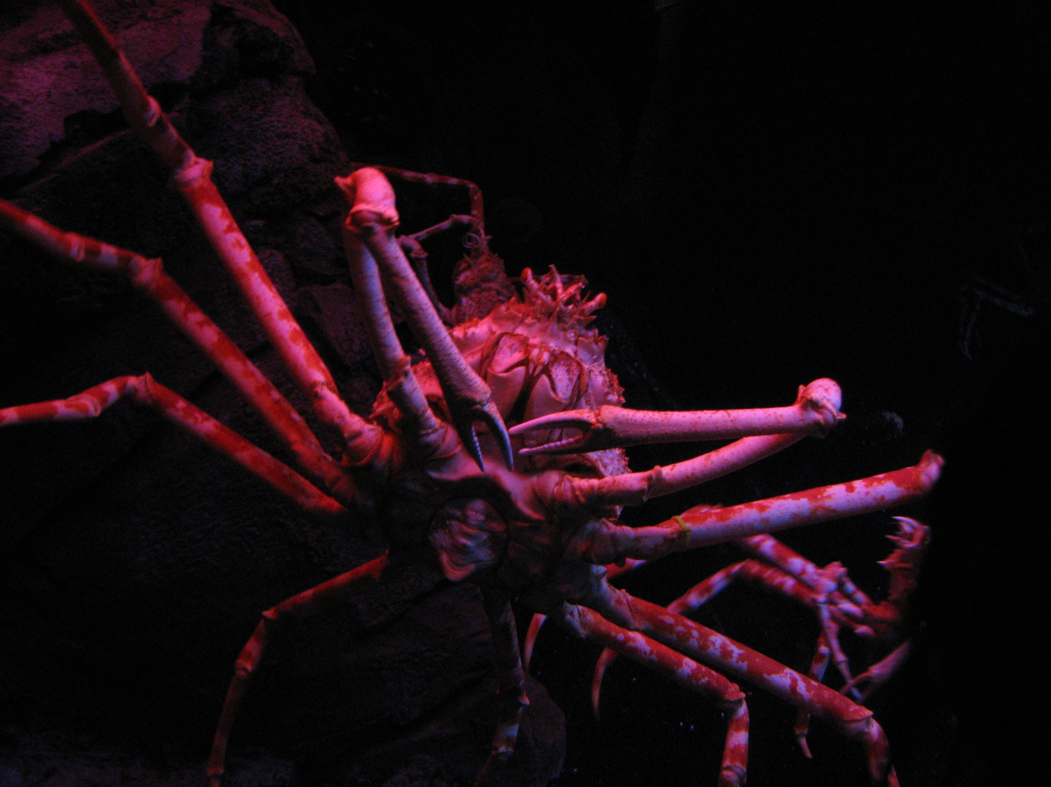
7.3
The Shell Method
Grows to over 12 feet wide
and lives 100 years.
Japanese Spider Crab
Georgia Aquarium, Atlanta
Notes:
LIMERICK GENERATING STATION
Limerick Generating Station, located in Limerick Township, Montgomery County, PA, is a two-unit nuclear generation facility capable of producing enough electricity for over 1 million homes. The plant site is punctuated by two natural-draft hyperbolic cooling towers, each 507 feet tall, which help cool the plant.
Limerick's two boiling water reactors, designed by General Electric, are each capable of producing 1,143 net megawatts. Unit 1 began commercial operation in February 1986, with Unit 2 going on-line in January 1990.

Slide 2
Find the volume of the region bounded by , , and revolved about the y-axis.
We can use the washer method if we split it into two parts:
inner
radius
cylinder
outer
radius
thickness
of slice
Japanese Spider Crab
Georgia Aquarium, Atlanta

Slide 3
Here is another way we could approach this problem:
cross section
If we take a vertical slice
and revolve it about the y-axis
we get a cylinder.
If we add all of the cylinders together, we can reconstruct the original object.

Slide 4
cross section
The volume of a thin, hollow cylinder is given by:
r is the x value of the function.
h is the y value of the function.
thickness is dx.

Slide 5
This is called the shell method because we use cylindrical shells.
cross section
If we add all the cylinders from the smallest to the largest:

Slide 6
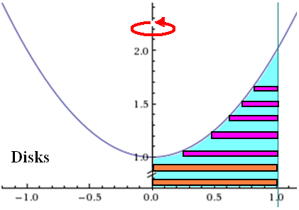
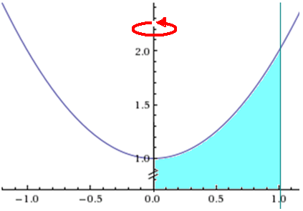
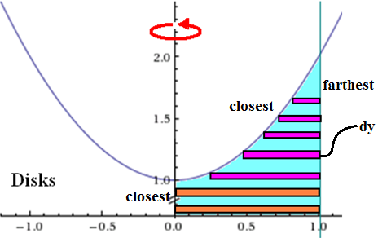
Chapter 6.3
The Shell Method
Use the disk and shell methods to setup and evaluate the volume of the solid formed by
rotating the given region around the y-axis.
Perpendiscular

Slide 7
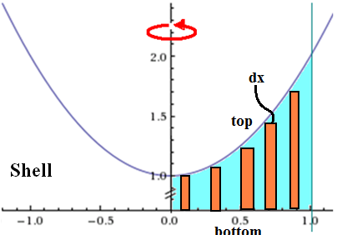
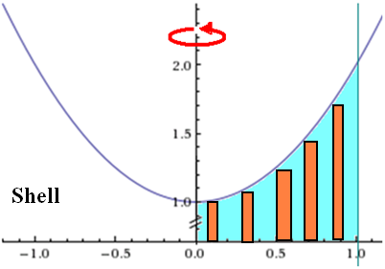
Chapter 6.3
The Shell Method
Use the disk and shell methods to setup and evaluate the volume of the solid formed by
rotating the given region around the y-axis.
Parashell

Slide 8
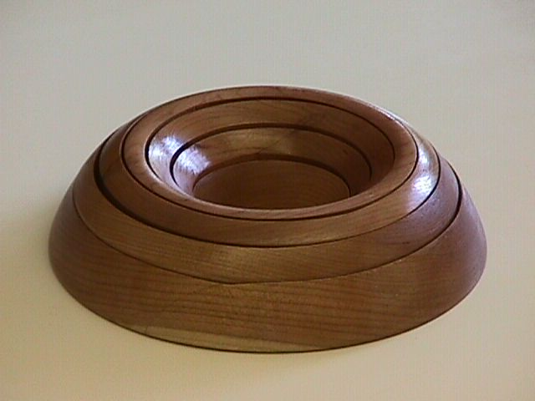
Find the volume generated when this shape is revolved about the y axis.
We can’t solve for x, so we can’t use a horizontal slice directly.

Slide 9
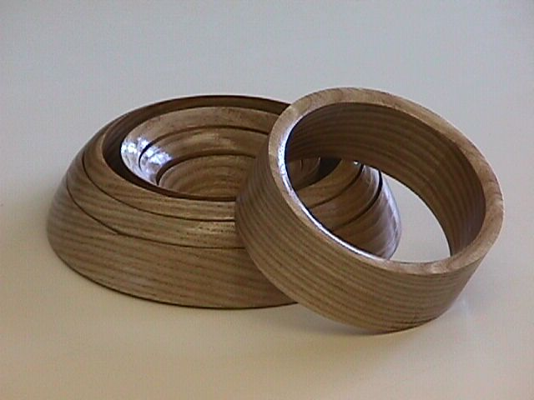
If we take a vertical slice
and revolve it about the y-axis
we get a cylinder.
Shell method:
Notes:
This model of the shell method and other calculus models are available from: Foster Manufacturing Company, 1504 Armstrong Drive, Plano, Texas 75074-6027 Phone/FAX: (972) 424-3644 http://home.flash.net/~fmco

Slide 10
Note:
When entering this into the calculator, be sure to enter the multiplication symbol before the parenthesis.

Slide 11
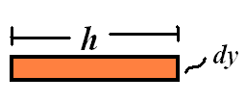
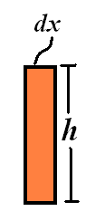
Chapter 6.2
Solids of Revolution

Slide 12
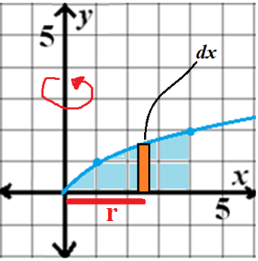
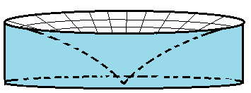
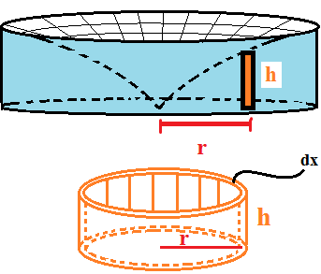
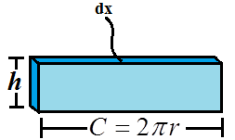
Chapter 6.3
The Shell Method
Set up but do not evaluate the integrals that give the volume of the solid formed by revolving the region about the y-axis using shell method.

Slide 13
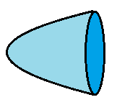
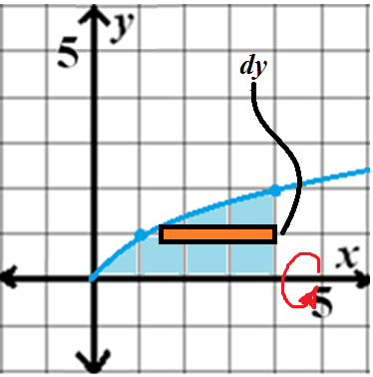
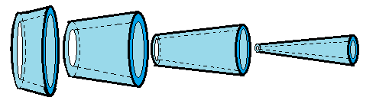
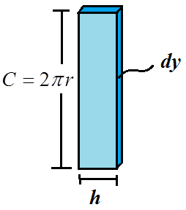
Chapter 6.3
The Shell Method
Set up but do not evaluate the integrals that give the volume of the solid formed by revolving the region about the x-axis using the shell method.

Slide 14
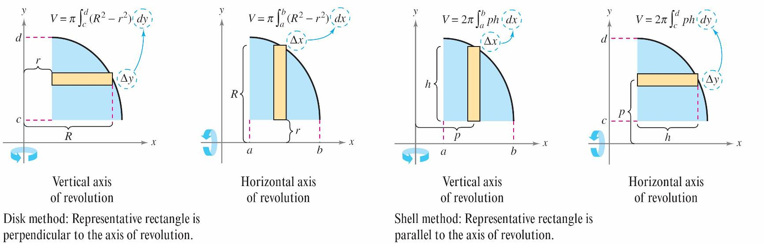
When the strip is parallel to the axis of rotation, use the shell method.
When the strip is perpendicular to the axis of rotation, use the washer method.
π

Slide 15
HW: p. 437 # 1-9 odd, 13-17 odd, 21

