Slide 1
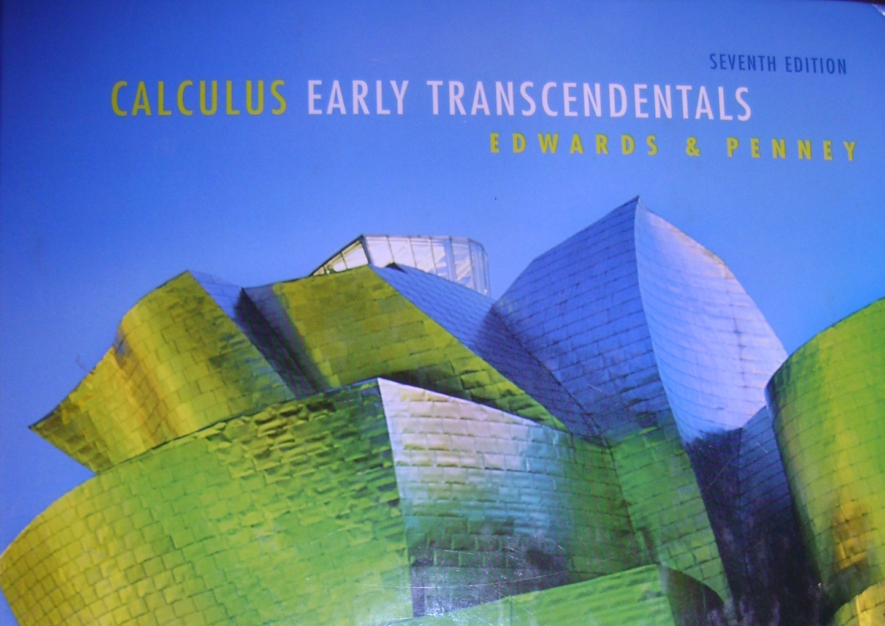
.
Slope Fields
After Section 5.7

Slide 2
In mathematics, a slope field (or direction field) is a graphical representation of the solutions of a first-order differential equation.
In other words, it is a graphical representation of the slope of a differential equation many different points.
Differential equations play a prominent role in engineering, physics, economics, and other disciplines.

Slide 3
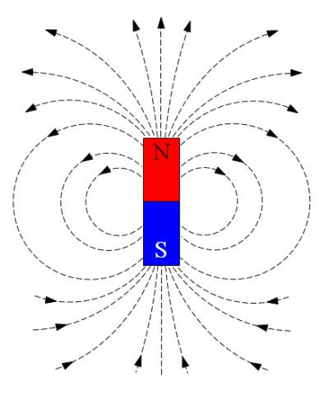
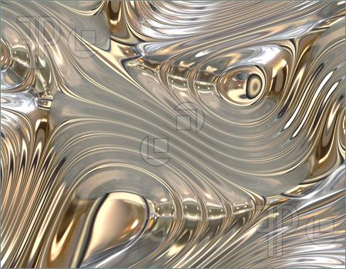
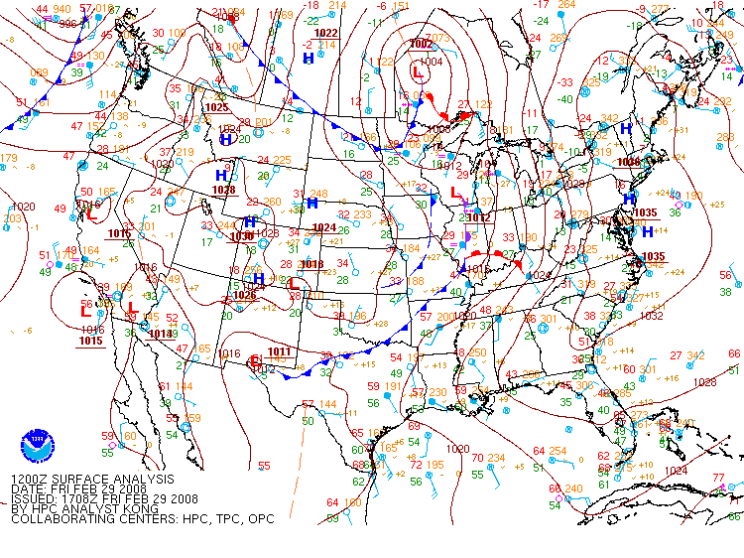
Slope fields can represent the flow of liquids or gasses, illustrate weather patterns and magnetic fields.

Slide 4
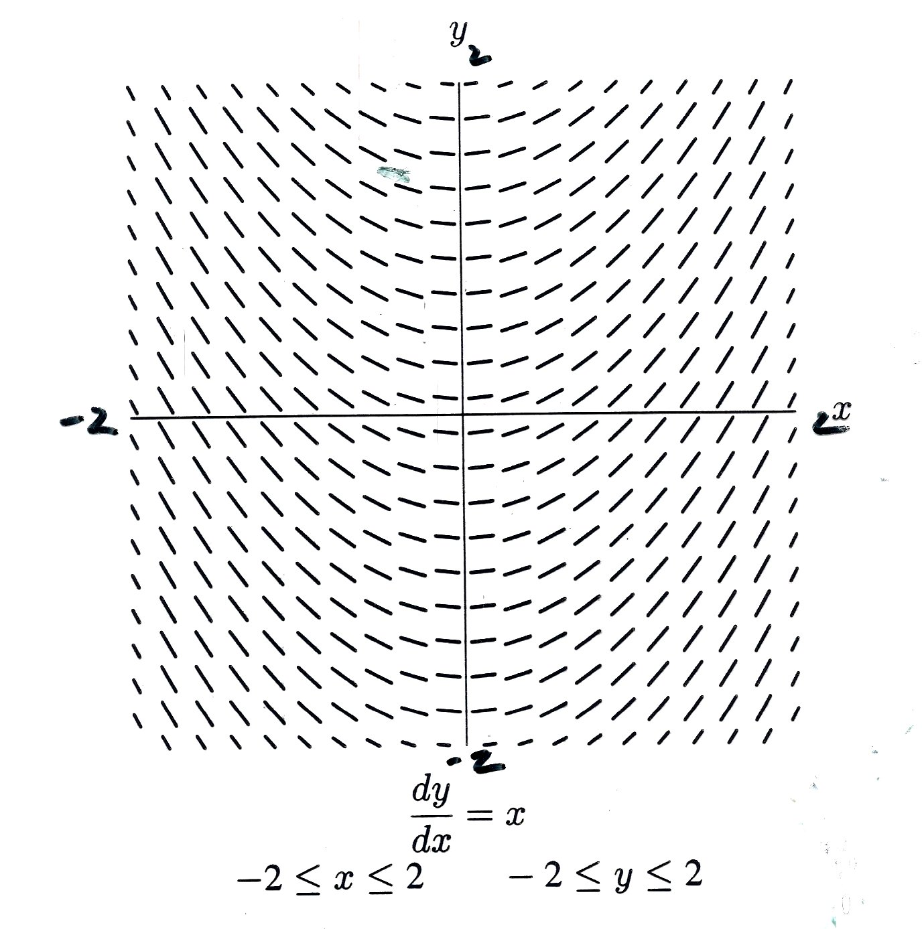
Given a point on the curve, we can sketch a particular solution.
Each little line segment is a portion of the tangent line with slope = $x.$
Can you see the “family” of curves whose slope = $x ?$
$$y=\frac{1}{2}x^{2}+C$$
The equation (above) is called the general solution to the differential equation: $\frac{dy}{dx}=x$
Ex: (0, -1)

Slide 5
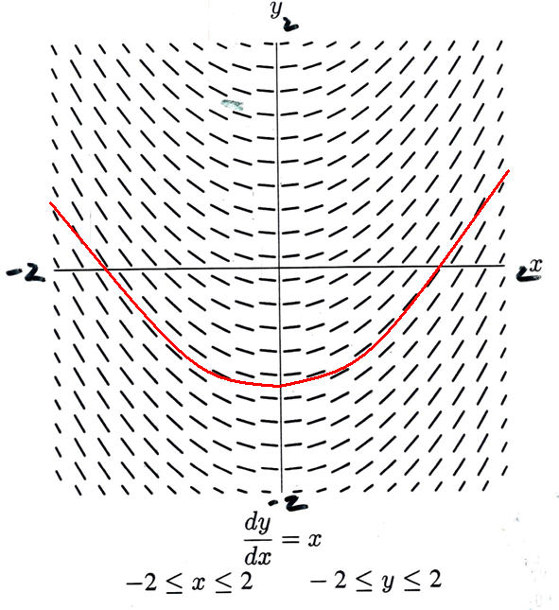
Given a point on the curve, we can sketch a particular solution.
Each little line segment is a portion of the tangent line with slope = $x.$
Can you see the “family” of curves whose slope = $x ?$
$$y=\frac{1}{2}x^{2}+C$$
The equation (above) is called the solution to the differential equation: $\frac{dy}{dx}=x$
Ex: (0, -1)

Slide 6
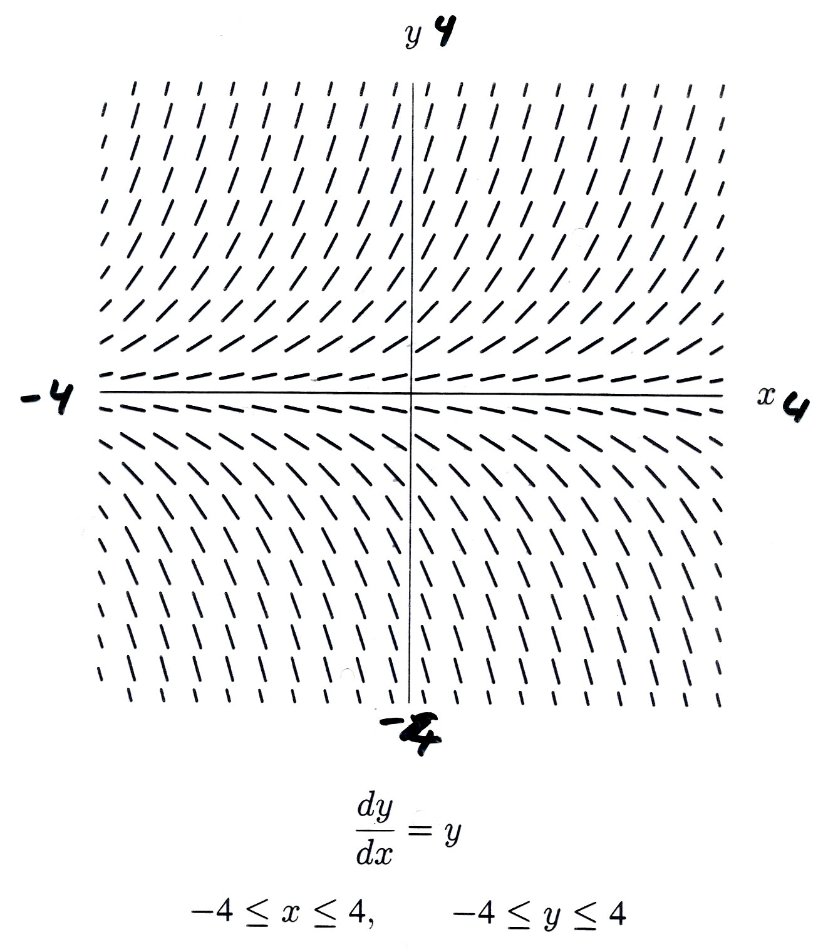
If the slopes stay the same from left to right,
The slope field is called autonomous.
This only happens if the derivative contains only $y^{′}s and no x^{′}s.$
What does this family
of solutions look like?
What kind of functions
are their own derivatives?
$$y=Ae^{x+k}$$

Slide 7
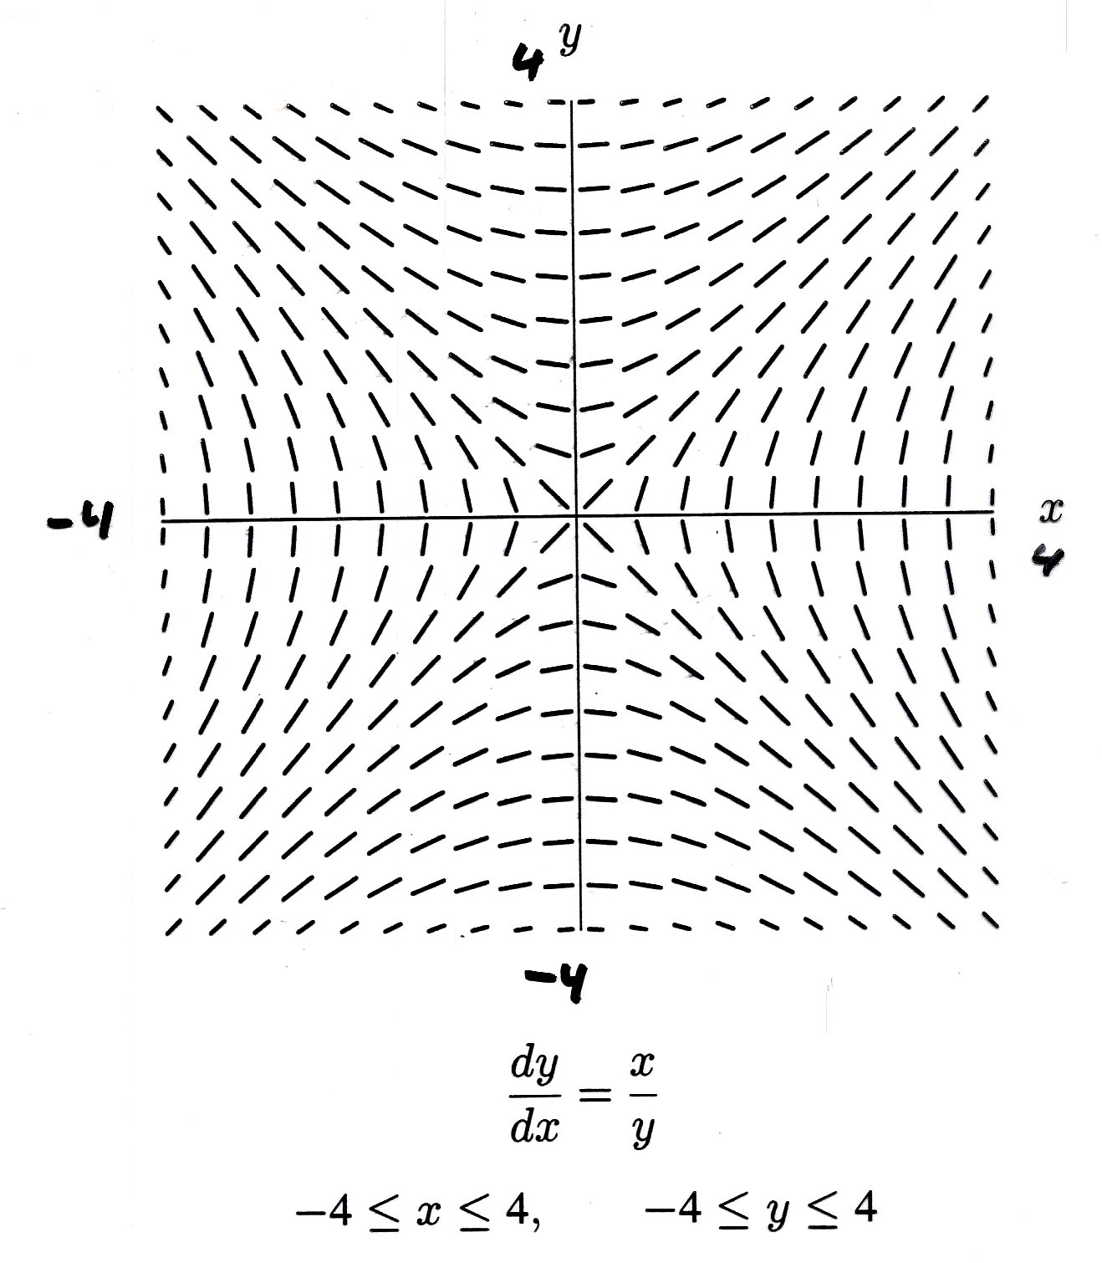
What type of curves do you see now?
Hyperbolas?
Implicit differential equations can produce implicit solutions. The solutions can be equations representing more than one function.
${ x}^{2}{− y}^{2}=C$

Slide 8
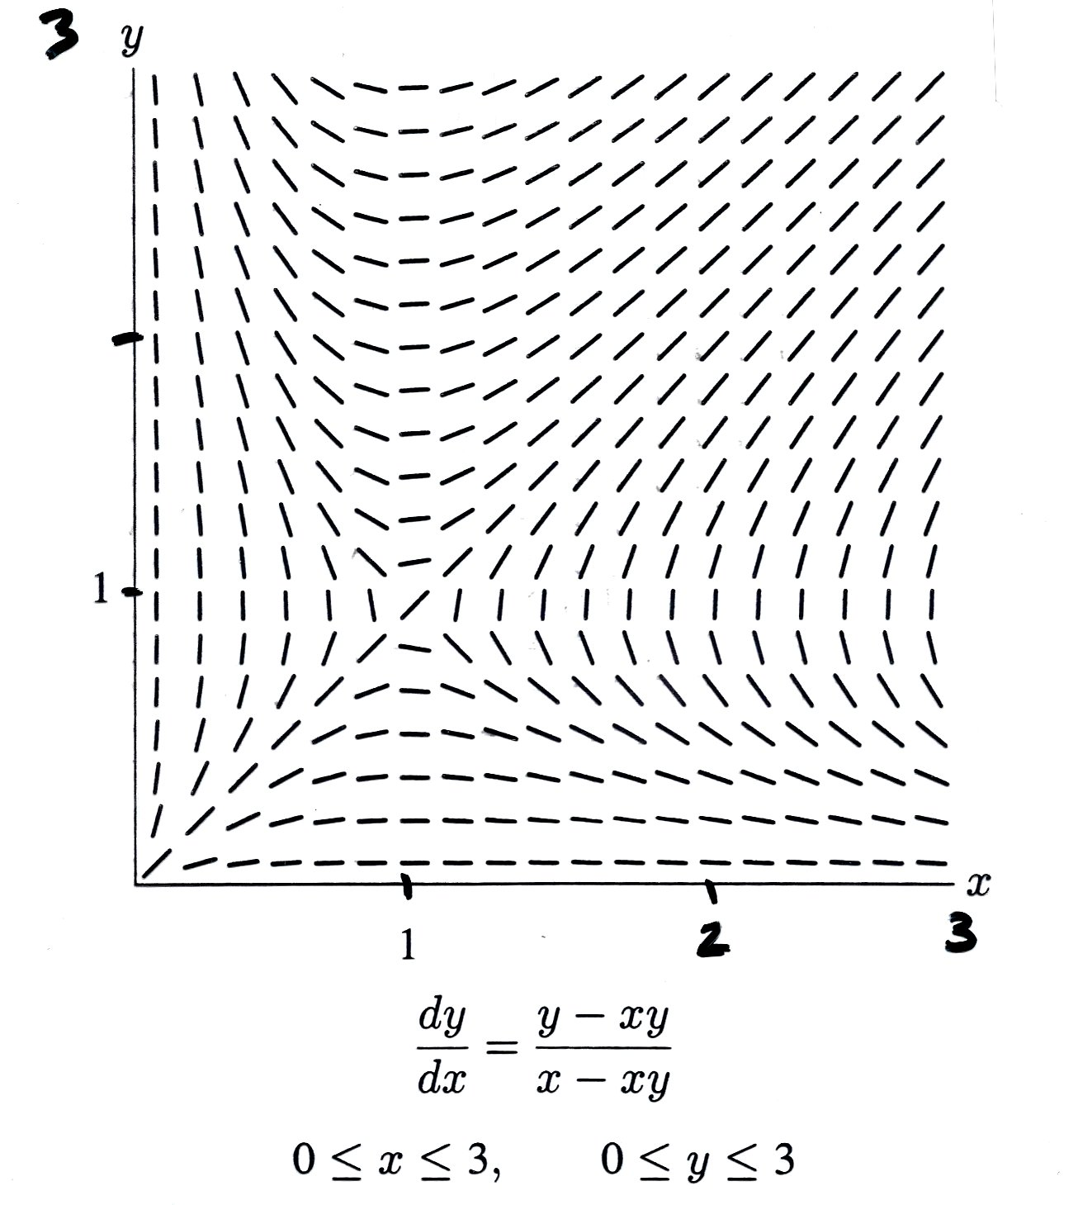
This particular differential equation is too difficult for us to solve…but can you imagine a gas or a liquid swirling around in this pattern?
Could you sketch the path of a small object starting at, say, $\left(\frac{1}{4},3\right)$ and floating along with the liquid’s flow ?

Slide 9
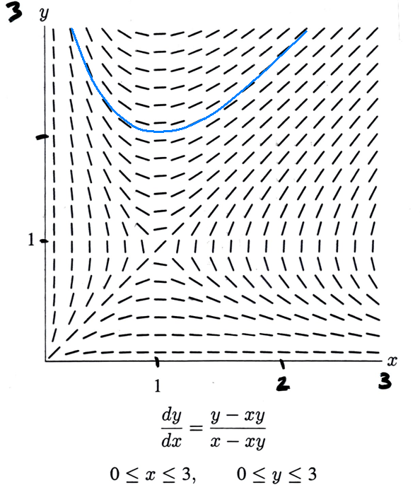
This particular differential equation is too difficult for us to solve…but can you imagine a gas or liquid swirling around in this pattern?
Could you sketch the path of a small object starting at, say, $\left(\frac{1}{4},3\right)$ and floating along with the liquid’s flow ?

Slide 10
Creating a slope field can be tedious.
Of course, technically, there is an infinitely small sloping line segment at every point. So if you drew all the elements of any slope field, all you would see would be a black plane.

Slide 11
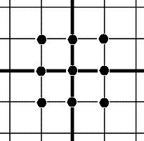
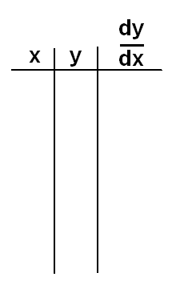
Instead, we can create partial slope fields by hand using just a handful of points…ha ha ha … a handful of points! (I kill myself.)
Create a slope field using only the 9 points shown on the graph.
$$0$$
0
0
1
1
1
-1
-1
-1
-1
0
1
-1
0
1
-1
0
1
1
0
-1
2
1
0
0
-1
-2
$$\frac{dy}{dx}=x−y$$

Slide 12
Draw other solutions that go through the given points.

Slide 13
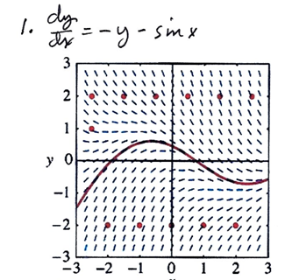
Either run along next to or on top of the nearest line segment.
If you cross through a line segment…you are not drawing correctly.

Slide 14
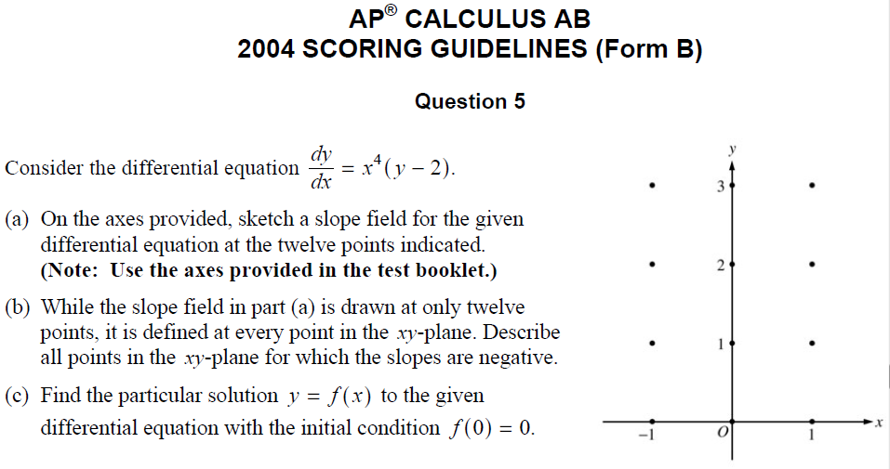

Slide 15
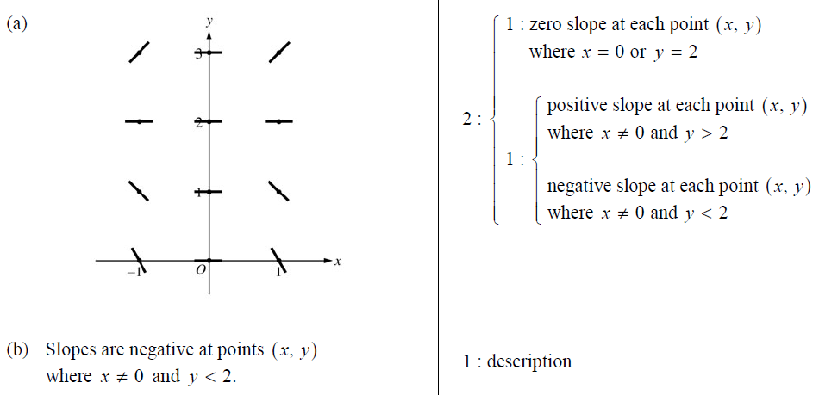
Solutions to (a) and (b)

Slide 16
Solution to (c)

Slide 17
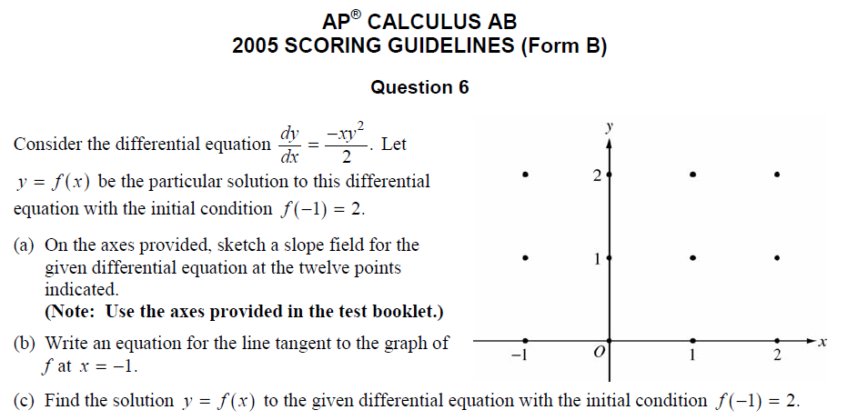

Slide 18
