Slide 1
Hyperbolic Functions

Slide 2
Consider the following two functions:
These functions show up frequently enough that they
have been given names.

Slide 3
The behavior of these functions shows such remarkable
parallels to trig functions, that they have been given
similar names.

Slide 4
Hyperbolic Sine:
(pronounced “cinch x”)
Hyperbolic Cosine:
(pronounced “kosh x”)

Slide 5
Hyperbolic Tangent:
“tansh (x)”
Hyperbolic Cotangent:
“cotansh (x)”
Hyperbolic Secant:
“sech (x)”
Hyperbolic Cosecant:
“cosech (x)”

Slide 6
Now, if we have “trig-like” functions, it follows that we will have “trig-like” identities.
First, an easy one:

Slide 7
(This one doesn’t really have an analogy in trig.)

Slide 8
Note that this is similar to but not the same as:

Slide 9
Derivatives can be found relatively easily using the definitions.
Surprise, this is positive!

Slide 10
(quotient
rule)

Slide 11
All of the derivatives are similar to trig functions except for some of the signs.
Sinh, Cosh and Tanh are positive.
The others are negative

Slide 12
Applications of
Hyperbolic Functions

Slide 13
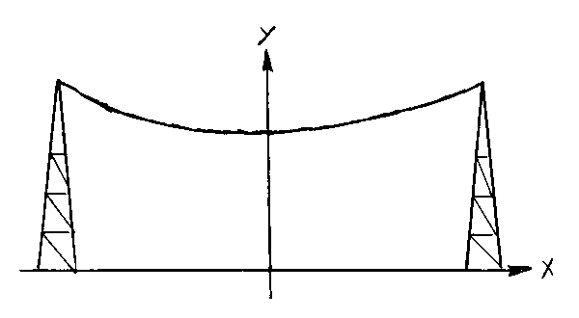
A hanging cable makes a shape called a catenary.
Even though it looks like a parabola, it is not a parabola!
(for some constant a)
Length of curve calculation:

Slide 14
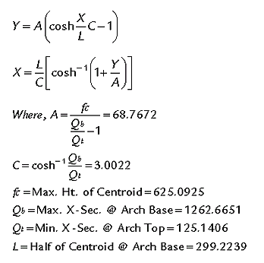
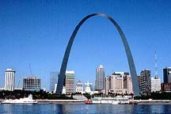
Another example of a catenary is the Gateway Arch in St. Louis, Missouri.

Slide 15
Taking Air Resistance into consideration, free-fall can be calculated by:
y is the distance the object falls in t seconds.
A and B are constants.

Slide 16
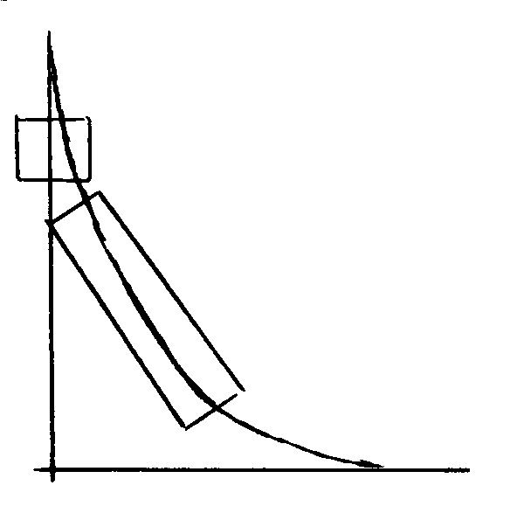
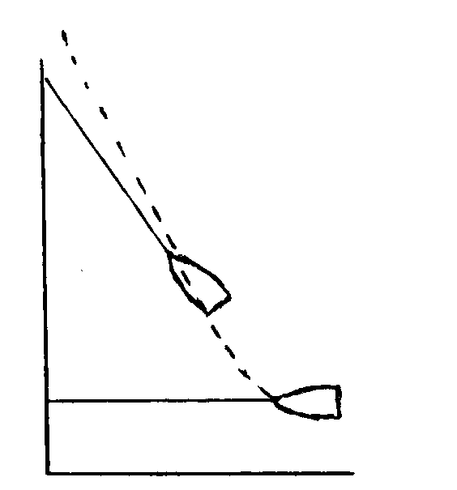
A third application is the tractrix.
(pursuit curve)
An example of a real-life situation that can be modeled by a tractrix equation is a semi-truck turning a corner.
semi-truck
Another example is a boat attached to a rope being pulled by a person walking along the shore.
boat

Slide 17
a
Both of these situations (and others) can be modeled by:
semi-truck
a
boat

Slide 18
The word tractrix comes from the Latin tractus, which means “to draw, pull or tow”. (Our familiar word “tractor” comes from the same root.)
Other examples of a tractrix curve include a heat-seeking missile homing in on a moving airplane, and a dog leaving the front porch and chasing person running on the sidewalk.
π

