Slide 1
Slope Fields Day 2

Slide 2
Draw other solutions that go through the given points.

Slide 3
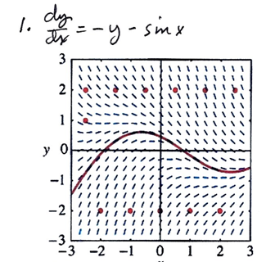
Either run along next to or on top of the nearest line segment.
If you cross through a line segment…you are not drawing correctly.

Slide 4
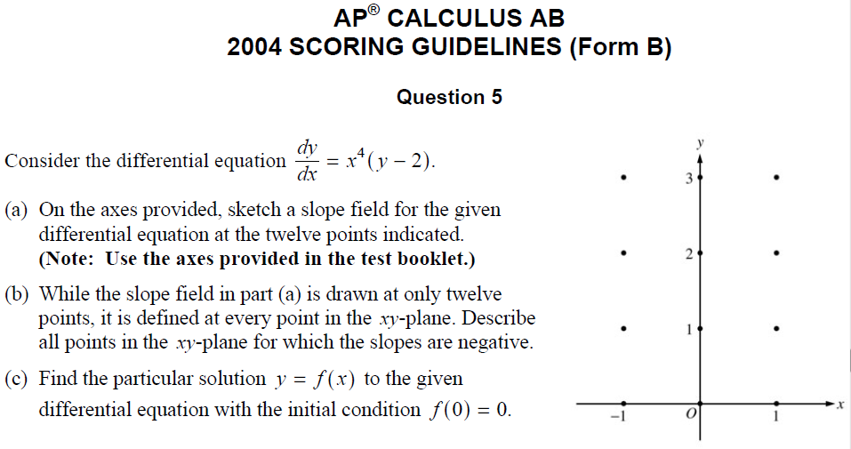

Slide 5
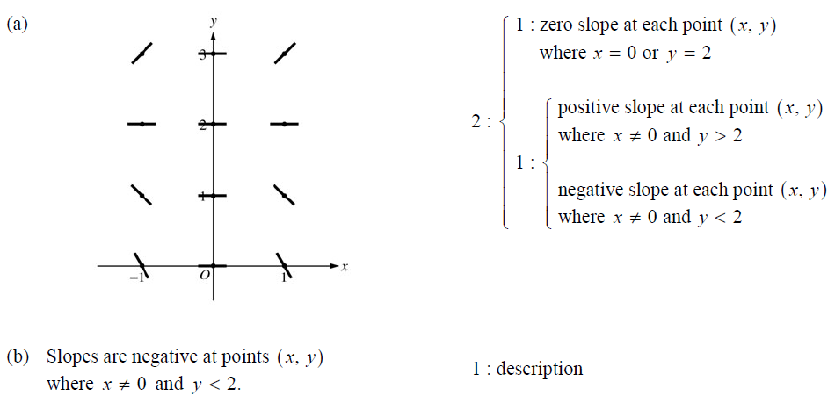
Solutions to (a) and (b)

Slide 6
Solution to (c)

Slide 7
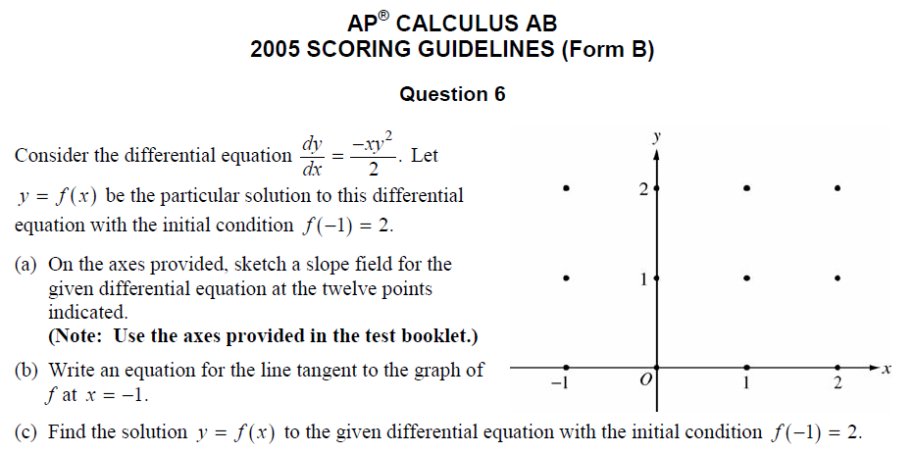

Slide 8
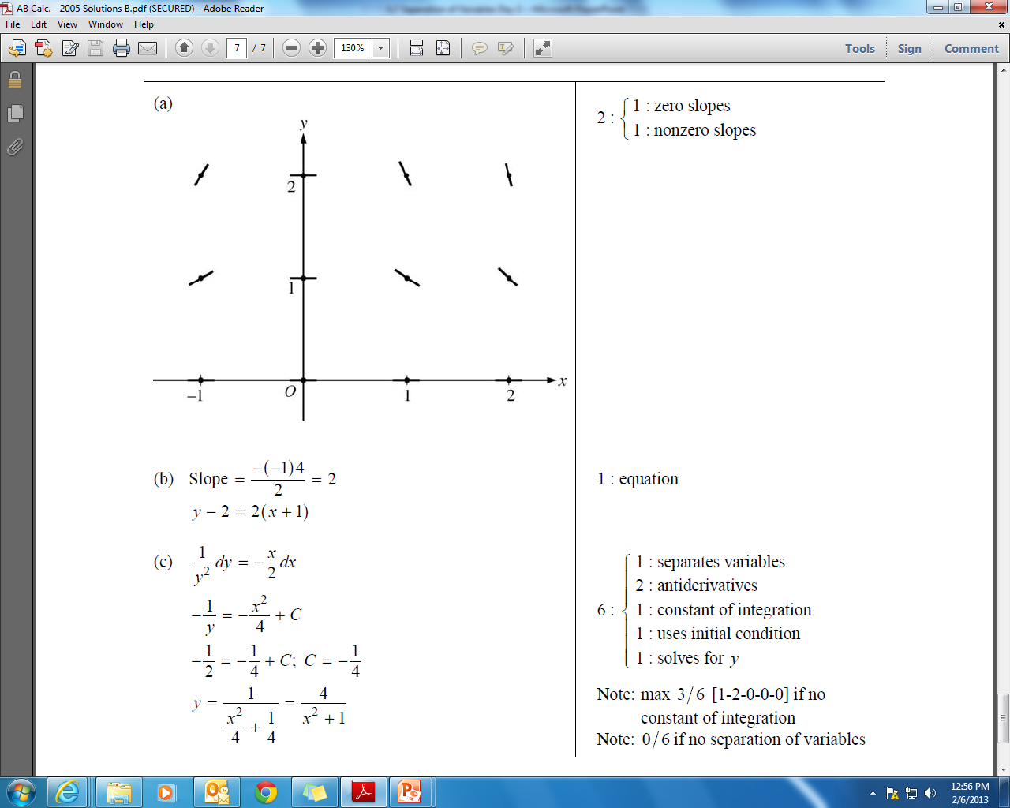

Slide 9
HW: p. 330 # 41, 42
p. 350 # 113, 114
p. 378 # 87 – 90
+ AP problem on the ‘Q’

