Slide 1
Lesson Plan
Work in groups to reflect on previous night’s HW.
Cover up to midpoint Riemann Sum

Slide 2
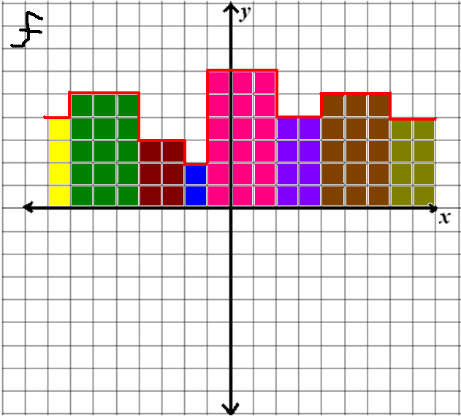
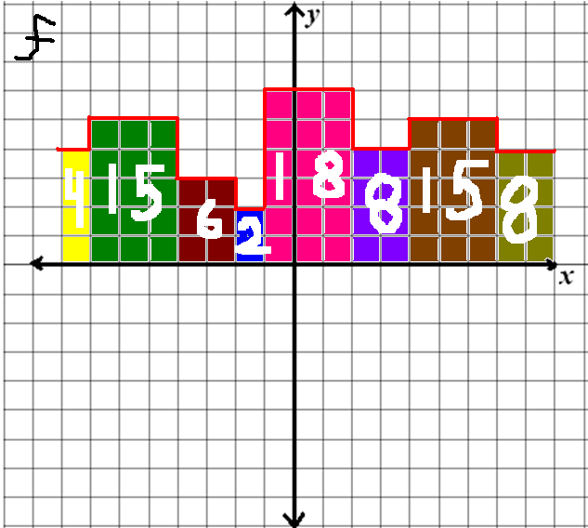
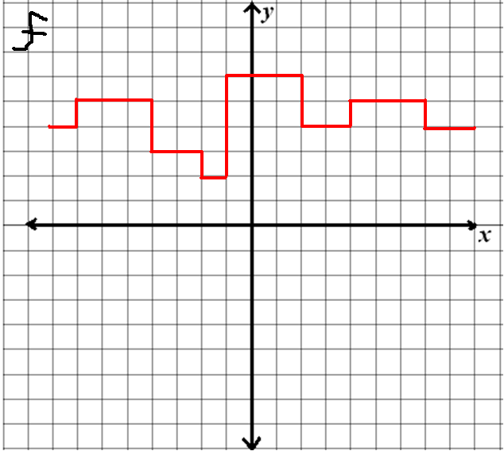
Warm Up

Slide 3
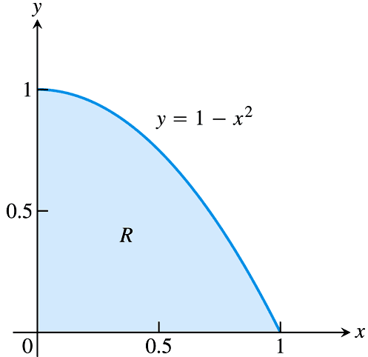
The Area of a Plane Region
Recall from Chapter 1 that the origins of calculus are connected to two classic problems:
The tangent line problem (been working on)
The area problem
Suppose we want to know
the area under the curve:
How can we go about
estimating this area?

Slide 4
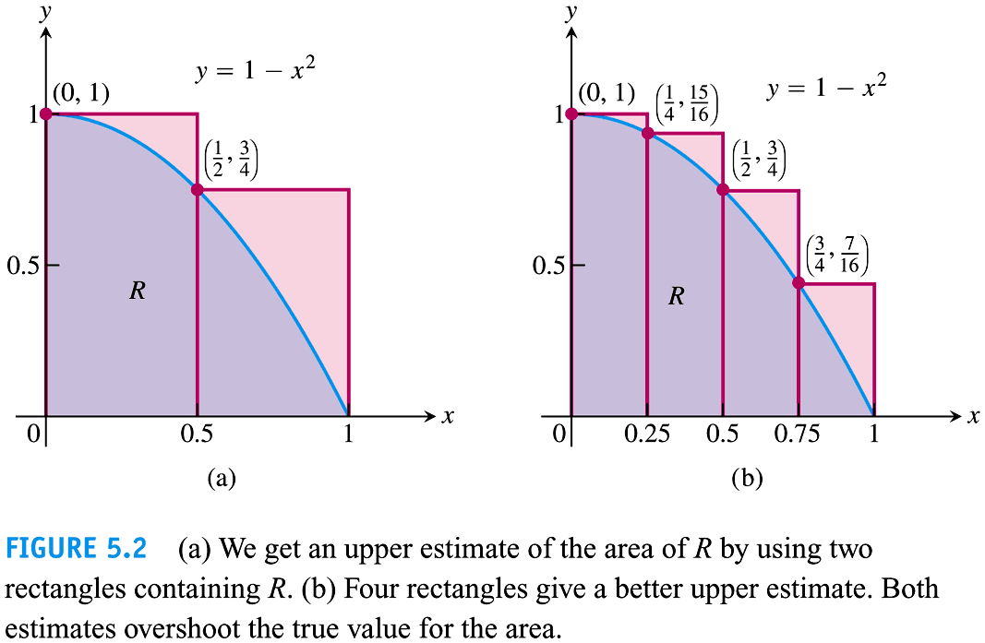
The Area of a Plane Region
We can approximate the area between the graph of the function and the x-axis by dividing the area into rectangles.
The more rectangles we use, the more accurate our estimate will be.

Slide 5
When we find the area under a curve by adding rectangles, the answer is called a Rieman sum.
The width of a rectangle is called a subinterval.
The entire interval is called the partition.
subinterval
partition
Subintervals do not all have to be the same size.

Slide 6
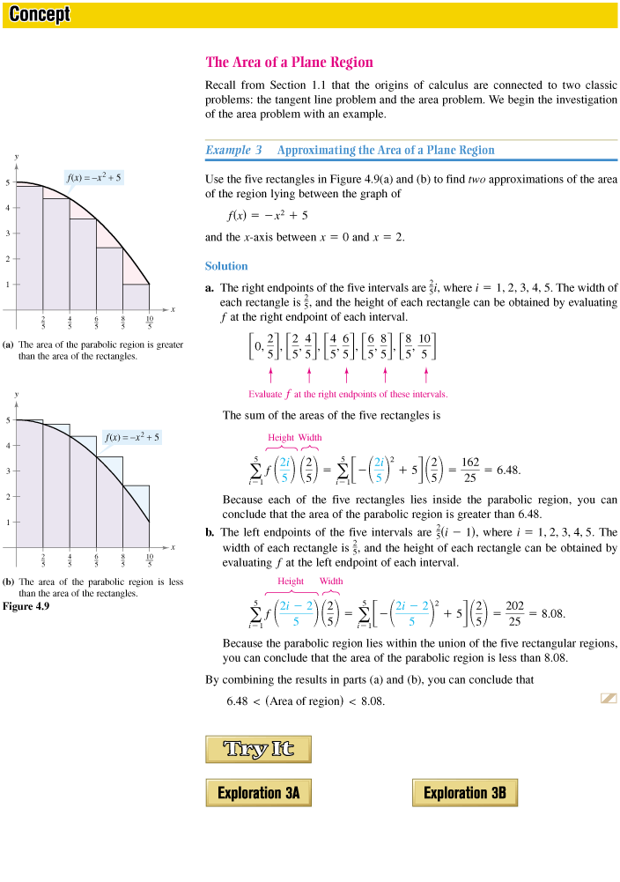
Example
Use 5 rectangles to find two approximations of the area of the region lying between the graph of
and the x-axis between x = 0 and x = 2.
We can do: a Right End Sum and
How can we
figure out what the
length of each
rectangle is?
What is the
height of each
rectangle?
a Left End Sum
Does the Δx change?

Slide 7
Notation and Right Sum Area
Where
given a and b are the interval and n is the number of rectangles.
So here
Area of first rectangle:
Area of Region:

Slide 8
Notation and Left Sum Area
remains the same, but what is the area of the 1st rectangle?
Area of Region:

Slide 9
Let’s do the problem
Use 5 rectangles to find two approximations of the area of the region lying between the graph of and the x-axis between x = 0 and x = 2.
We can approach the problem by simply making a table of values:

Slide 10
Conclusion
The area of the actual region is in between the Right Sum and the Left Sum.
For the Right Sum Area you should have got:
For the Left Sum Area you should have got:
Conclusion: 6.48 < (Area of Region) < 8.08

Slide 11
Cover rest next day

Slide 12
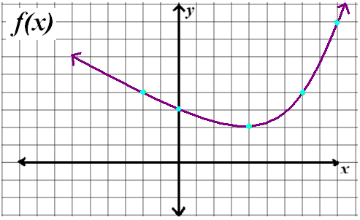
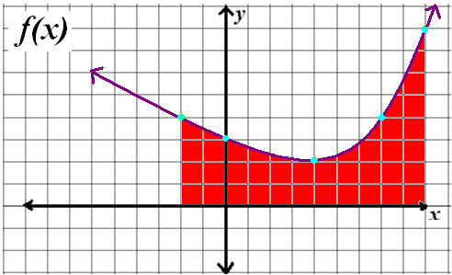
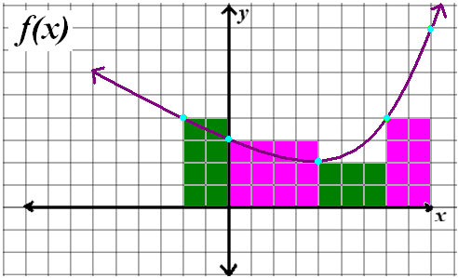
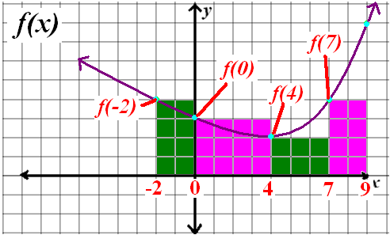
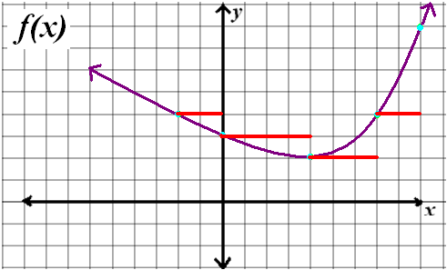
Chapter 4.3 Riemann Sums and Definite Integrals

Slide 13
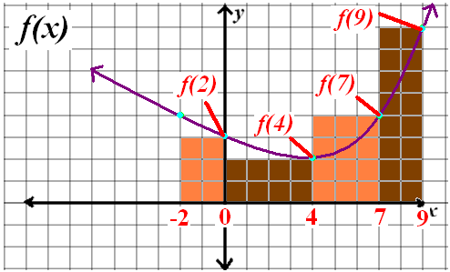
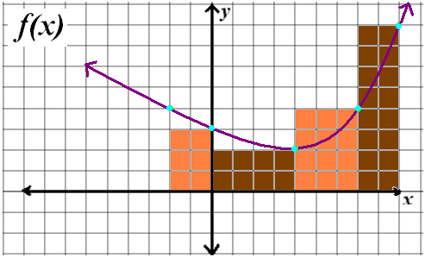
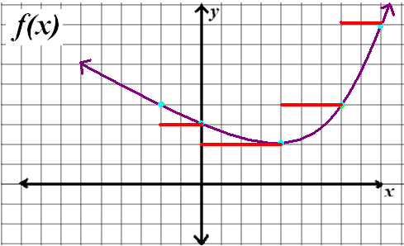
Chapter 4.3 Riemann Sums and Definite Integrals
0

Slide 14
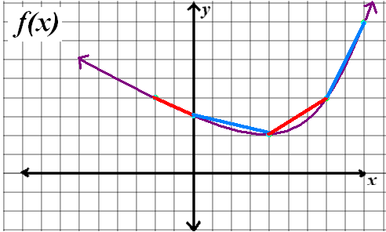
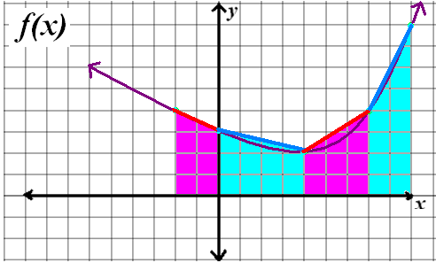
Chapter 4.3 Riemann Sums and Definite Integrals

Slide 15
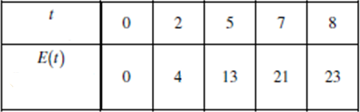
Chapter 4.3 Riemann Sums and Definite Integrals

Slide 16
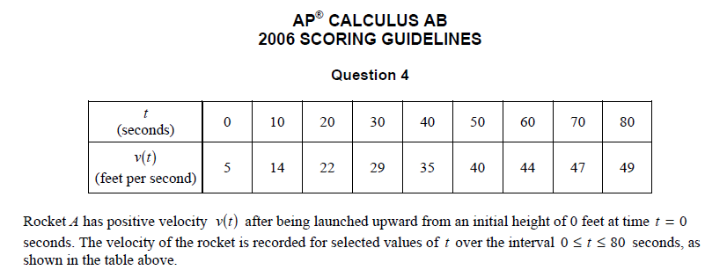

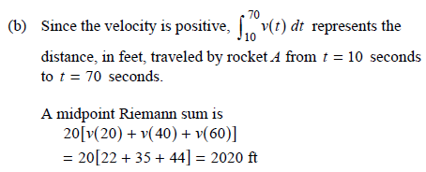
Chapter 4.3 Riemann Sums and Definite Integrals

Slide 17
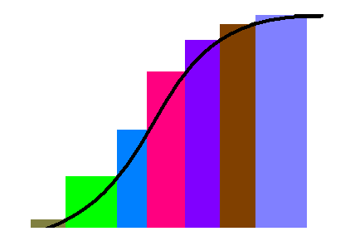
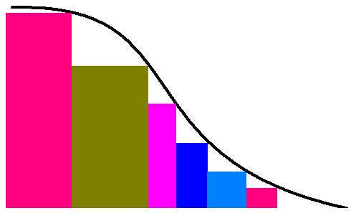
Chapter 4.3 Riemann Sums and Definite Integrals

Slide 18
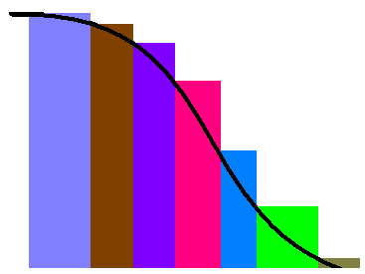
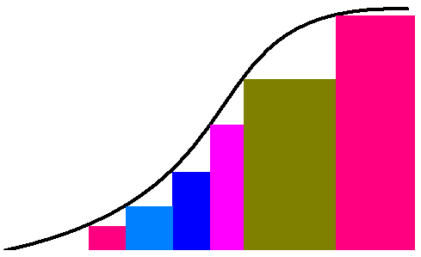
Chapter 4.3 Riemann Sums and Definite Integrals

Slide 19
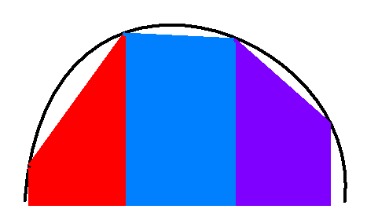
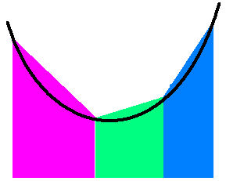
Chapter 4.3 Riemann Sums and Definite Integrals

Slide 20
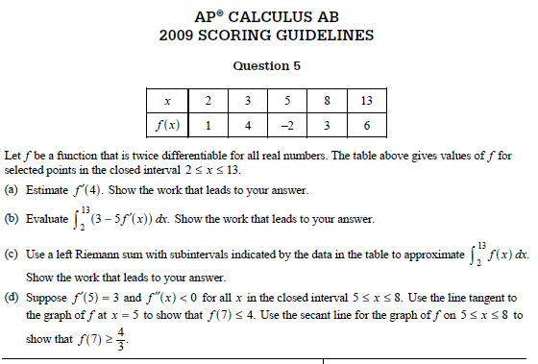
Chapter 4.3 Riemann Sums and Definite Integrals

Slide 21
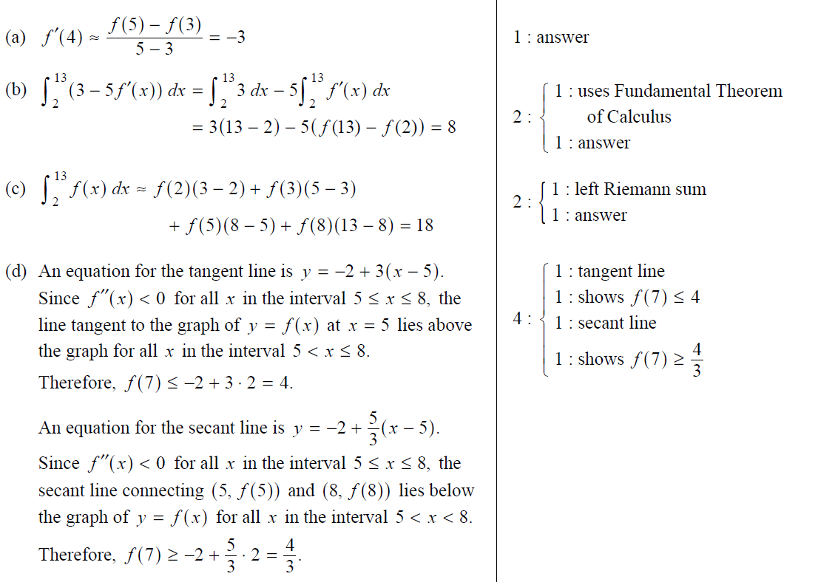
Chapter 4.3 Riemann Sums and Definite Integrals

Slide 22
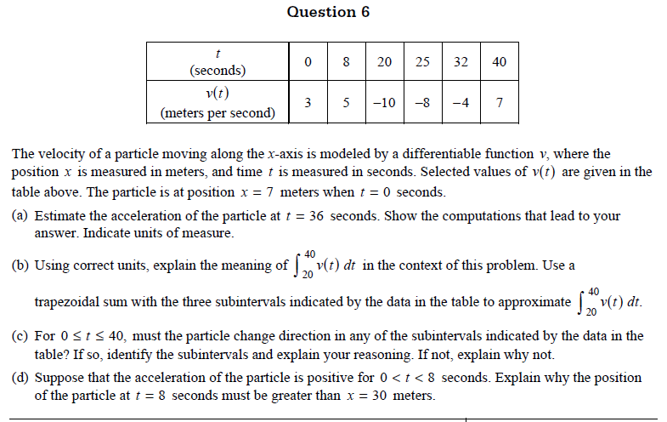
Chapter 4.3 Riemann Sums and Definite Integrals

Slide 23
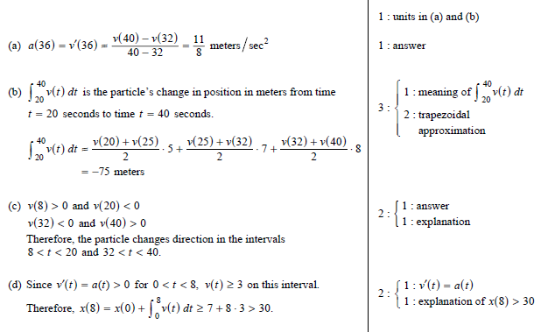
Chapter 4.3 Riemann Sums and Definite Integrals

