Slide 1
Lesson Plan
Work in groups to reflect on previous night’s HW.
Cover up to midpoint Riemann Sum

Slide 2
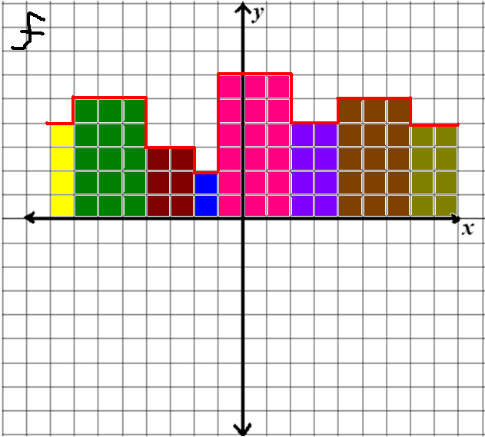
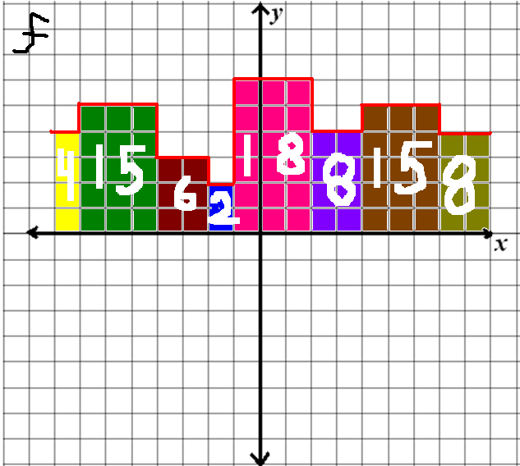
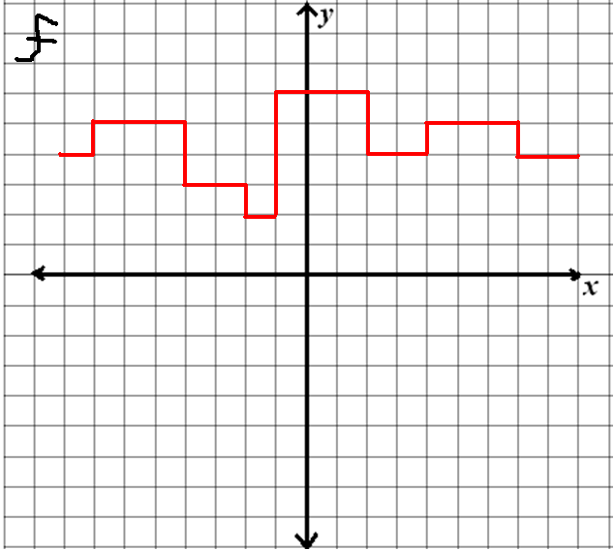
Warm Up

Slide 3
When we find the area under a curve by adding rectangles, the answer is called a Rieman sum.
The width of a rectangle is called a subinterval.
The entire interval is called the partition.
subinterval
partition
Subintervals do not all have to be the same size.

Slide 4
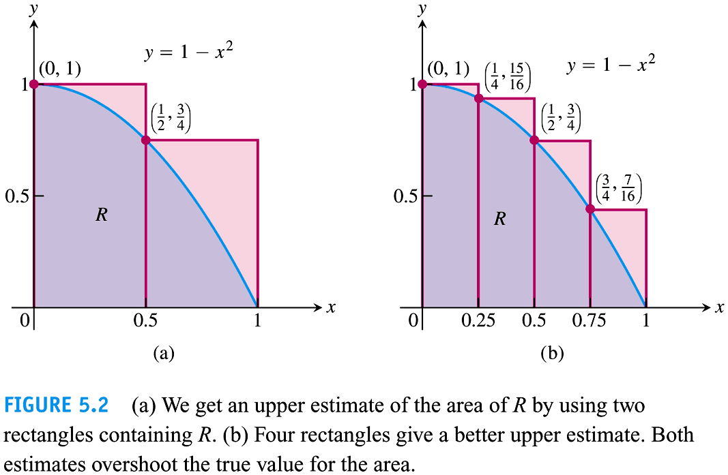
The Area of a Plane Region
We can approximate the area between the graph of the function and the x-axis by dividing the area into rectangles.
The more rectangles we use, the more accurate our estimate will be.

Slide 5
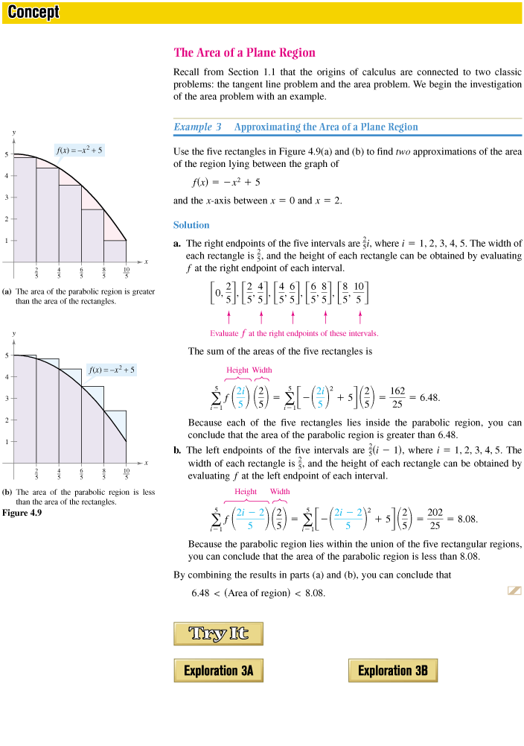
Example
Use 5 rectangles to find two approximations of the area of the region lying between the graph of
and the x-axis between x = 0 and x = 2.
We can do: a Right End Sum and
a Left End Sum

Slide 6
Notation and Right Sum Area
Where
given a and b are the interval and n is the number of rectangles.
So here
Area of first rectangle:
Area of Region:

Slide 7
Notation and Left Sum Area
remains the same, but what is the area of the 1st rectangle?
Area of Region:

Slide 8
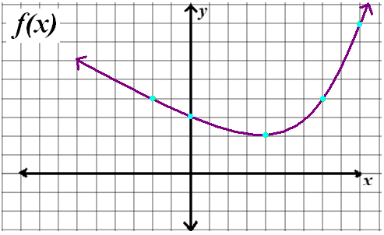
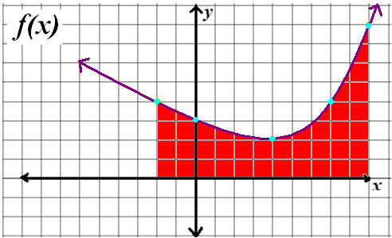
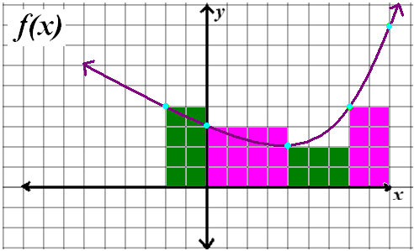
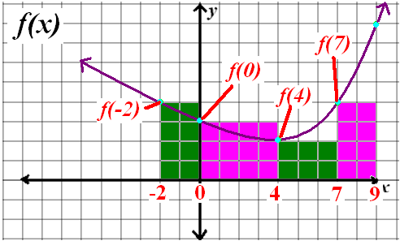
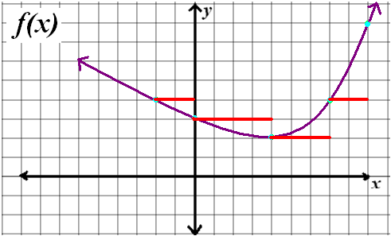
Chapter 4.3 Riemann Sums and Definite Integrals

Slide 9
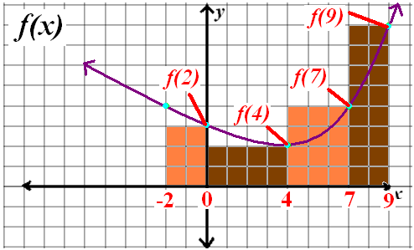
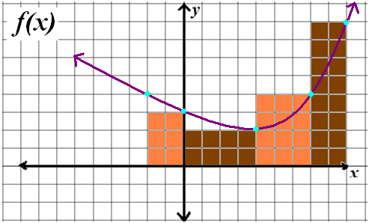
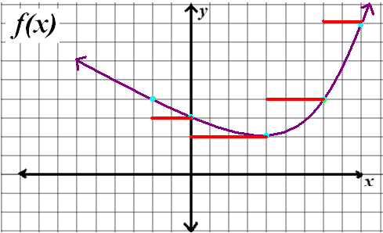
Chapter 4.3 Riemann Sums and Definite Integrals
0

Slide 10
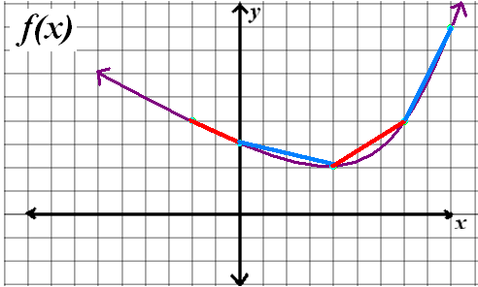
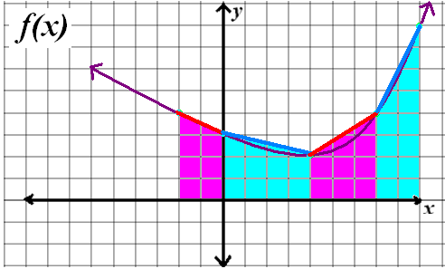
Chapter 4.3 Riemann Sums and Definite Integrals

Slide 11
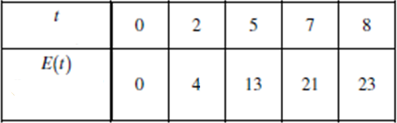
Chapter 4.3 Riemann Sums and Definite Integrals

Slide 12
Cover rest next day

Slide 13
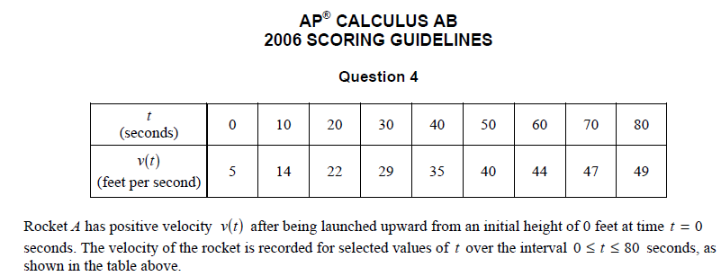

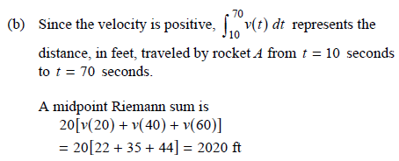
Chapter 4.3 Riemann Sums and Definite Integrals

Slide 14
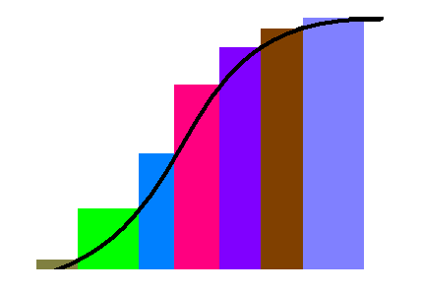
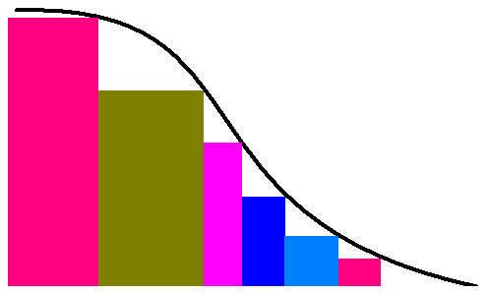
Chapter 4.3 Riemann Sums and Definite Integrals

Slide 15
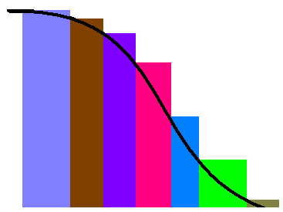
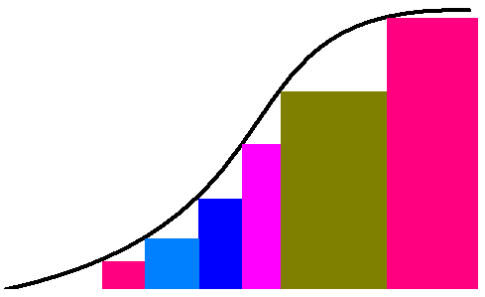
Chapter 4.3 Riemann Sums and Definite Integrals

Slide 16
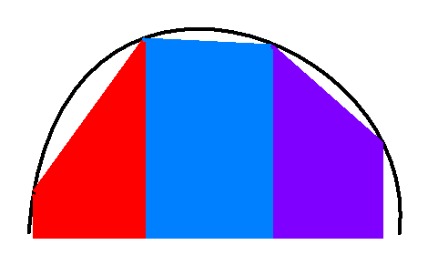
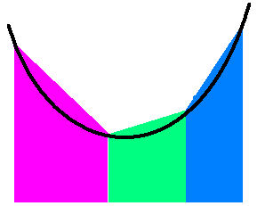
Chapter 4.3 Riemann Sums and Definite Integrals

Slide 17
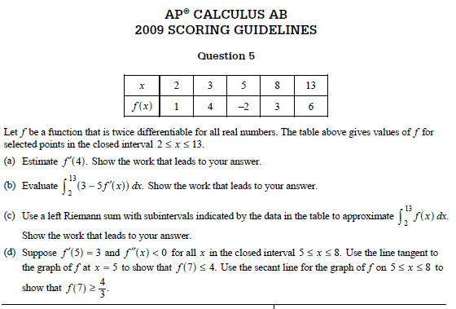
Chapter 4.3 Riemann Sums and Definite Integrals

Slide 18
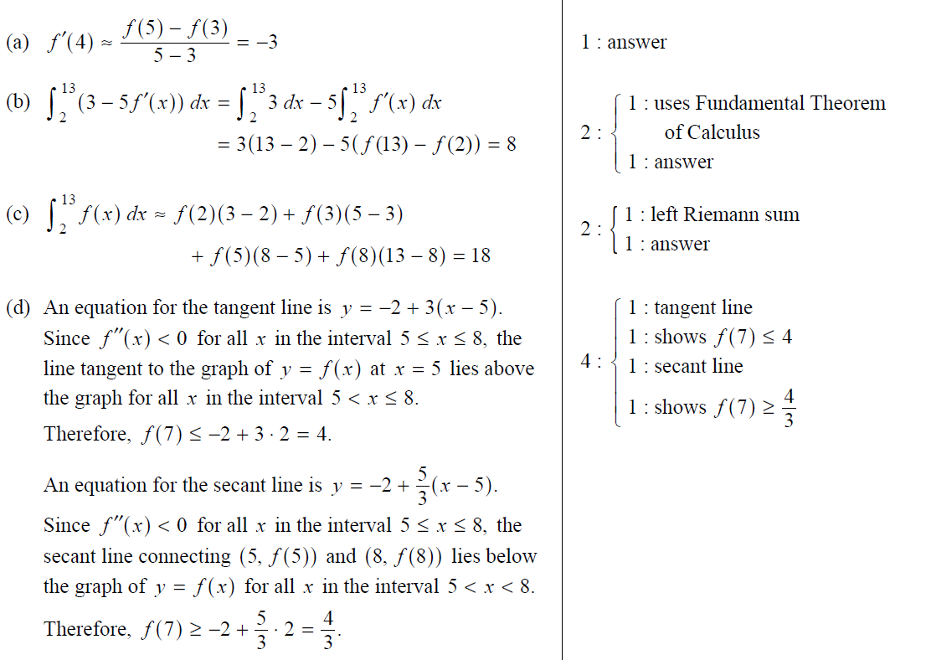
Chapter 4.3 Riemann Sums and Definite Integrals

Slide 19
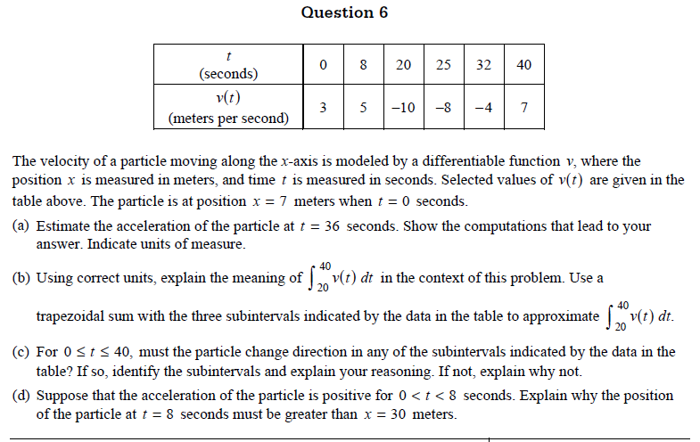
Chapter 4.3 Riemann Sums and Definite Integrals

Slide 20
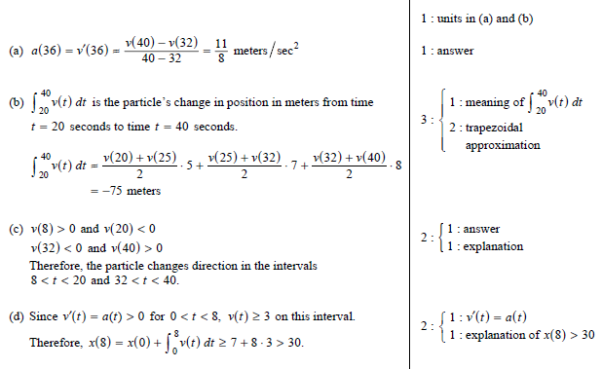
Chapter 4.3 Riemann Sums and Definite Integrals

