Slide 1
Lesson Plan Day 1
Go over the 3 types of graphs
Show video on histograms
Do line plot with student ages
Cover box and whisker plot
Lesson Plan Day 2
Go over PPT
Go over finding standard deviation
Lesson Plan Day 3
Go over PPT (68-95-99.7 Rule)

Slide 2
Statistics
Distributions And Their Shapes

Slide 3
Introduction
As stated before, statistics is all about data. Without data to talk about or to analyze or to question, statistics would not exist.
Data sets are often summarized by graphs; the graphs are the first indicator of variability in the data, and provide a great visual for us to analyze.

Slide 4
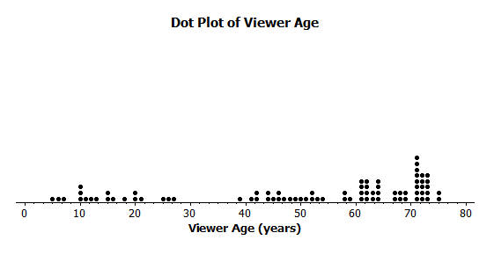
Type of Graphs- Dot Plots
Dot plots: A plot of each data value on a scale or number line.

Slide 5
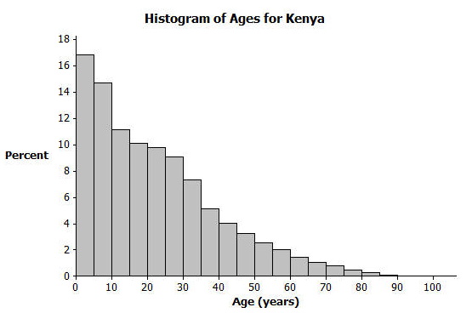
Type of Graphs- Histograms
Histograms: A graph of data that groups the data based on intervals and represents the data in each interval by a bar.

Slide 6
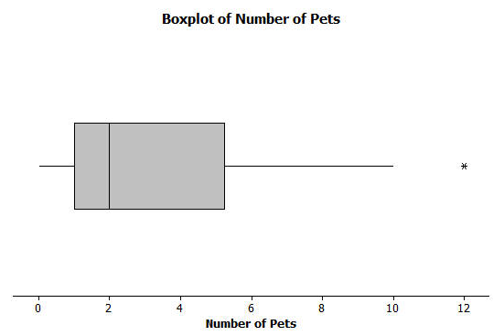
Type of Graphs- Box Plots
Box plots: A graph that provides a picture of the data ordered and divided into four intervals that each contains approximately 25% of the data.

Slide 7
Day 2

Slide 8
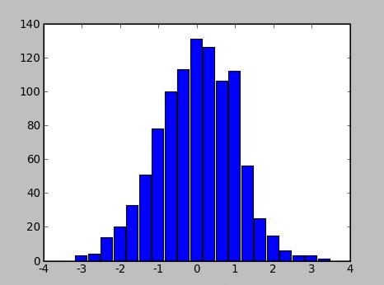
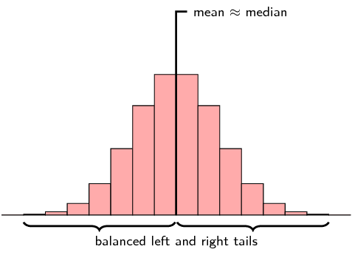
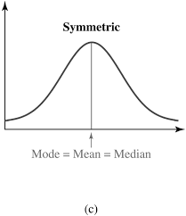
Shape of Graphs
Symmetry. When it is graphed, a symmetric distribution can be divided at the center so that each half is a mirror image of the other.
Roughly or somewhat symmetric
Bell-shaped

Slide 9
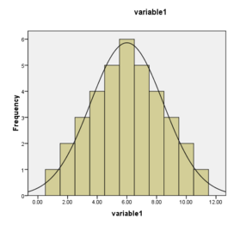
Shape of Graphs
Number of peaks. Distributions can have few or many peaks. Distributions with one clear peak are called unimodal, and distributions with two clear peaks are called bimodal. When a symmetric distribution has a single peak at the center, it is referred to as bell-shaped.

Slide 10
Shape of Graphs
Skewness. When they are displayed graphically, some distributions have many more observations on one side of the graph than the other.
Distributions with fewer observations on the right are said to be positively skewed or skewed right;
Distributions with fewer observations on the left are said to be negatively skewed or skewed left.

Slide 11
Shape of Graphs
Uniform. When the observations in a set of data are equally spread across the range of the distribution, the distribution is called a uniform distribution. A uniform distribution has no clear peaks.

Slide 12
Shape of Graphs
Outliers. Sometimes, distributions are characterized by extreme values that differ greatly from the other observations. These extreme values are called outliers.
All of the above observations fall between 0 and 4, except for the one 9.
As a "rule of thumb", a value is often considered to be an outlier if it is at least 1.5 interquartile ranges below the firstquartile (Q1), or at least 1.5 interquartile ranges above the third quartile (Q3).

Slide 13
Inference and Conclusions from Data
Other than visually inspecting the graphs of data, we can analyze and compare the Center and the Spread of the data. Measures of center are mean, median, and mode, and for spread we use IQR, range, and standard deviation.
Measures of Center
Mean ( ): add all the values and divide by the number of data values – BALANCING POINT
Median: middle value of an ordered set of data – SPLITS DATA IN HALF
Mode- Most (Peaks)

Slide 14
Inference and Conclusions from Data
Other than visually inspecting the graphs of data, we can analyze and compare the Center and the Spread of the data. Measures of center are mean, median, and mode, and for spread we use IQR, range, and standard deviation.
Measures of Spread
IQR (Inner Quartile Range): Q3-Q1
Range: Max - Min
Standard Deviation: square root of the variance; measure of how spread out the data are from the mean.

Slide 15
Variance and Standard Deviation

Slide 16
Day 3

Slide 17
Relationship between mean and standard deviation

Slide 18
(68-95-99.7 Rule)

Slide 19
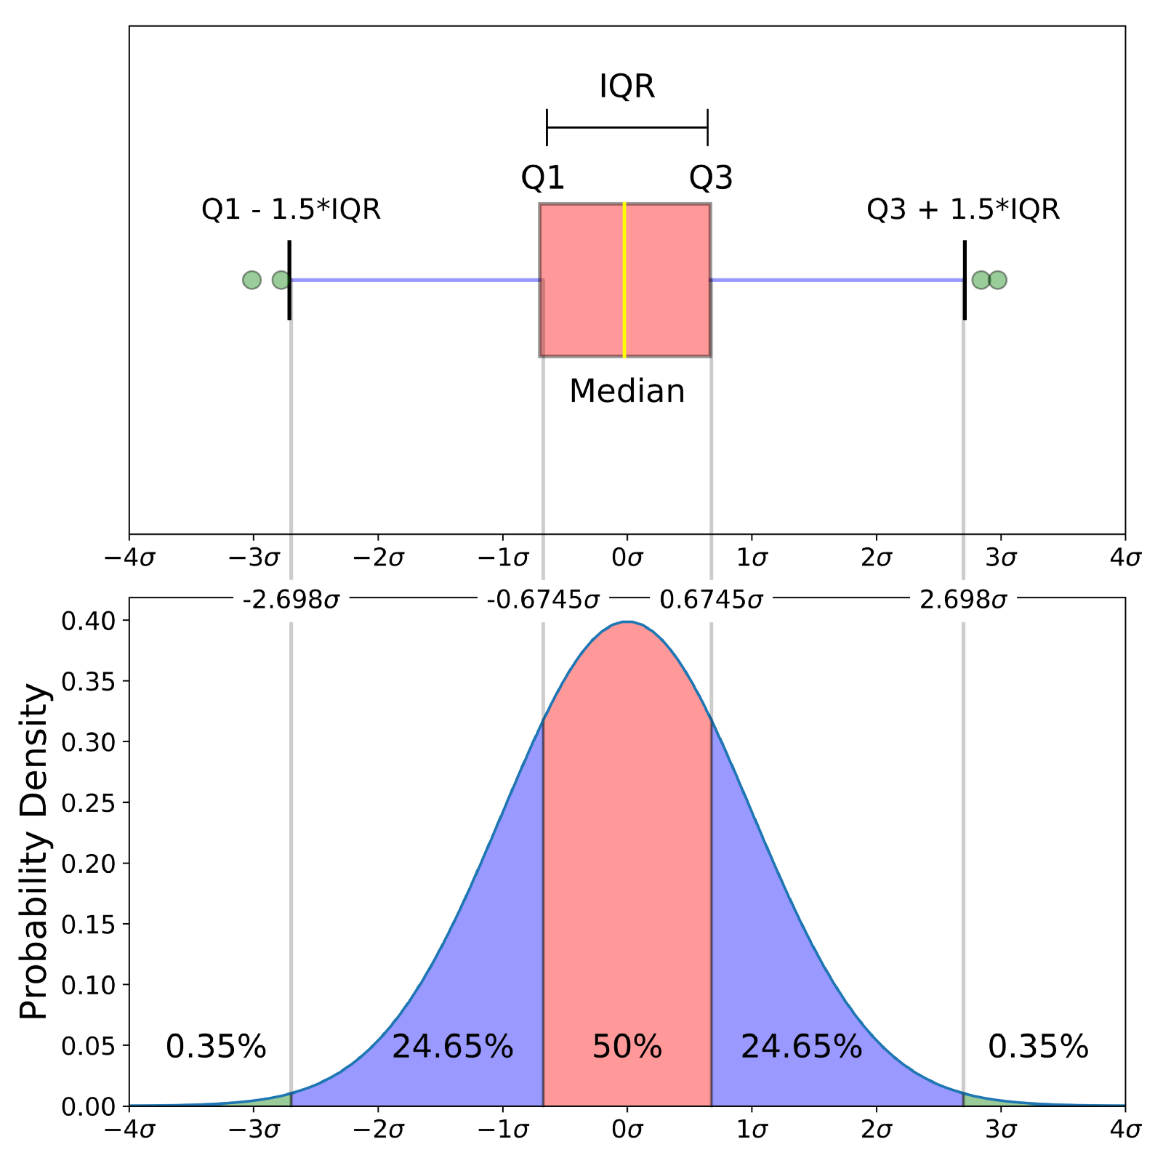
Visual of IQR vs Normal Distribution

Slide 21
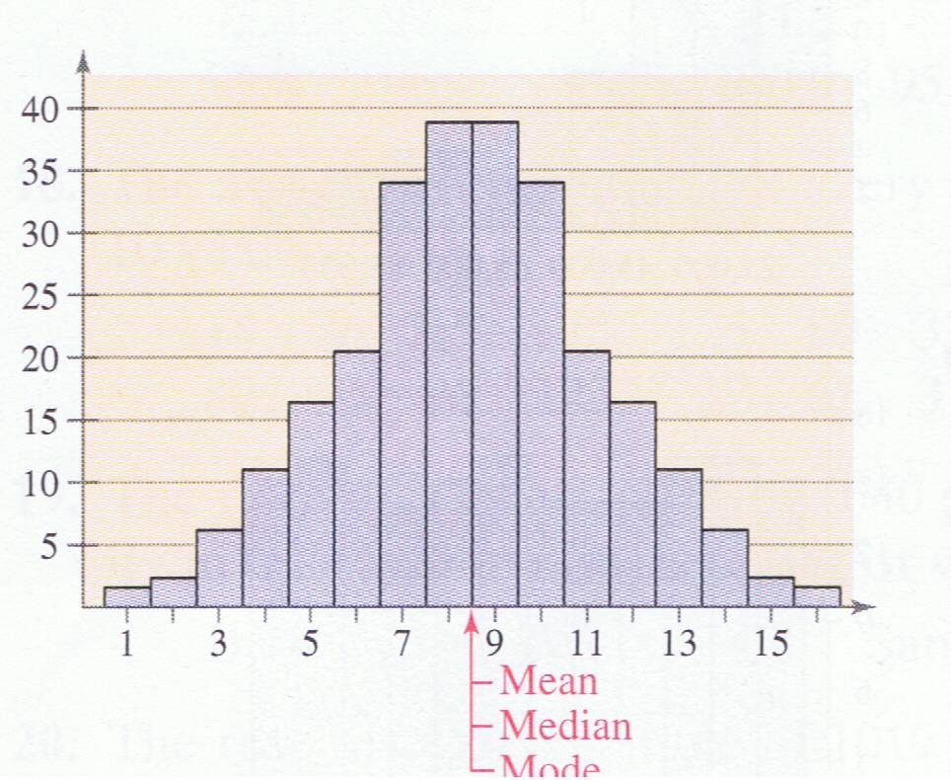
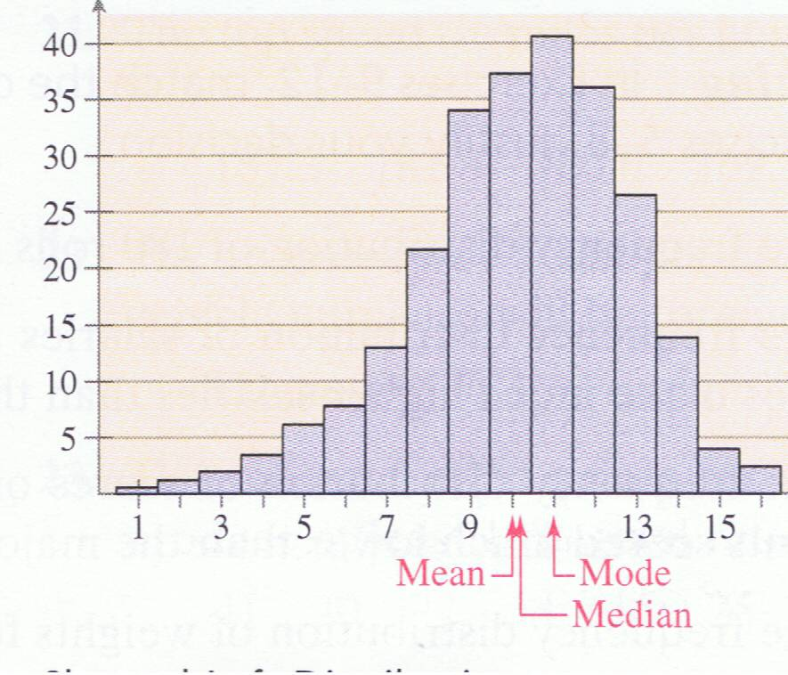
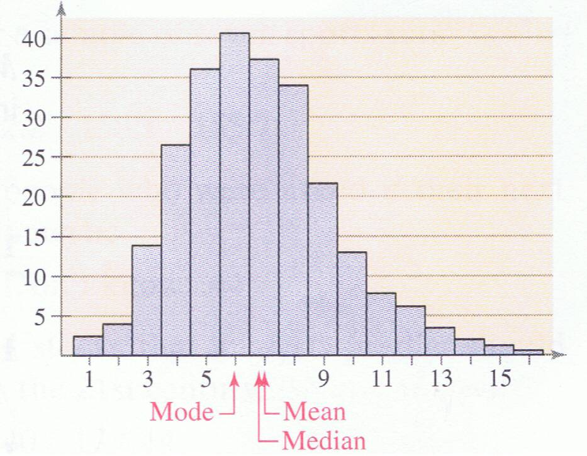
When looking at the distribution of a set of data, you want to focus on the center and 2 other key characteristics:
Shape
Spread
Shape – look at a histogram, dotplot, or boxplot of the data
Symmetric Skewed Left Skewed Right

Slide 22
http://stattrek.com/statistics/charts/data-patterns.aspx?tutorial=ap

