Slide 1
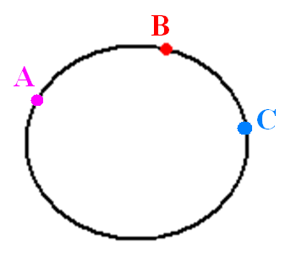
The Limit Definition of the Derivative
2.1

Slide 2

The Derivative and Tangent Line Problem
2.1
No more Monkeying Around. We have to get serious!
On the agenda:
Revisiting the tangent line problem
Defining the derivative
HW: p. 101-102 # 5 – 23 odd

Slide 3
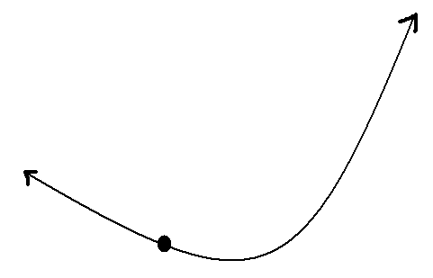
The Limit Definition of the Derivative
2.1

Slide 4
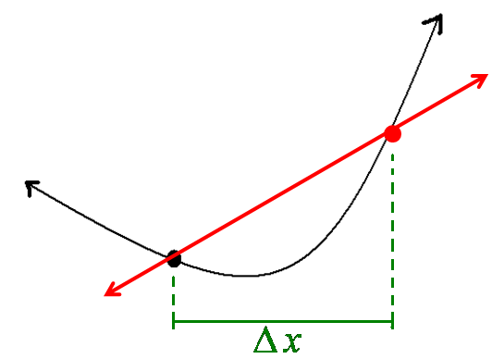
The Limit Definition of the Derivative
2.1

Slide 5
The Concept
The derivative is the slope of the tangent line at the point of tangency.
ONCE AGAIN: The derivative is the slope of the tangent line at the point of tangency.

Slide 6
All mean the same concept.

Slide 7
The Limit Definition of the Derivative
2.1

Slide 8
The Limit Definition of the Derivative
2.1

Slide 9
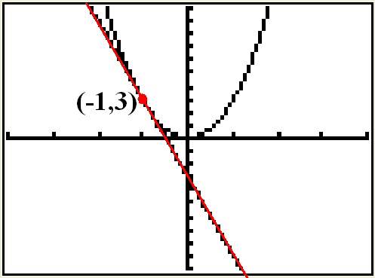
The Limit Definition of the Derivative
2.1

