Slide 1
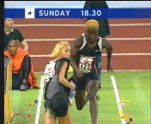
A Preview of Calculus
1.1
Your head-on collision with Calculus is
about to begin!!!
On the agenda:
What is Calculus (Video)
Idea of a limit
Rules (Do’s and Don’ts)
HW: p. 46 # 1-8, 11

Slide 2
What is Calculus?
Video1
Video2

Slide 3
Understanding Limit
The notion of a limit is fundamental to the study of calculus.
The next examples are to help you get a good understanding of a limit.

Slide 4
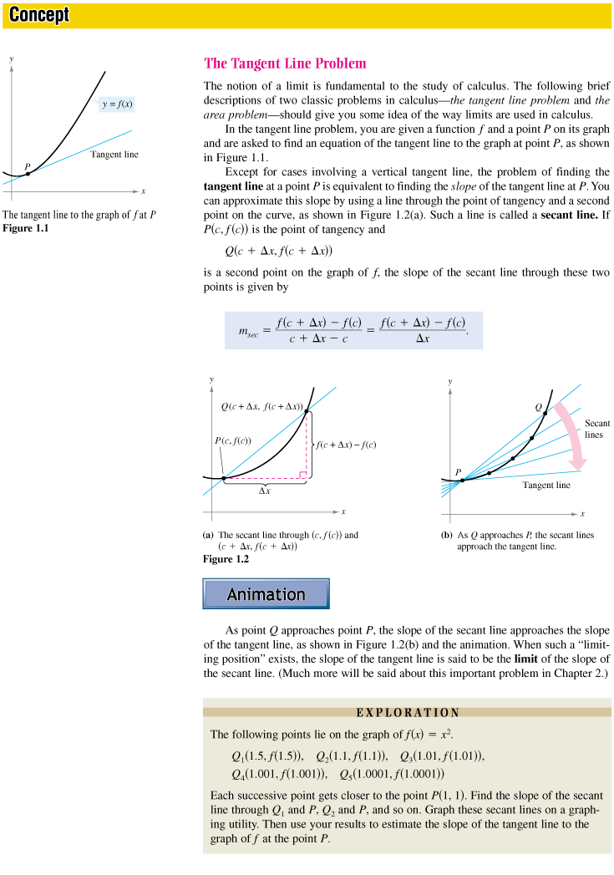
Idea of a Limit – The Tangent Line Problem
Suppose you want to find the equation of a tangent line of some function f(x) at a point, P:
What would be key in finding
the equation of this line?
The slope!
Can we say that the slope of this
tangent line has a fixed value?

Slide 5
Tangent Line Problem Cont…
Let’s make sure you understand the notation for points P and Q!
Suppose we want to approximate this slope by using a secant line, say line PQ.
Q1: What is the slope of this
secant line?
Q2: What do you think will
happen as Δx gets smaller and
smaller?

Slide 6
Tangent Line Problem Cont…
Q1
Q2
As Δx gets smaller and smaller,
the slope of the secant line
approaches the slope of the tangent line.
It can be said: The slope of the tangent line serves as the “limit” of the slope of the secant line, which implies that the slope of the secant line can get infinitely close to the slope of the tangent line, but cannot go beyond it.

Slide 7
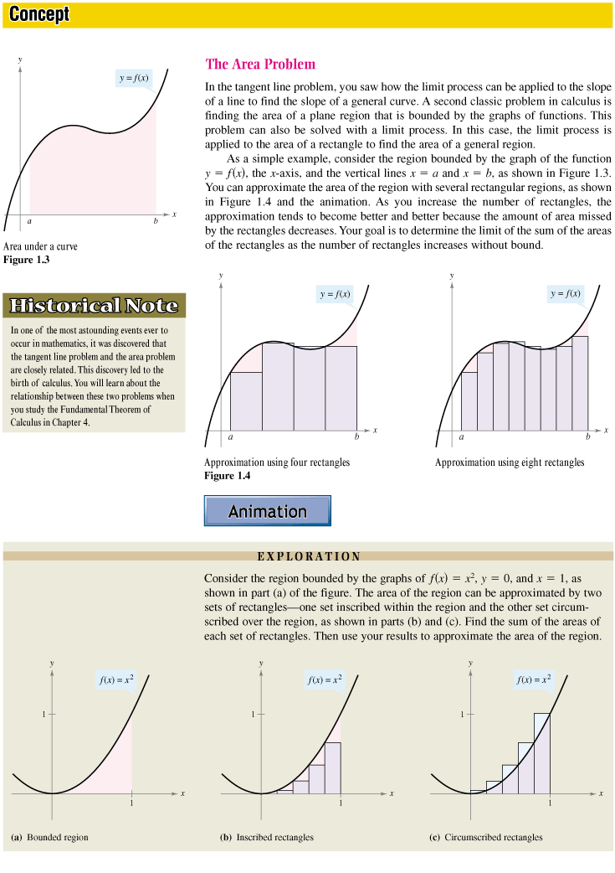
Idea of a Limit – The Area Problem
Suppose you want to find the area under a curve bounded by f(x) from point a to b.
Any ideas on how we can do
this?
We can approximate the area
of the region by dividing the
region into several rectangular
regions.

Slide 8
Area Problem cont…
We can see that more rectangles gives us a better approximation of the actual area.
As the number of rectangles increases with out bound, the area of the rectangles approaches the area of the region.
The actual area serves as the limit to the sum of area of the rectangles.

Slide 9
Limit Simplified

Slide 10
The Limit
The Limit is the y-value, as x approaches some given value.
To reiterate: THE LIMIT IS THE Y-VALUE.
The general notation is:
Read as “the limit of f(x) as x approaches c is equal to L”, where c and L are real numbers, and c is the x-component, while L is the y-component.

Slide 11
Do’s and Don’ts
1. Write your answers using 3 decimal places. (more is okay)
2. Use as many decimal places possible in the body of the problem. Only round your final answer to 3 decimal places.
3. Don’t cross out / erase your work unless you KNOW you can do better.
4. If you use your calculator, describe it clearly in mathematical terms, not in calculator speak. (ex. fnint Y1, X, 2, 5)
5. Always circle your answers.
6. Be sure to use correct units.

Slide 12
Do’s and Don’ts
7. If you are worried that your result in part (a) is incorrect, use it anyway to finish the problem.
8. Make sure you answer what the problem is asking.
9. Be sure to justify your answers completely when asked. BUT do not say more than you have to.
10. Don’t write bad math! (e.g. “Slope of the derivative.” or “6.2368 = 6.237" or “-17.21 = 17.21“ or “n² = 16 = n = ±4”)
11. Every pronoun needs an antecedent. Name the function you are referring to. Do not say, “The slope is ...”. Say, “The slope of g is ....”, especially when more than one function is being discussed.

Slide 13
Idea of a Limit –Circle area with radius 10 problem
Video

